Slide 1
Neural Architecture for Foundational Models
Heng Ji
hengji@illinois.edu
Acknowledgement: Some Slides are from Alex Chandler

Slide 2
Previous Work Recap
The RNN and LSTM neural models were designed to process language and perform tasks like classification, summarization, translation, and sentiment detection
RNN: Recurrent Neural Network
LSTM: Long Short Term Memory
In both models, layers get the next input word and have access to some previous words, allowing it to use the word’s left context
They used word embeddings where each word was encoded as a vector of 100-300 real numbers representing its meaning

Slide 3
Vanilla Encoder-Decoder Limitations
Pass only the last hidden state from the encoder to the decoder
Information has to be compressed into a fixed length vector and information can be lost in this compression. Especially information found early in the sequence tends to be “forgotten” after the entire sequence is processed
One Solution: Adding bi-directional layers remedies this by processing the input in reversed order. While this helps for shorter sequences, the problem still persists for long input sequences.
Another solution: The development of attention enables the decoder to attend to the whole sequence and thus use the context of the entire sequence during the decoding step.

Slide 4
4
Notes:
Change low resource IL to a language which is not in wikipedia
Word-level: from bi-lingual dicts and alignment; structure-level comes from wals; multi-level alignment

Slide 5
5
Notes:
Change low resource IL to a language which is not in wikipedia
Word-level: from bi-lingual dicts and alignment; structure-level comes from wals; multi-level alignment

Slide 6
Transformer: Put in Context
Transformers extend this to allow the network to process a word input knowing the words in both its left and right context
This provides a more powerful context model
Transformers add additional features, like attention, which identifies the important words in this context
And break the problem into two parts:
An encoder (e.g., Bert)
A decoder (e.g., GPT)

Slide 7
Self-Attention Finds Meaning
Quiz Time!
She poured water from the pitcher to the cup until it was full.
What does “it” refer to? And why?
She poured water from the pitcher to the cup until it was empty.
What does “it” refer to? And why?
The key is to be selective and determine which words are most important in a specific context.
7
Notes:
Change low resource IL to a language which is not in wikipedia
Word-level: from bi-lingual dicts and alignment; structure-level comes from wals; multi-level alignment

Slide 8
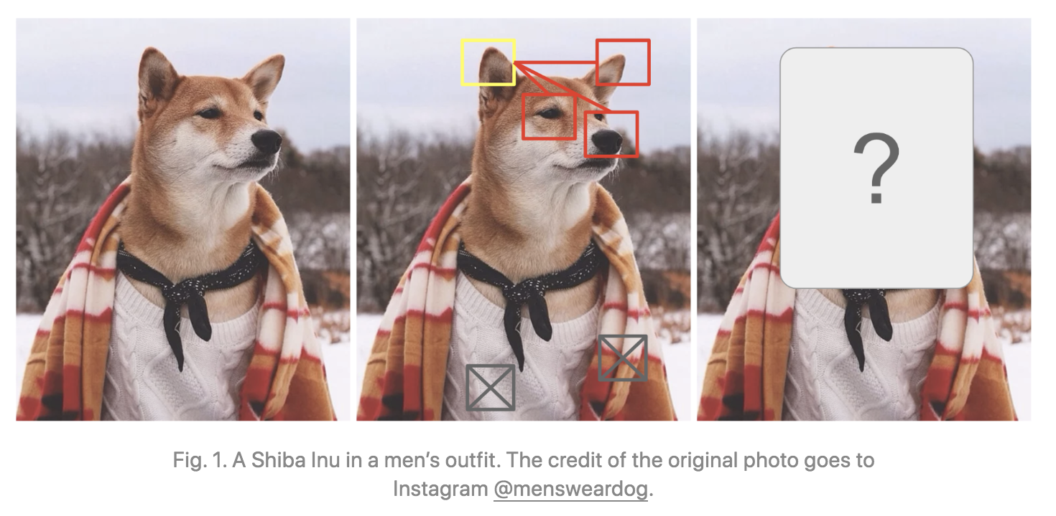
Self-Attention Finds Meaning
8
Notes:
Change low resource IL to a language which is not in wikipedia
Word-level: from bi-lingual dicts and alignment; structure-level comes from wals; multi-level alignment

Slide 9
Self-Attention Finds Meaning
9
Notes:
Change low resource IL to a language which is not in wikipedia
Word-level: from bi-lingual dicts and alignment; structure-level comes from wals; multi-level alignment

Slide 10
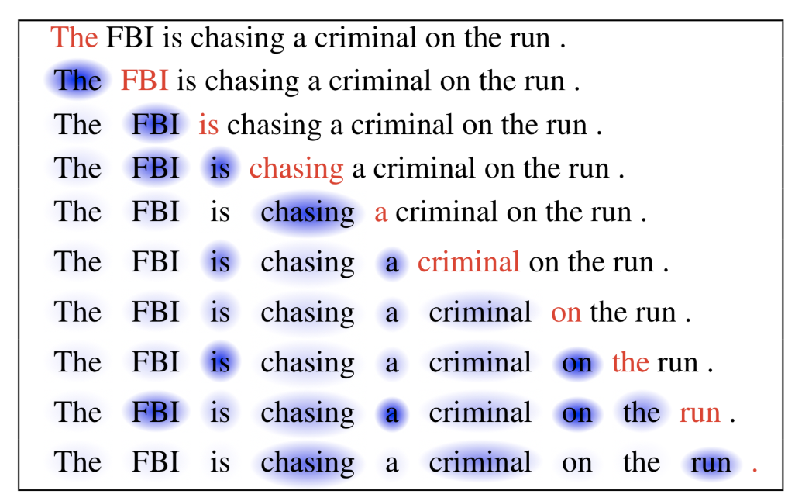
Self-Attention for Generation
10
Notes:
Change low resource IL to a language which is not in wikipedia
Word-level: from bi-lingual dicts and alignment; structure-level comes from wals; multi-level alignment

Slide 11
11
Notes:
Change low resource IL to a language which is not in wikipedia
Word-level: from bi-lingual dicts and alignment; structure-level comes from wals; multi-level alignment

Slide 12
Why Self-Attention is Powerful?
The Attention mechanism is based on a common-sensical intuition that we “attend to” a certain part when processing a large amount of information.
The Attention mechanism enables the transformers to have extremely long-term memory. A transformer model can “attend” or “focus” on all previous tokens that have been generated.
Self-attention can enhance the information content of an input embedding by including information about the input’s context.
It enables the model to weigh the importance of different elements in an input sequence and dynamically adjust their influence on the output.
This is especially important for language processing tasks, where the meaning of a word can change based on its context within a sentence or document.
12
Notes:
Change low resource IL to a language which is not in wikipedia
Word-level: from bi-lingual dicts and alignment; structure-level comes from wals; multi-level alignment

Slide 13
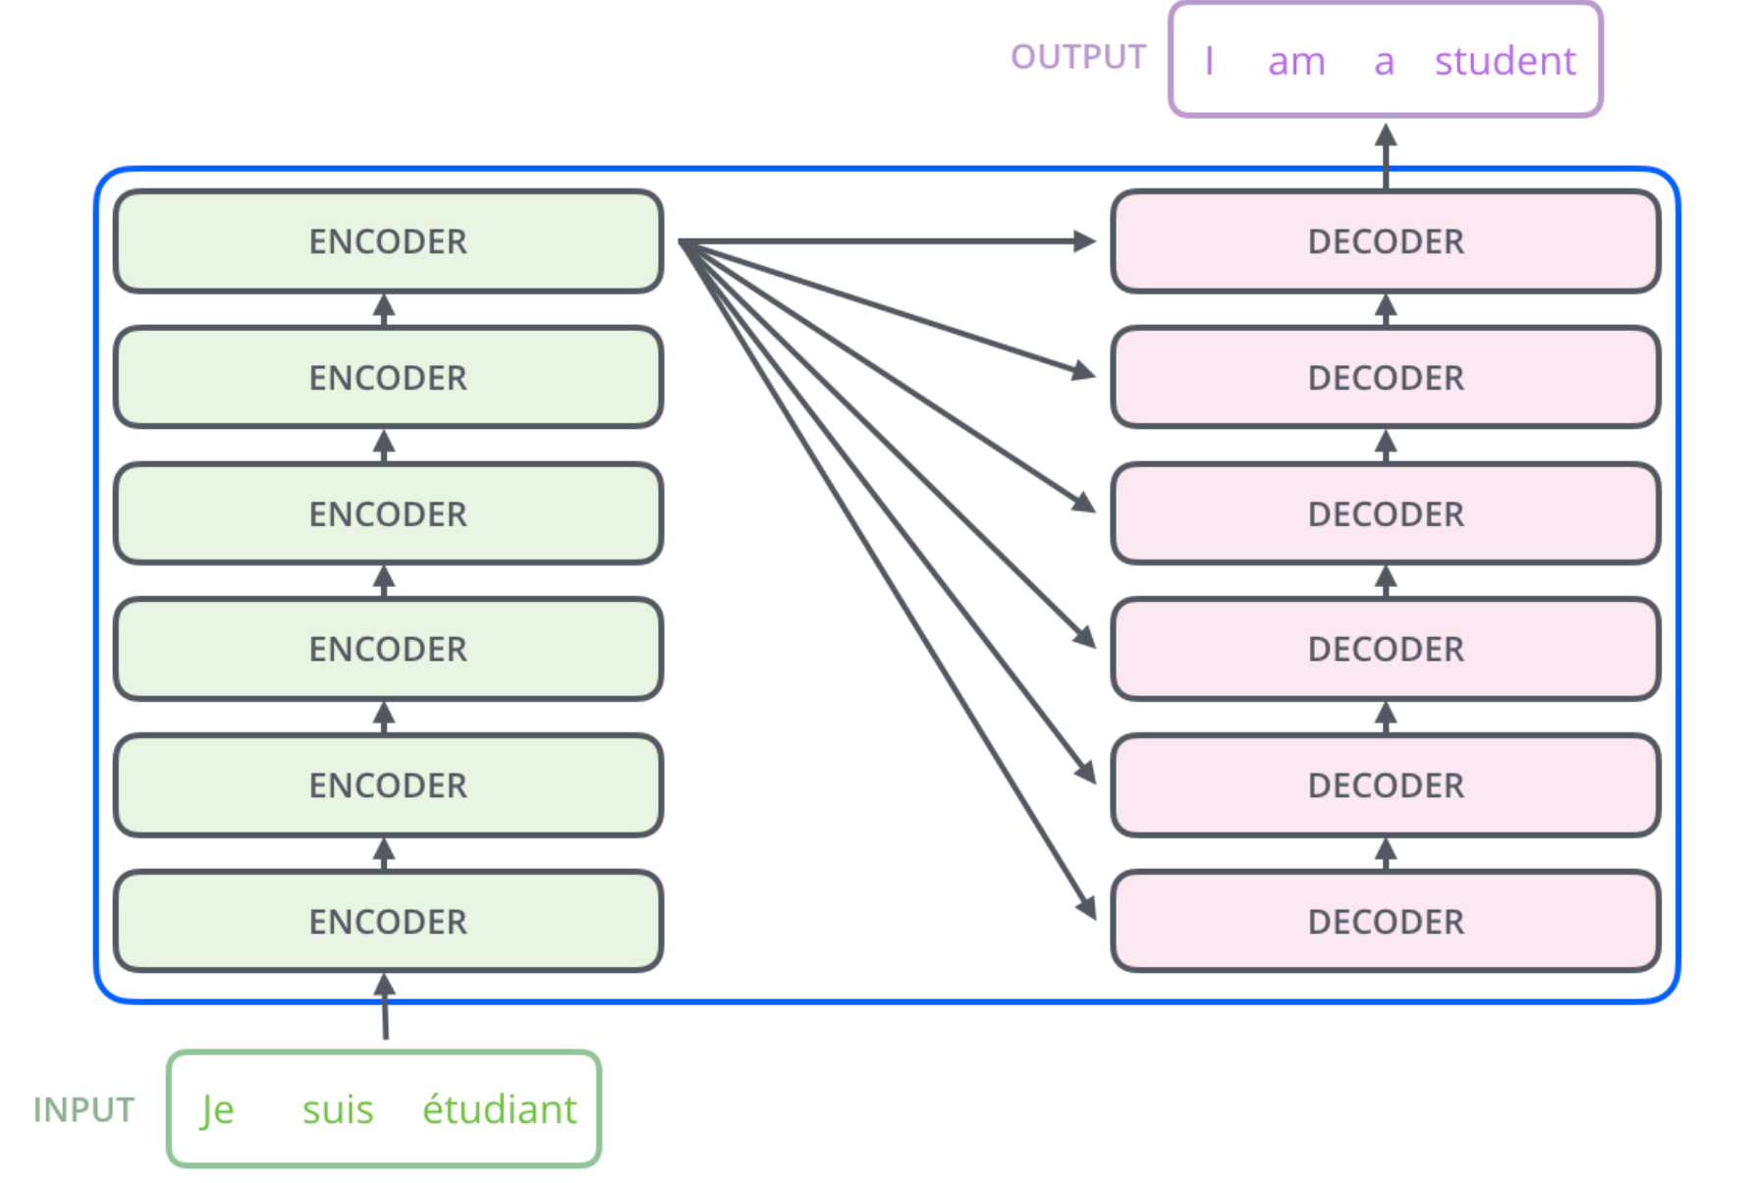
Transformer: High-level architecture
Will only look at the ENCODER(s) part in detail

Slide 14
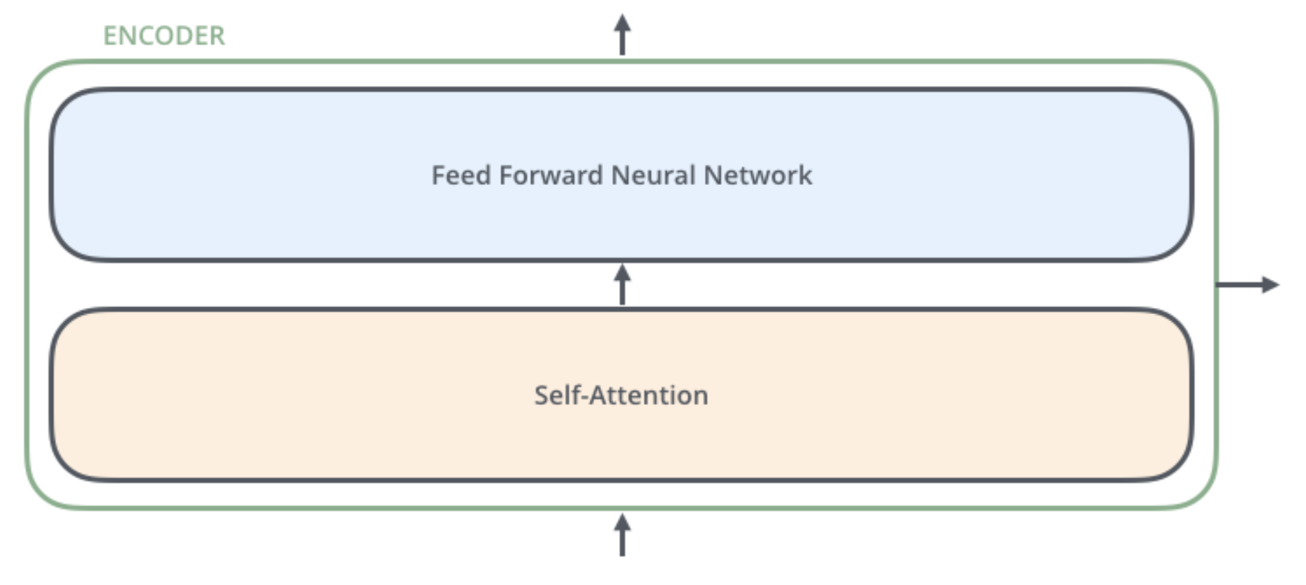
The encoders are all identical in structure (yet they do not share weights). Each one is broken down into two sub-layers
outputs of the self-attention are fed to a feed-forward neural network. The exact same one is independently applied to each position.
helps the encoder look at other words in the input sentence as it encodes a specific word.

Slide 15
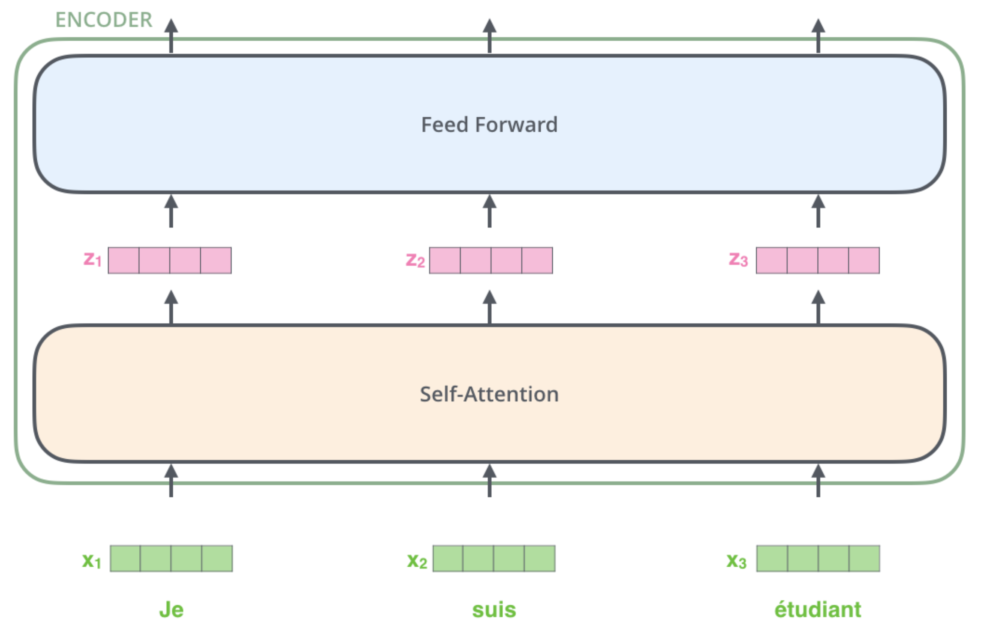
Key property of Transformer: word in each position flows through its own path in the encoder.
There are dependencies between these paths in the self-attention layer.
Feed-forward layer does not have those dependencies => various paths can be executed in parallel !
Word embeddings
Notes:
The size of this list is hyperparameter we can set – basically it would be the length of the longest sentence in our training dataset.
Here we begin to see one key property of the Transformer, which is that the word in each position flows through its own path in the encoder. There are dependencies between these paths in the self-attention layer. The feed-forward layer does not have those dependencies, however, and thus the various paths can be executed in parallel while flowing through the feed-forward layer.

Slide 16
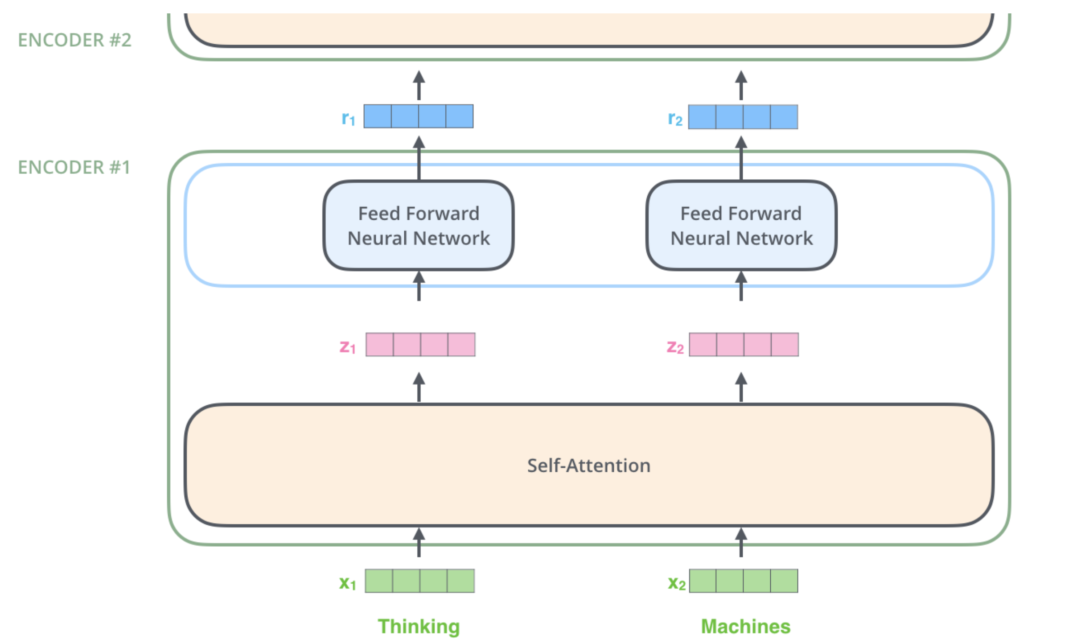
Visually clearer on two words
dependencies in self-attention layer.
No dependencies in Feed-forward layer
Word embeddings

Slide 17
Self-Attention

Slide 18
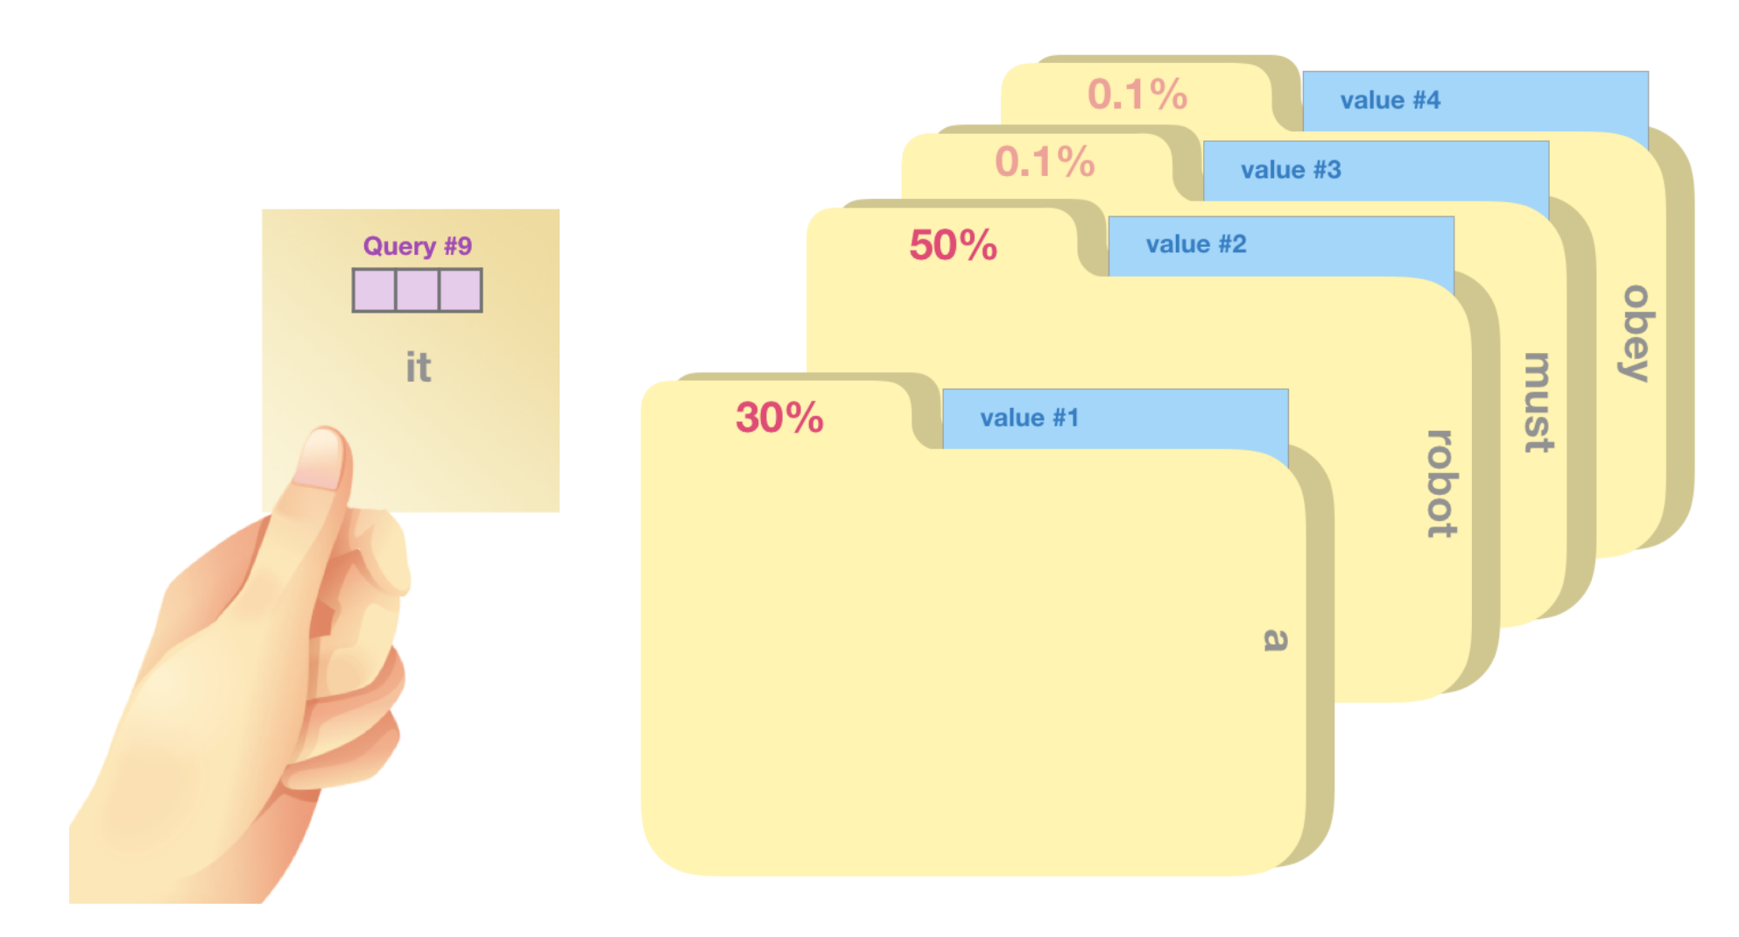
Self Attention

Slide 19
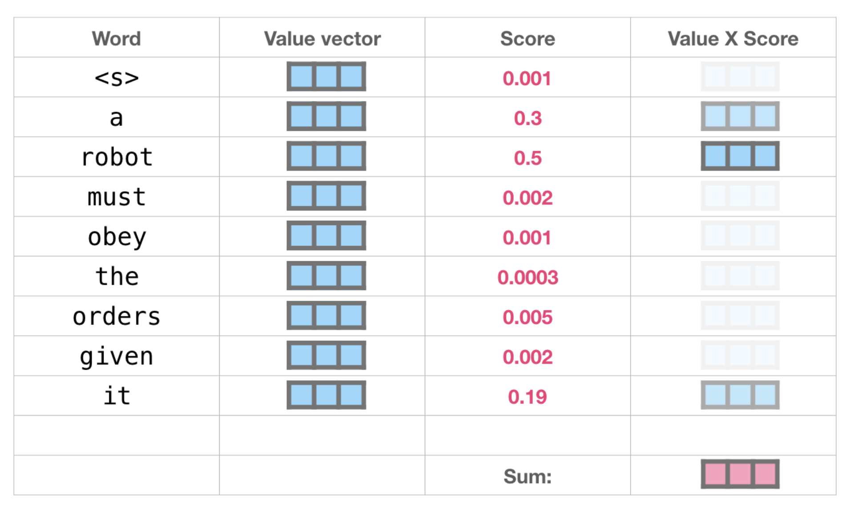
Self Attention

Slide 20
Self Attention

Slide 21
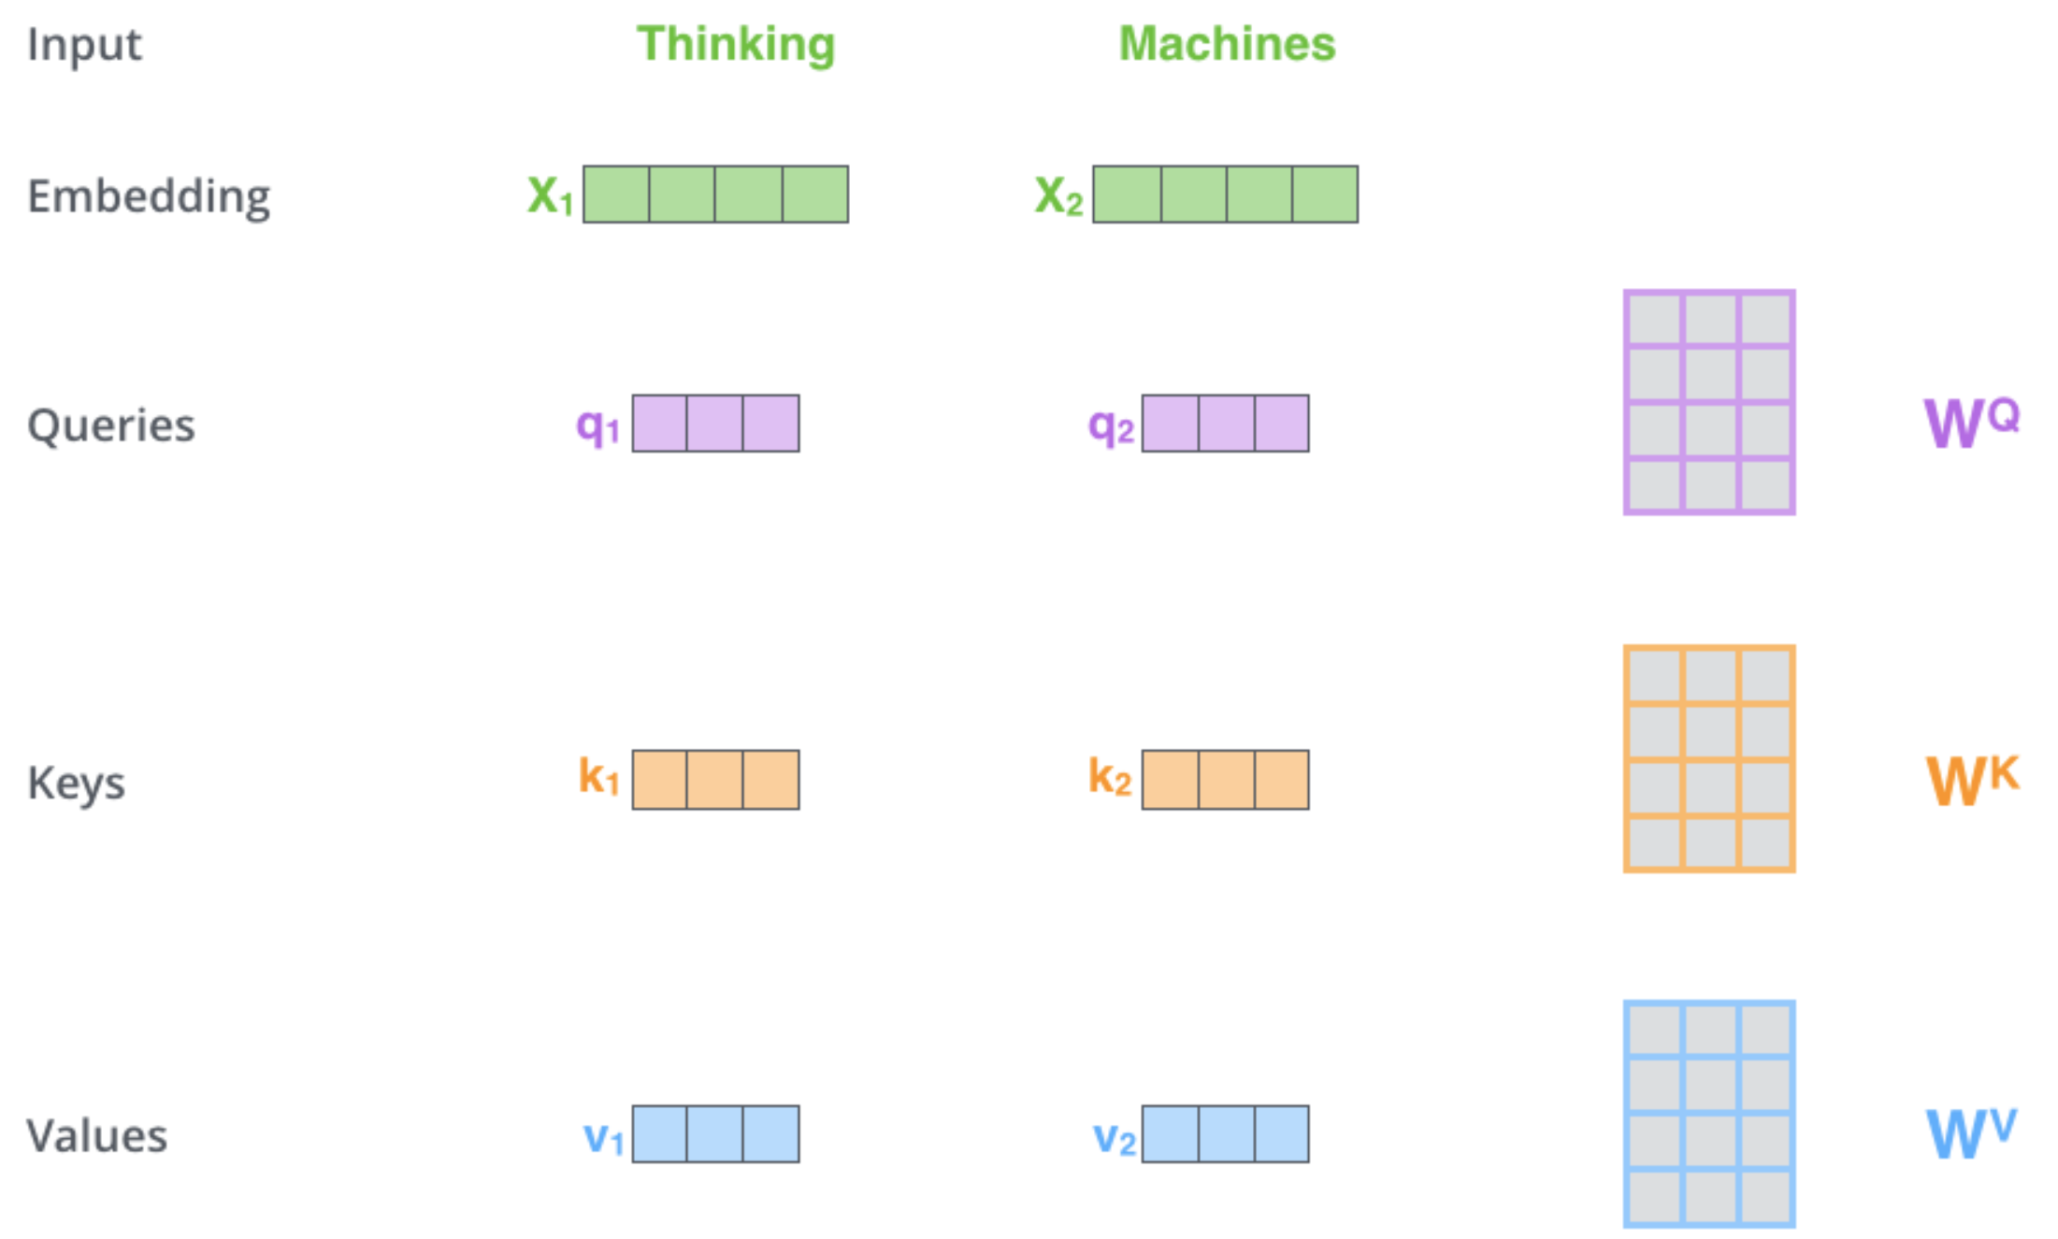
Self-Attention: Put them into Computer
While processing each word it allows to look at other positions in the input sequence for clues to build a better encoding for this word.
Step1: create three vectors from each of the encoder’s input vectors:
Query, a Key, Value (typically smaller dimension).
by multiplying the embedding by three matrices that we trained during the training process.
Think this in search point of view: The text which you type in the search box is the QUERY. The results which appear as the video or article title are the KEY and the content inside them is the VALUE.
Notes:
As the model processes each word (each position in the input sequence), self attention allows it to look at other positions in the input sequence for clues that can help lead to a better encoding for this word.
If you’re familiar with RNNs, think of how maintaining a hidden state allows an RNN to incorporate its representation of previous words/vectors it has processed with the current one it’s processing. Self-attention is the method the Transformer uses to bake the “understanding” of other relevant words into the one we’re currently processing.
The first step in calculating self-attention is to create three vectors from each of the encoder’s input vectors (in this case, the embedding of each word). So for each word, we create a Query vector, a Key vector, and a Value vector. These vectors are created by multiplying the embedding by three matrices that we trained during the training process.
Notice that these new vectors are smaller in dimension than the embedding vector. Their dimensionality is 64, while the embedding and encoder input/output vectors have dimensionality of 512. They don’t HAVE to be smaller, this is an architecture choice to make the computation of multiheaded attention (mostly) constant.

Slide 22
Self-Attention
Step 2: calculate a score (like we have seen for regular attention!) how much focus to place on other parts of the input sentence as we encode a word at a certain position.
Take dot product of the query vector with the key vector of the respective word we’re scoring.
E.g., Processing the self-attention for word “Thinking” in position #1, the first score would be the dot product of q1 and k1. The second score would be the dot product of q1 and k2.
Notes:
The second step in calculating self-attention is to calculate a score. Say we’re calculating the self-attention for the first word in this example, “Thinking”. We need to score each word of the input sentence against this word. The score determines how much focus to place on other parts of the input sentence as we encode a word at a certain position.
The score is calculated by taking the dot product of the query vector with the key vector of the respective word we’re scoring. So if we’re processing the self-attention for the word in position #1, the first score would be the dot product of q1 and k1. The second score would be the dot product of q1 and k2.

Slide 23
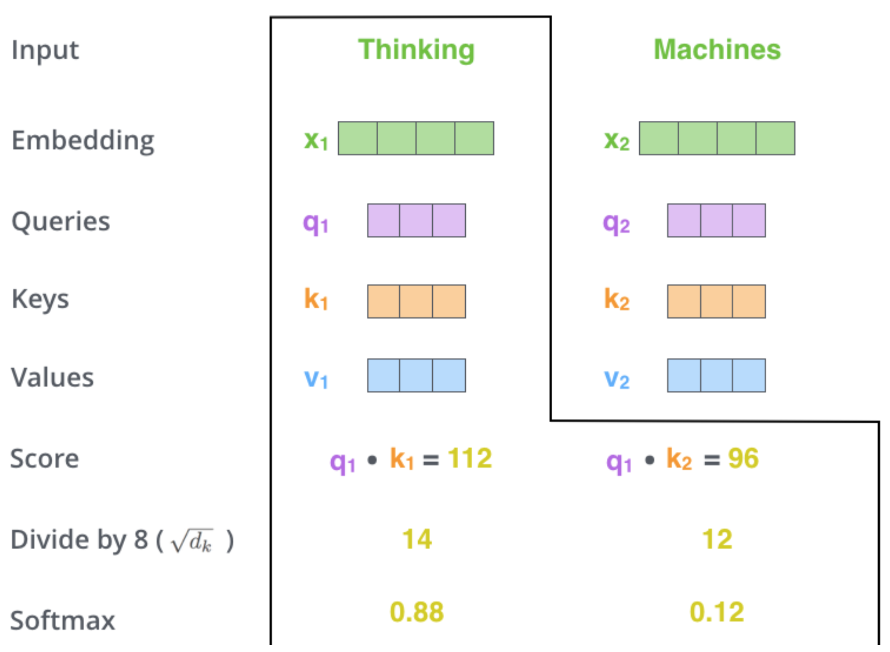
Self Attention
Step 3 divide scores by the square root of the dimension of the key vectors (more stable gradients).
In the paper the dimension of the key vector is 64, so that will be 8. The reason behind that is if the dot products become large, this causes some self-attention scores to be very small after we apply softmax function in the future.
Step 4 pass result through a softmax operation. (all positive and add up to 1)
Intuition: softmax score determines how much each word will be expressed at this position.
Notes:
The third and forth steps are to divide the scores by 8 (the square root of the dimension of the key vectors used in the paper – 64. This leads to having more stable gradients. There could be other possible values here, but this is the default), then pass the result through a softmax operation. Softmax normalizes the scores so they’re all positive and add up to 1

Slide 24
24
Notes:
Change low resource IL to a language which is not in wikipedia
Word-level: from bi-lingual dicts and alignment; structure-level comes from wals; multi-level alignment

Slide 25
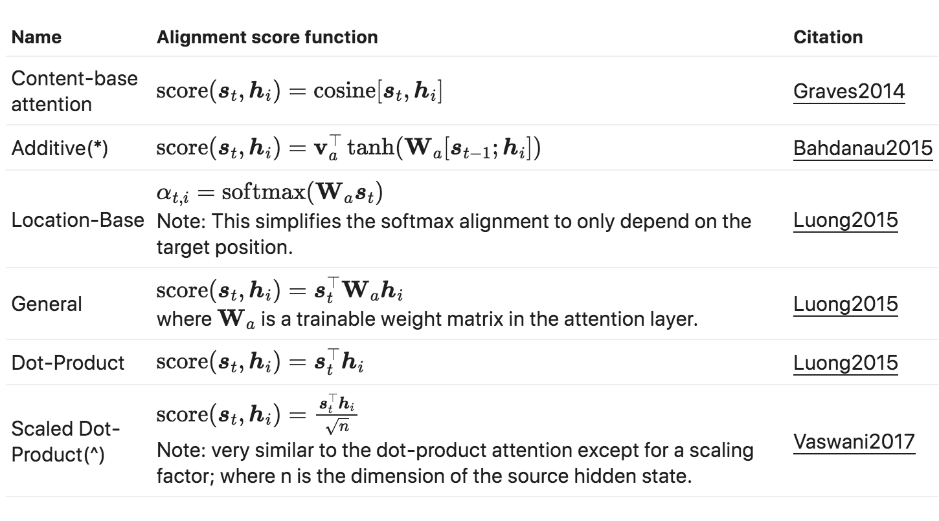
Other Ways to Compute Attention
Notes:
The second step in calculating self-attention is to calculate a score. Say we’re calculating the self-attention for the first word in this example, “Thinking”. We need to score each word of the input sentence against this word. The score determines how much focus to place on other parts of the input sentence as we encode a word at a certain position.
The score is calculated by taking the dot product of the query vector with the key vector of the respective word we’re scoring. So if we’re processing the self-attention for the word in position #1, the first score would be the dot product of q1 and k1. The second score would be the dot product of q1 and k2.

Slide 26
Other Ways to Compute Attention
Notes:
The second step in calculating self-attention is to calculate a score. Say we’re calculating the self-attention for the first word in this example, “Thinking”. We need to score each word of the input sentence against this word. The score determines how much focus to place on other parts of the input sentence as we encode a word at a certain position.
The score is calculated by taking the dot product of the query vector with the key vector of the respective word we’re scoring. So if we’re processing the self-attention for the word in position #1, the first score would be the dot product of q1 and k1. The second score would be the dot product of q1 and k2.

Slide 27
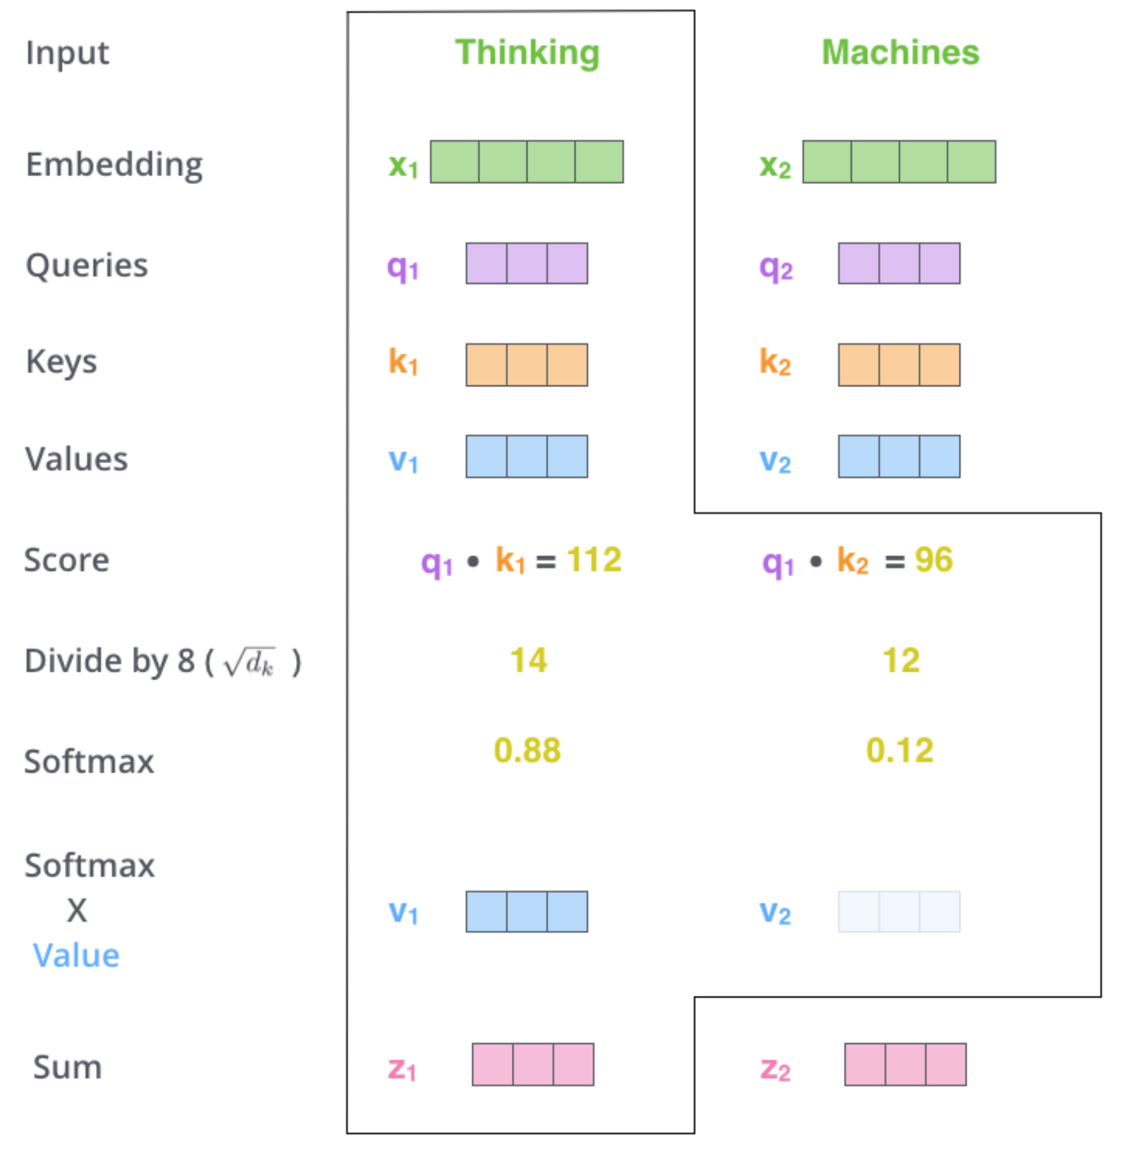
Self Attention
Step6 : sum up the weighted value vectors. This produces the output of the self-attention layer at this position
More details:
What we have seen for a word is done for all words (using matrices)
Need to encode position of words
And improved using a mechanism called “multi-headed” attention
see https://jalammar.github.io/illustrated-transformer/
Notes:
The third and forth steps are to divide the scores by 8 (the square root of the dimension of the key vectors used in the paper – 64. This leads to having more stable gradients. There could be other possible values here, but this is the default), then pass the result through a softmax operation. Softmax normalizes the scores so they’re all positive and add up to 1

Slide 28
28
Notes:
Change low resource IL to a language which is not in wikipedia
Word-level: from bi-lingual dicts and alignment; structure-level comes from wals; multi-level alignment

Slide 29
29
Notes:
Change low resource IL to a language which is not in wikipedia
Word-level: from bi-lingual dicts and alignment; structure-level comes from wals; multi-level alignment

Slide 30
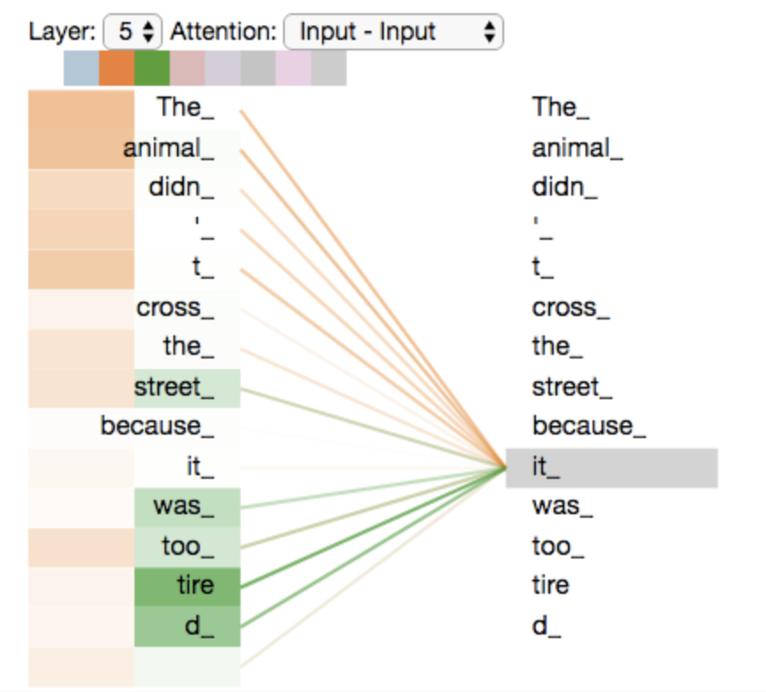
A visualization of the outputs upon using two heads.
We can see that if the Query word is it, the first head focuses more on the words the animal, and the second head focuses more on the word tired. Hence, the final context representation will be focusing on all the words the, animal and tired, and thus is a superior representation as compared to the traditional way.
30
Notes:
Change low resource IL to a language which is not in wikipedia
Word-level: from bi-lingual dicts and alignment; structure-level comes from wals; multi-level alignment

Slide 31
Once we have calculated the positional encodings, we can combine them with the respective word embeddings to get the final positional word embeddings.
31
Notes:
Change low resource IL to a language which is not in wikipedia
Word-level: from bi-lingual dicts and alignment; structure-level comes from wals; multi-level alignment

Slide 32
32
Notes:
Change low resource IL to a language which is not in wikipedia
Word-level: from bi-lingual dicts and alignment; structure-level comes from wals; multi-level alignment

Slide 33
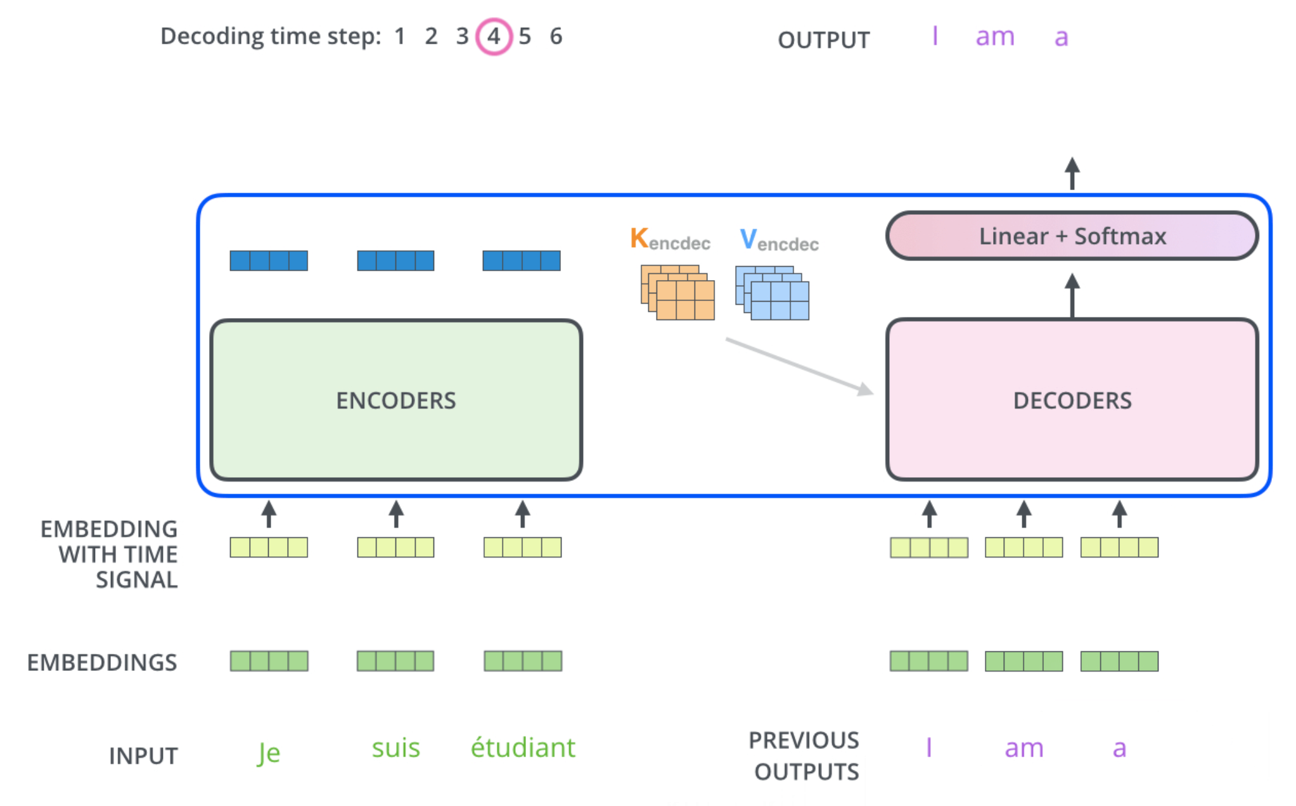
The Decoder Side
Relies on most of the concepts on the encoder side
See animation on https://jalammar.github.io/illustrated-transformer/

Slide 34
34
Notes:
Change low resource IL to a language which is not in wikipedia
Word-level: from bi-lingual dicts and alignment; structure-level comes from wals; multi-level alignment

Slide 35
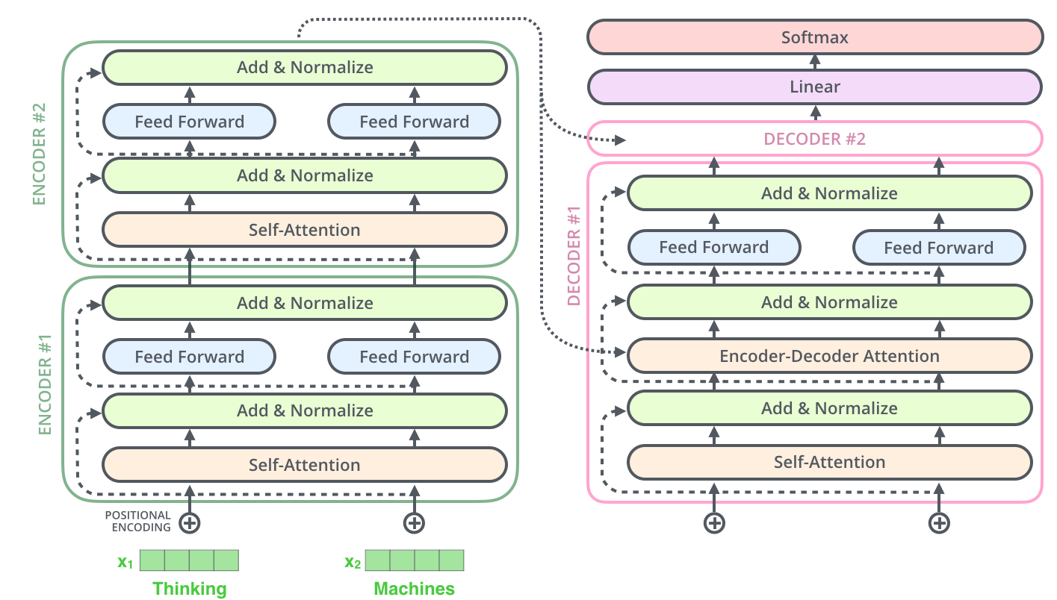
Relations Among Transformer model, BERT and GPT
Encoder (e.g., BERT)
Decoder (e.g., GPT)

Slide 36
Transformers, GPT-2, and BERT
A transformer uses an encoder stack to model input, and uses decoder stack to model output (using input information from encoder side)
If we do not have input, we just want to model the “next word”, we can get rid of the encoder side of a transformer and output “next word” one by one. This gives us GPT
If we are only interested in training a language model for the input for some other tasks, then we do not need the decoder of the transformer, that gives us BERT

Slide 37
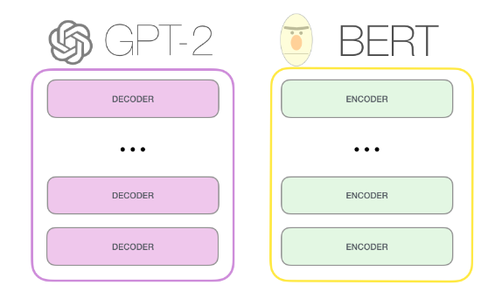
03
GPT-2, BERT

Slide 38
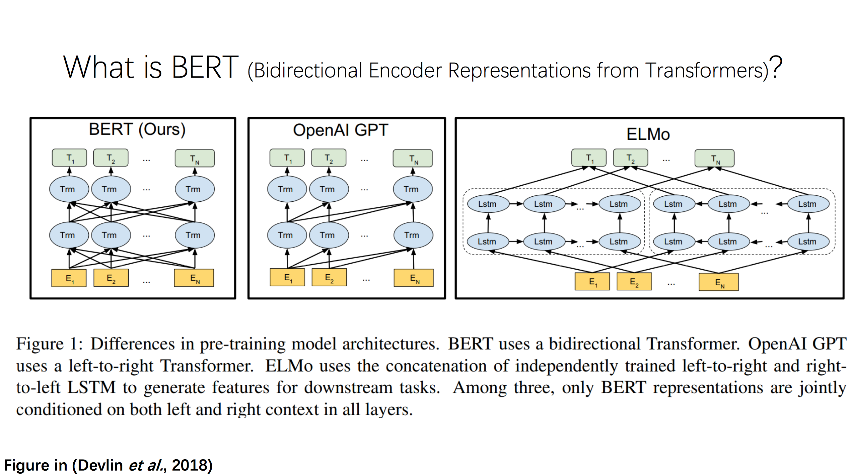
38
Notes:
Change low resource IL to a language which is not in wikipedia
Word-level: from bi-lingual dicts and alignment; structure-level comes from wals; multi-level alignment

Slide 39
39
Notes:
Change low resource IL to a language which is not in wikipedia
Word-level: from bi-lingual dicts and alignment; structure-level comes from wals; multi-level alignment

Slide 40
40
Notes:
Change low resource IL to a language which is not in wikipedia
Word-level: from bi-lingual dicts and alignment; structure-level comes from wals; multi-level alignment

Slide 41
41
Notes:
Change low resource IL to a language which is not in wikipedia
Word-level: from bi-lingual dicts and alignment; structure-level comes from wals; multi-level alignment

Slide 42
42
Notes:
Change low resource IL to a language which is not in wikipedia
Word-level: from bi-lingual dicts and alignment; structure-level comes from wals; multi-level alignment

Slide 43
43
Notes:
Change low resource IL to a language which is not in wikipedia
Word-level: from bi-lingual dicts and alignment; structure-level comes from wals; multi-level alignment

Slide 44
44
Notes:
Change low resource IL to a language which is not in wikipedia
Word-level: from bi-lingual dicts and alignment; structure-level comes from wals; multi-level alignment

Slide 45
45
Notes:
Change low resource IL to a language which is not in wikipedia
Word-level: from bi-lingual dicts and alignment; structure-level comes from wals; multi-level alignment

Slide 46
46
Notes:
Change low resource IL to a language which is not in wikipedia
Word-level: from bi-lingual dicts and alignment; structure-level comes from wals; multi-level alignment

Slide 47
47
Notes:
Change low resource IL to a language which is not in wikipedia
Word-level: from bi-lingual dicts and alignment; structure-level comes from wals; multi-level alignment

Slide 48
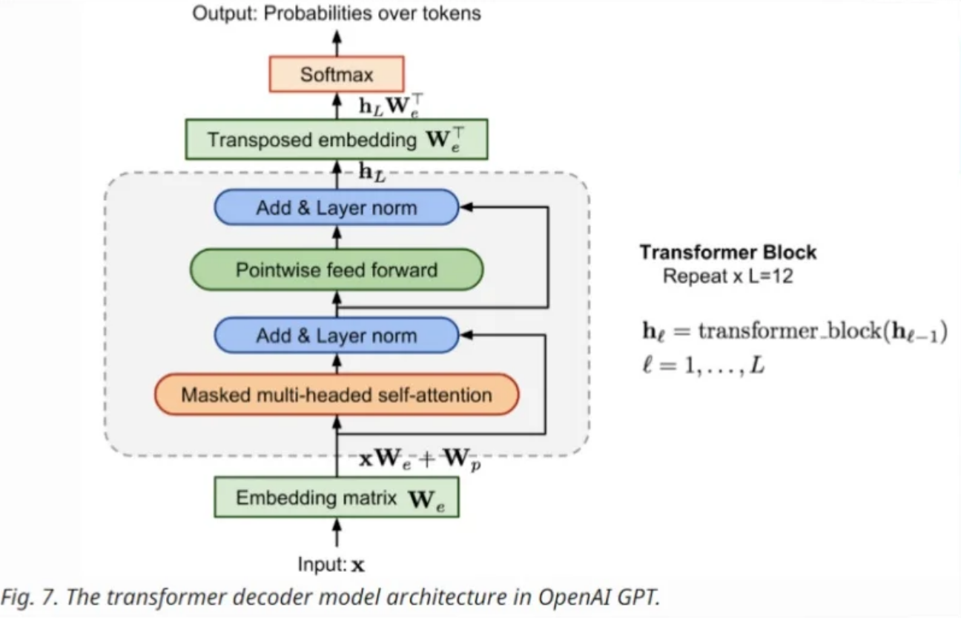
48
Notes:
Change low resource IL to a language which is not in wikipedia
Word-level: from bi-lingual dicts and alignment; structure-level comes from wals; multi-level alignment

Slide 49
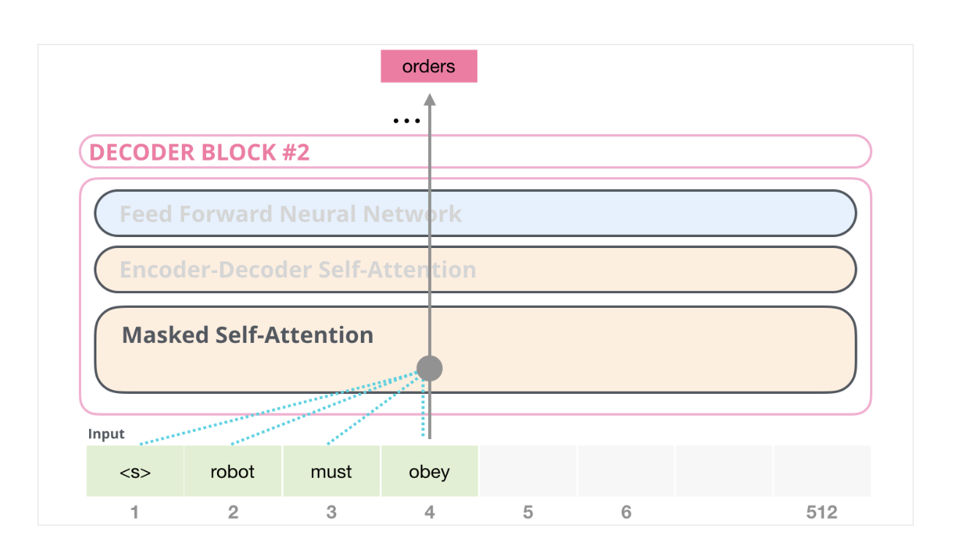
So What are the Major Differences?
Masked Self Attention: We are not allowed to peak into the future!

Slide 50
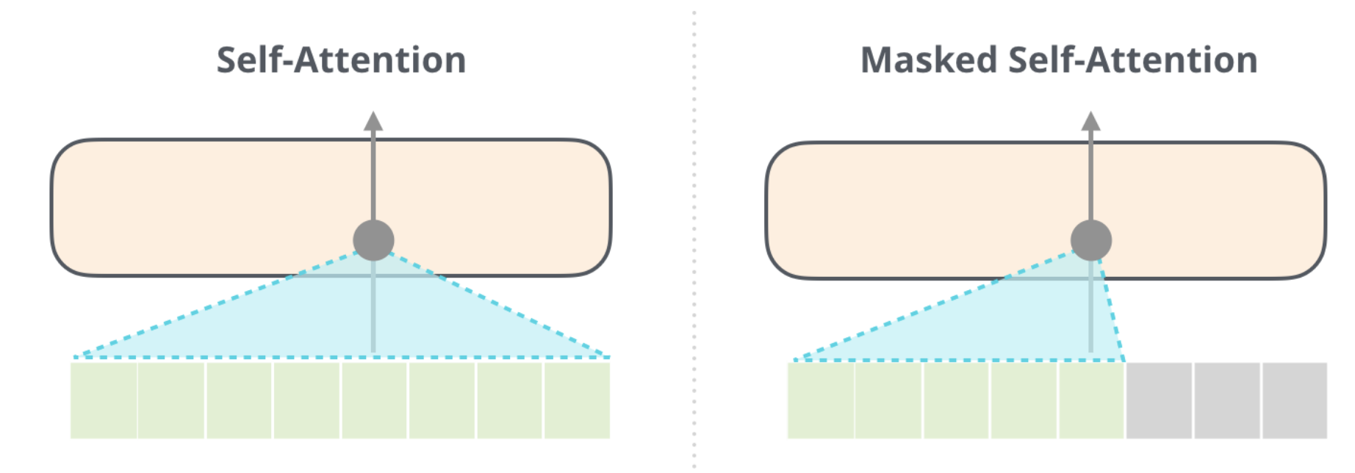
So What are the Major Differences?

Slide 51
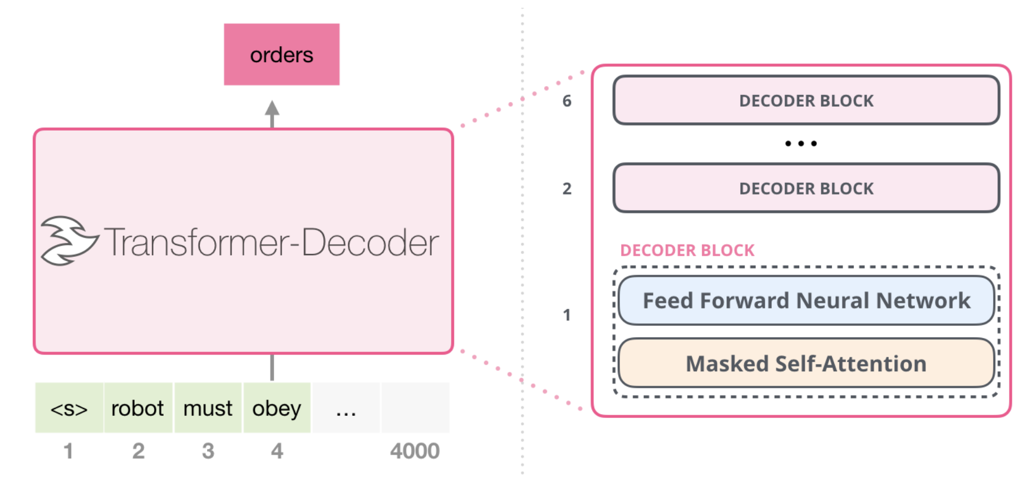
So What are the Major Differences?

Slide 52
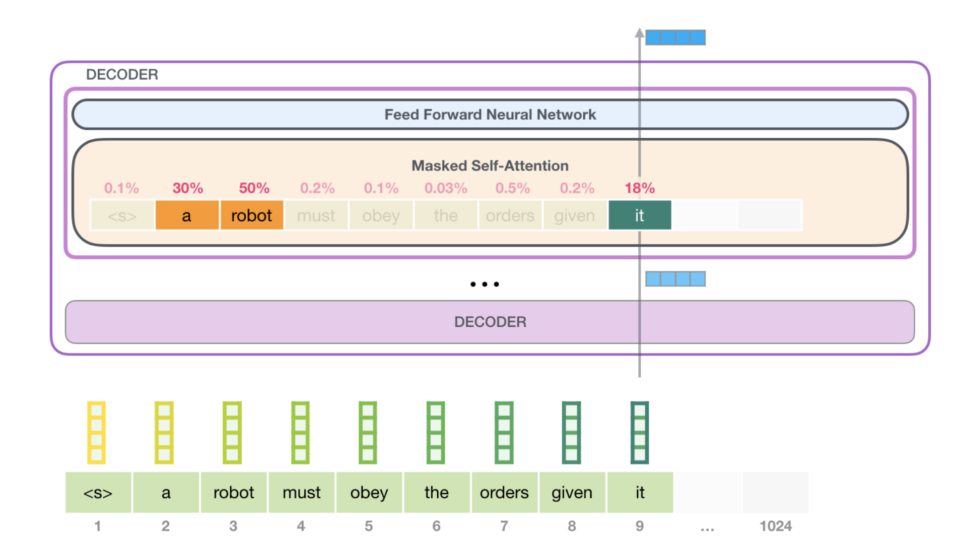
So What are the Major Differences?

Slide 53
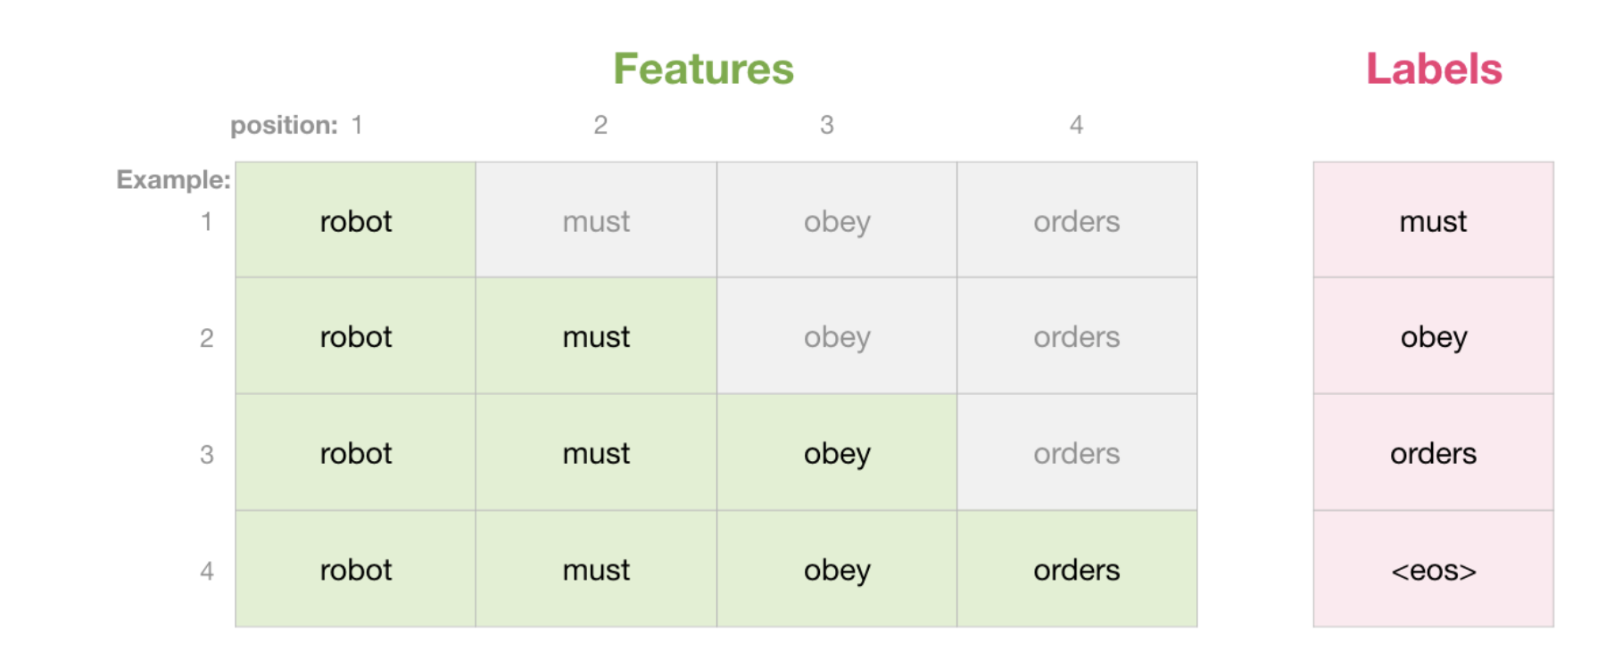
Self Attention

Slide 54
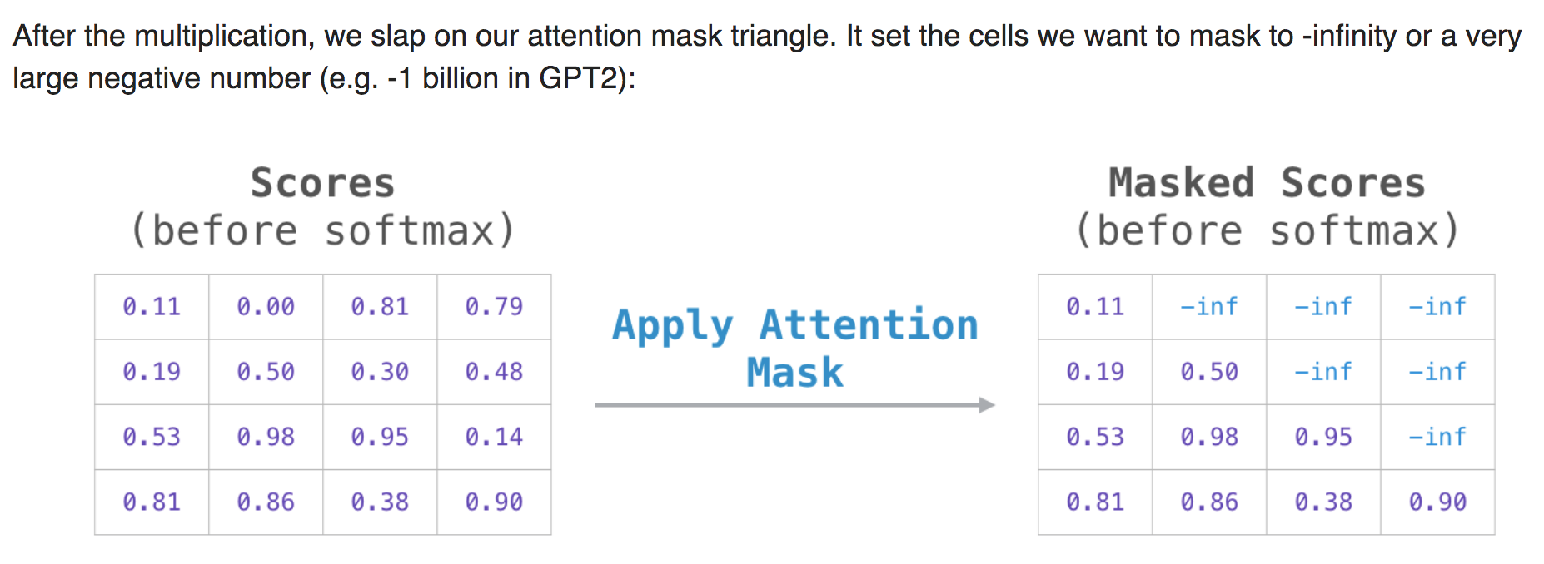
Self Attention

Slide 55
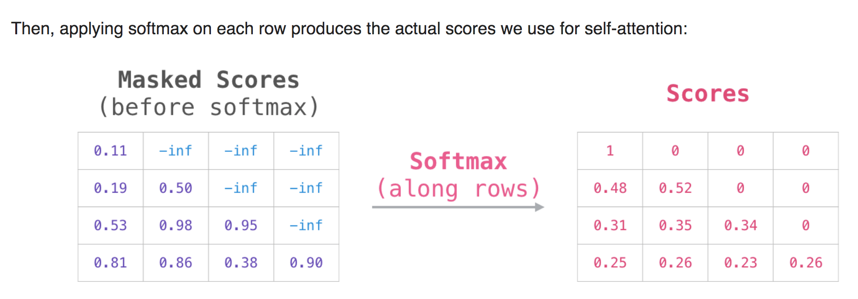
Self Attention

Slide 56
56
Notes:
Change low resource IL to a language which is not in wikipedia
Word-level: from bi-lingual dicts and alignment; structure-level comes from wals; multi-level alignment

Slide 57
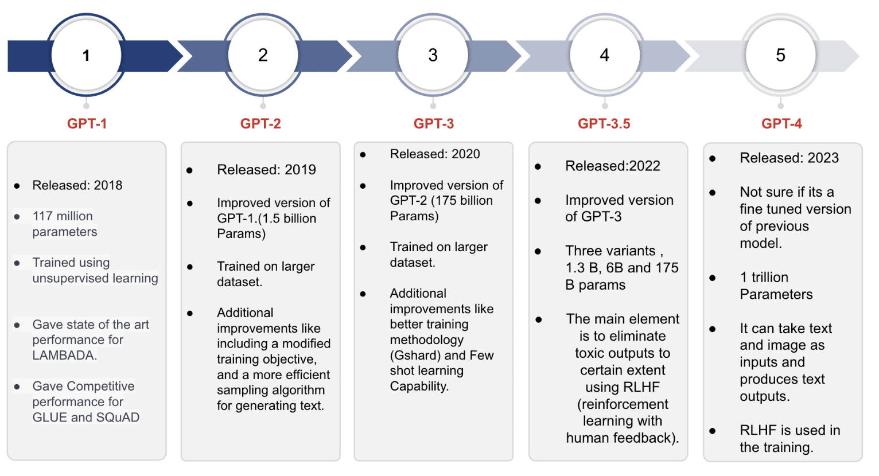
GPT4 Model
57
Notes:
Change low resource IL to a language which is not in wikipedia
Word-level: from bi-lingual dicts and alignment; structure-level comes from wals; multi-level alignment

