Slide 1
Prompt Learning
Heng Ji
hengji@illinois.edu
Acknowledgement: Some Slides are from Pengfei Liu

Slide 2
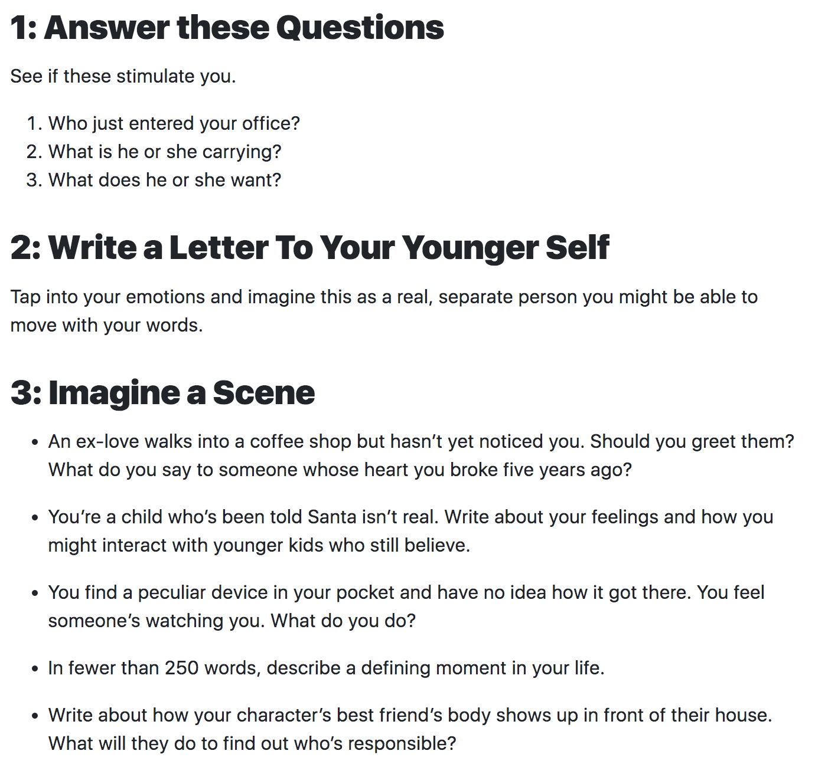
We Often do Prompt based Writing Exercise

Slide 3
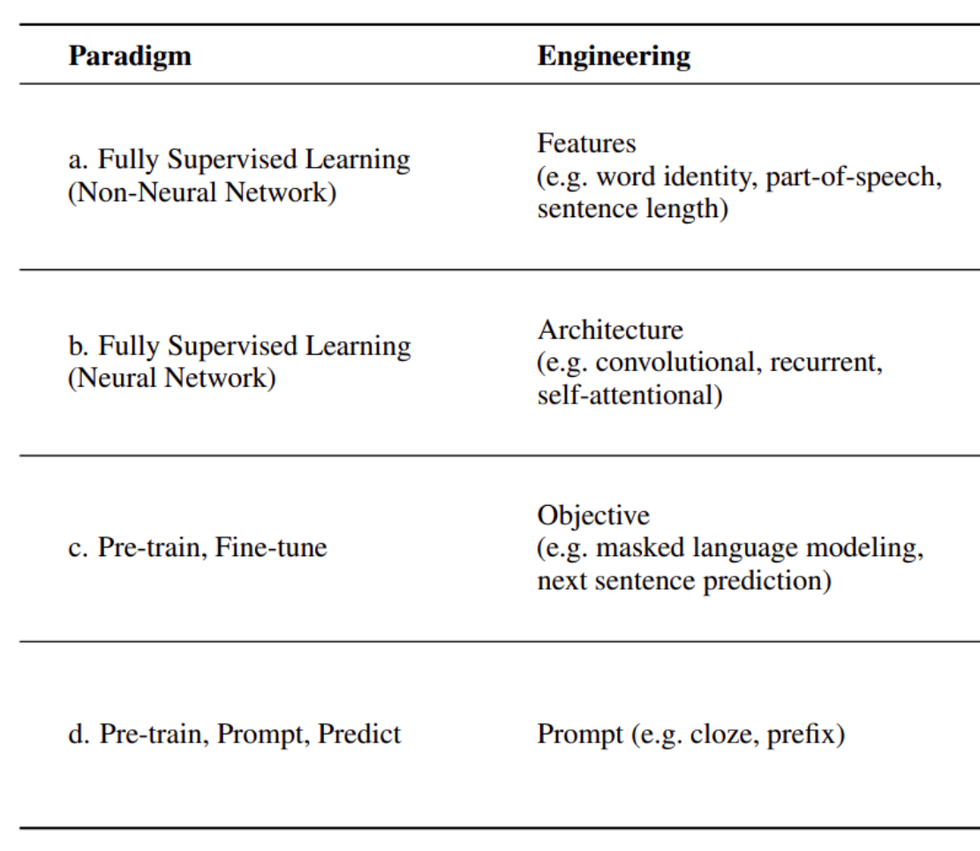
Some NLP Paradigm Shift
3
Notes:
Change low resource IL to a language which is not in wikipedia
Word-level: from bi-lingual dicts and alignment; structure-level comes from wals; multi-level alignment

Slide 4
Why Do We need Prompt Learning for LLMs?
Mostly because it’s one of the few ways we can ‘probe’ knowledge hidden in these “black-box” LLMs
Unstructured Multimodal Multilingual Data
Large Neural Models
Elicit Explicit Symbolic Knowledge
Knowledge Localization and Generalization
Knowledge Augmentation and Distillation
Knowledge Patching and Fusion
Knowledge Extraction
External Symbolic Knowledge
Background Knowledge
Domain-Specific Knowledge
World Knowledge
Structured Knowledge
Task-Specific Knowledge
Notes:
XXX check ideas in the knowledge section in position paper
XXX
Zi xue cheng cai
Self updating
Self correction
Knowledge generalization

Slide 5
Basic Prompt Learning Framework
5
Notes:
Change low resource IL to a language which is not in wikipedia
Word-level: from bi-lingual dicts and alignment; structure-level comes from wals; multi-level alignment

Slide 6
6
Notes:
Change low resource IL to a language which is not in wikipedia
Word-level: from bi-lingual dicts and alignment; structure-level comes from wals; multi-level alignment

Slide 7
7
Notes:
Change low resource IL to a language which is not in wikipedia
Word-level: from bi-lingual dicts and alignment; structure-level comes from wals; multi-level alignment

Slide 8
8
Notes:
Change low resource IL to a language which is not in wikipedia
Word-level: from bi-lingual dicts and alignment; structure-level comes from wals; multi-level alignment

Slide 9
9
Notes:
Change low resource IL to a language which is not in wikipedia
Word-level: from bi-lingual dicts and alignment; structure-level comes from wals; multi-level alignment

Slide 10
10
Notes:
Change low resource IL to a language which is not in wikipedia
Word-level: from bi-lingual dicts and alignment; structure-level comes from wals; multi-level alignment

Slide 11
11
Notes:
Change low resource IL to a language which is not in wikipedia
Word-level: from bi-lingual dicts and alignment; structure-level comes from wals; multi-level alignment

Slide 12
12
Notes:
Change low resource IL to a language which is not in wikipedia
Word-level: from bi-lingual dicts and alignment; structure-level comes from wals; multi-level alignment

Slide 13
13
Notes:
Change low resource IL to a language which is not in wikipedia
Word-level: from bi-lingual dicts and alignment; structure-level comes from wals; multi-level alignment

Slide 14
14
Notes:
Change low resource IL to a language which is not in wikipedia
Word-level: from bi-lingual dicts and alignment; structure-level comes from wals; multi-level alignment

Slide 15
15
Notes:
Change low resource IL to a language which is not in wikipedia
Word-level: from bi-lingual dicts and alignment; structure-level comes from wals; multi-level alignment

Slide 16
16
Notes:
Change low resource IL to a language which is not in wikipedia
Word-level: from bi-lingual dicts and alignment; structure-level comes from wals; multi-level alignment

Slide 17
17
Notes:
Change low resource IL to a language which is not in wikipedia
Word-level: from bi-lingual dicts and alignment; structure-level comes from wals; multi-level alignment

Slide 18
18
Notes:
Change low resource IL to a language which is not in wikipedia
Word-level: from bi-lingual dicts and alignment; structure-level comes from wals; multi-level alignment

Slide 19
19
Notes:
Change low resource IL to a language which is not in wikipedia
Word-level: from bi-lingual dicts and alignment; structure-level comes from wals; multi-level alignment

Slide 20
20
Notes:
Change low resource IL to a language which is not in wikipedia
Word-level: from bi-lingual dicts and alignment; structure-level comes from wals; multi-level alignment

Slide 21
21
Notes:
Change low resource IL to a language which is not in wikipedia
Word-level: from bi-lingual dicts and alignment; structure-level comes from wals; multi-level alignment

Slide 22
22
Notes:
Change low resource IL to a language which is not in wikipedia
Word-level: from bi-lingual dicts and alignment; structure-level comes from wals; multi-level alignment

Slide 23
23
Notes:
Change low resource IL to a language which is not in wikipedia
Word-level: from bi-lingual dicts and alignment; structure-level comes from wals; multi-level alignment

Slide 24
24
Notes:
Change low resource IL to a language which is not in wikipedia
Word-level: from bi-lingual dicts and alignment; structure-level comes from wals; multi-level alignment

Slide 25
25
Notes:
Change low resource IL to a language which is not in wikipedia
Word-level: from bi-lingual dicts and alignment; structure-level comes from wals; multi-level alignment

Slide 26
26
Notes:
Change low resource IL to a language which is not in wikipedia
Word-level: from bi-lingual dicts and alignment; structure-level comes from wals; multi-level alignment

Slide 27
27
Notes:
Change low resource IL to a language which is not in wikipedia
Word-level: from bi-lingual dicts and alignment; structure-level comes from wals; multi-level alignment

Slide 28
Exercises 1: Reading Comprehension
Given the following input:
Heng Ji has two cats, Michelin and Donny. Michelin is half an hour older than Donny.
She adopted them from NYC Shelter.
The younger one likes to come to her home office in the upstairs when she is meeting her students.
Design prompts to answer the following questions, if you see any incorrect answer try to refine your prompts until you get the correct answer:
Are Donny and Michelin boys or girls?
Is Heng Ji man or woman and Why? What does Heng Ji do for living?
Which cat likes to bother Heng Ji’s work schedule?
Continue to writing the story.
28
Notes:
Change low resource IL to a language which is not in wikipedia
Word-level: from bi-lingual dicts and alignment; structure-level comes from wals; multi-level alignment

Slide 29
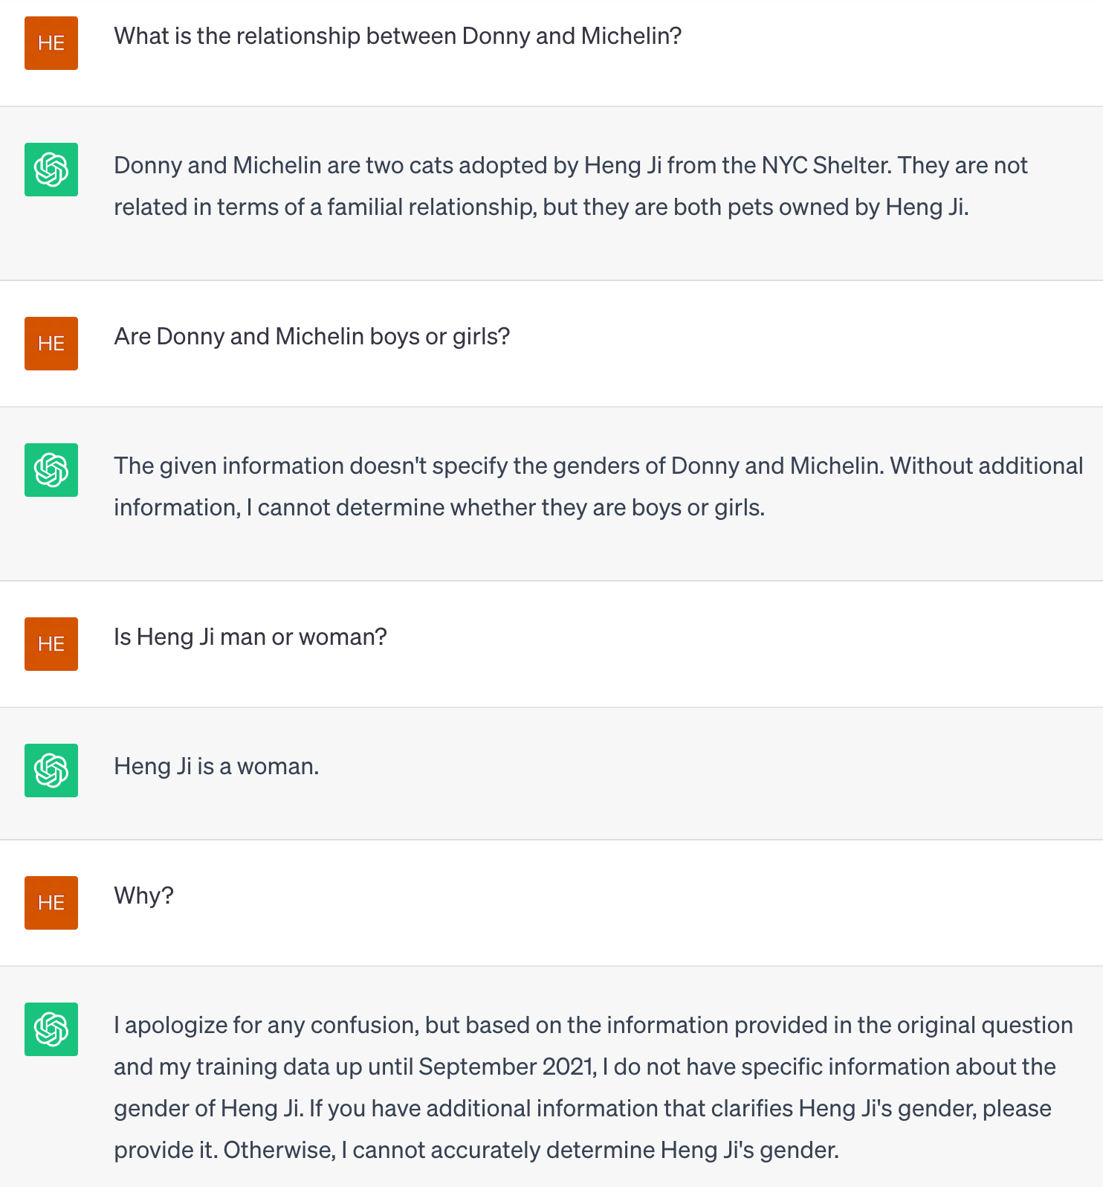
Exercises
29
Notes:
Change low resource IL to a language which is not in wikipedia
Word-level: from bi-lingual dicts and alignment; structure-level comes from wals; multi-level alignment

Slide 30
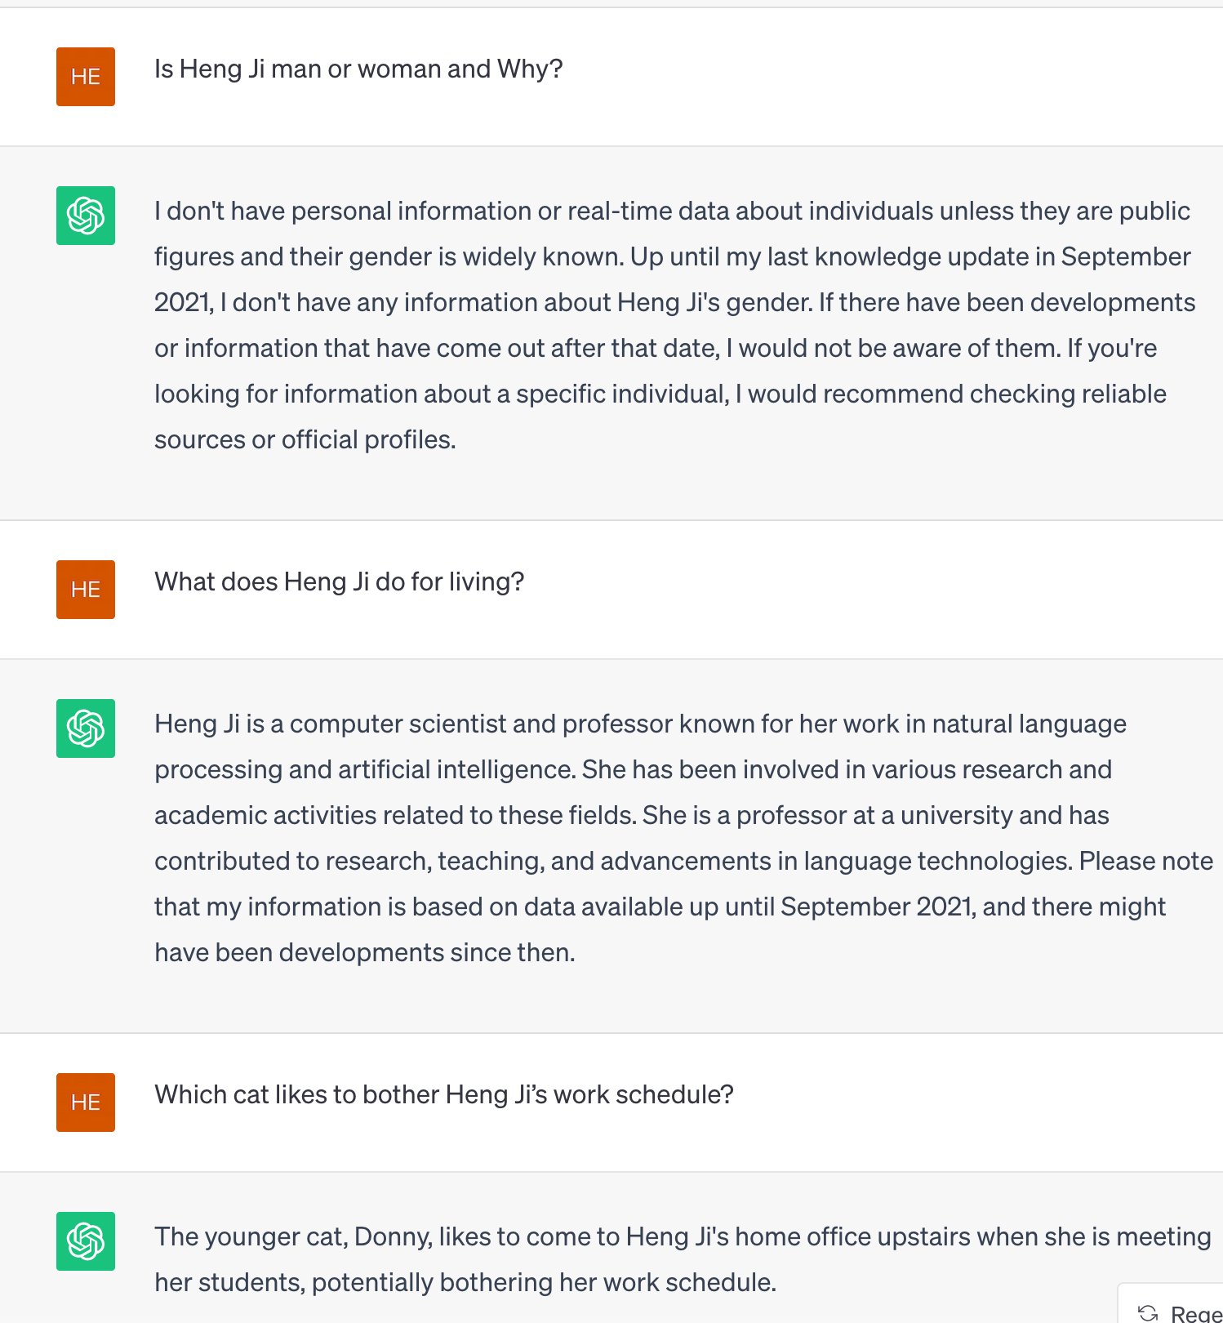
Exercises
30
Notes:
Change low resource IL to a language which is not in wikipedia
Word-level: from bi-lingual dicts and alignment; structure-level comes from wals; multi-level alignment

Slide 31
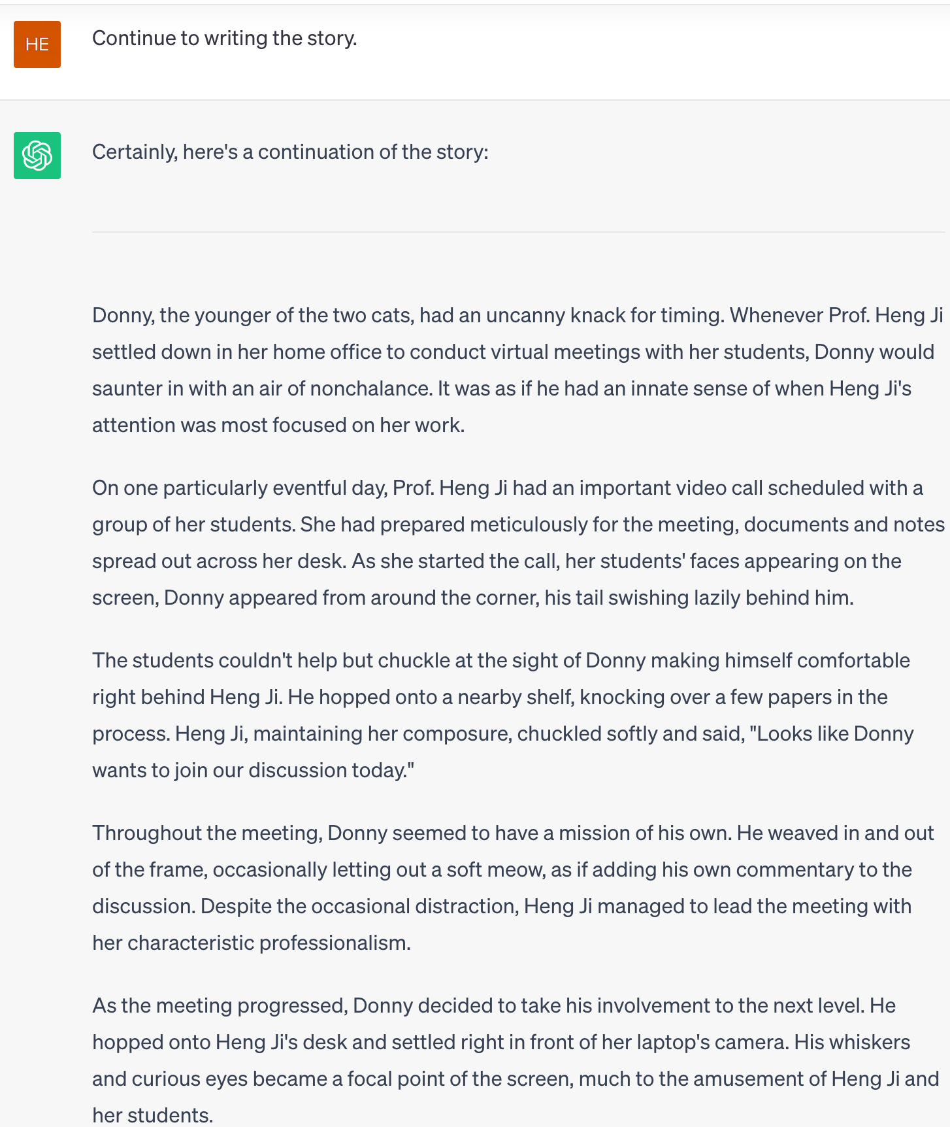
Exercises
31
Notes:
Change low resource IL to a language which is not in wikipedia
Word-level: from bi-lingual dicts and alignment; structure-level comes from wals; multi-level alignment

Slide 32
Exercises 2: Knowledge Discovery
What are social norms when meeting people?
E.g., What are social norms when meeting senior people for the first time?
E.g., What are Chinese social norms when meeting senior people for the first time?
E.g., What are American social norms when meeting senior people for the first time?
E.g., What are American social norms when meeting strangers in the elevator?
E.g., What are Chinese social norms when meeting strangers in the elevator?
32
Notes:
Change low resource IL to a language which is not in wikipedia
Word-level: from bi-lingual dicts and alignment; structure-level comes from wals; multi-level alignment

Slide 33
Exercises 3: Event Detection
What types of events are contained in this sentence?
The pro-reform director of Iran's biggest - selling daily newspaper and officialorgan of Tehran's municipality has stepped down following the appointmentof a conservative as the city's new mayor, press reports said Sunday.
33
Notes:
Change low resource IL to a language which is not in wikipedia
Word-level: from bi-lingual dicts and alignment; structure-level comes from wals; multi-level alignment

Slide 34
Exercises 4: Event Participant (Argument) Extraction
Who did what to whom, where and when?
Elliott testified that on April 15, McVeigh came into the body shopand reserved the truck, to be picked up at 4pm two days later. Elliott said that McVeigh gave him the $280.32 in exact change after declining to pay an additional amount for insurance. Prosecutors say he drove the truck to Geary Lake in Kansas, that4,000 pounds of ammonium nitrate laced with nitromethane were loaded into the truck there, and that it was driven to Oklahoma Cityand detonated.
34
Notes:
Change low resource IL to a language which is not in wikipedia
Word-level: from bi-lingual dicts and alignment; structure-level comes from wals; multi-level alignment

