Slide 1
Tool Learning
Yi R. Fung (TA)
yifung2@illinois.edu

Slide 2
Outline
Background Motivation
Tool Learning Framework Overview
Recent Research Trends in Scaling LLM Tool Usage Capability Effectively & Efficiently
Benchmarks and Resources Summarization
⭐

Slide 3
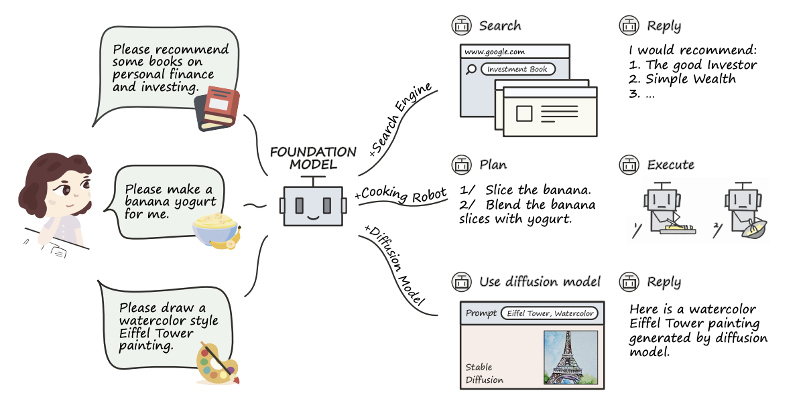
Motivational Example
Tool learning with foundation models is a paradigm that aims to combines the strengths of specialized tools and foundation models to achieve enhanced accuracy, efficiency, and automation in problem-solving.
Tool Learning with Foundation Models [Qin et al., 2023 Survey Paper]

Slide 4
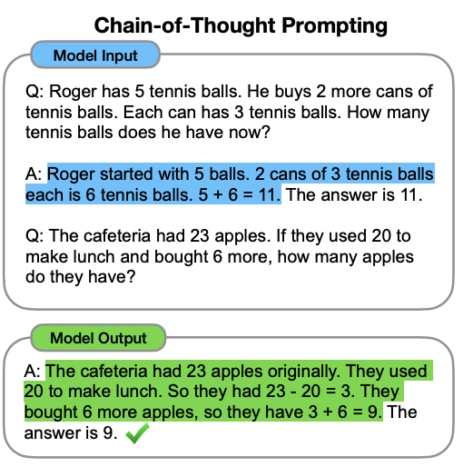
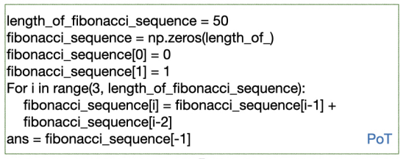
The Underlying Paradigm Shift of Foundation Models
The rise of large language models (LLMs), pretrained on massive corpora to learn general linguistic ability and world knowledge, has expedited a new trend of unified reasoning across various NLP tasks.
We witness the release of powerful LLMs such as ChatGPT and GPT-4 Davinci
Additionally, scaling the parameter size and training data size of LMs has given rise to the concept of emergent abilities, which are present in the larger models but not in the smaller models, such as strong few-shot performance [Wei et al., TMLR 2022]
In Fibonacci sequence, it follows the rule that each number is equal to the sum of the preceding two numbers. Assuming the first two numbers are 0 and 1, what is the 50th number in Fibonacci sequence?
Chain-of-Thought (COT) Prompting
Program-of-Thought (POT) Prompting
[Chen et al., 2022]
[Wei et al., 2022]
Notes:
not present in smaller models but is present in larger models.

Slide 5
The Underlying Paradigm Shift of Foundation Models
But many tasks transcend the scope of purely natural language.
For example, LLMs can’t do complicated math that well.
So, calculators may come in handy.
LLMs tends to hallucinate for queries or domains in which they struggle with a knowledge gap.
Hence, search engines may come in handy for the LLMs to access real-time knowledge
or new domain knowledge.
And there are also other tasks which may involve UI for interaction with human users and physical world interaction experiences, etc.
How can we best leverage the strong reasoning capability and expressiveness of LLMs
to handle these more complicated tasks?

Slide 6
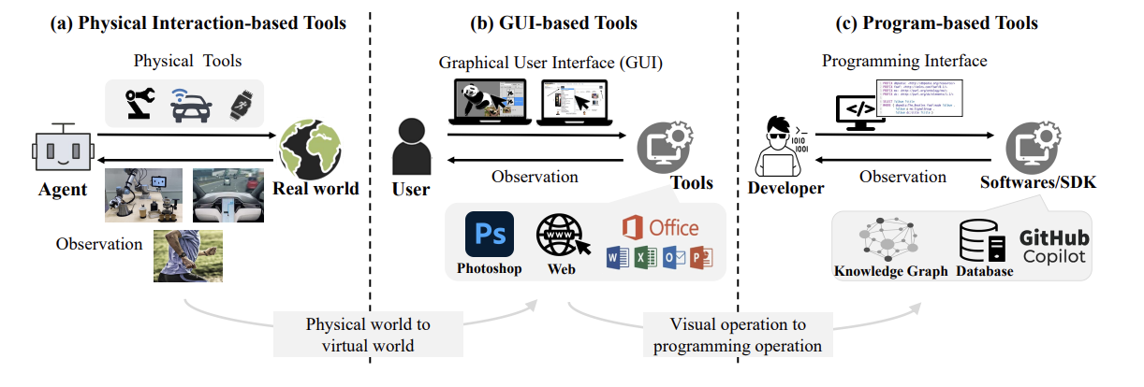
The Underlying Paradigm Shift of Foundation Models
Tool learning plays a key role here by decomposing complex tasks into sub-actions, tokenizing actions in the form of natural language, and converting them into executable instructions that can be understood by specific tools.
Language models serve as “translators”, making complex tasks more accessible to individuals without specialized technical knowledge.
Tool Learning with Foundation Models [Qin et al., 2023 Survey Paper]

Slide 7
Advantages in Tools Complementing Foundation Models
Benefits of Tools
Memory Mitigation
Enhanced Expertise
Better Interpretability
Improved Robustness
Tool Learning with Foundation Models [Qin et al., 2023 Survey Paper]

Slide 8
Advantages in Tools Complementing Foundation Models
Benefits of Tools
Memory Mitigation
Enhanced Expertise
Better Interpretability
Improved Robustness
Benefits of Foundation Models
Improved Decision-Making and Reasoning Abilities
Better User Experience
Combine the best of both worlds
Tool Learning with Foundation Models [Qin et al., 2023 Survey Paper]

Slide 9
Outline
Background Motivation
Tool Learning Framework Overview
Recent Research Trends in Scaling LLM Tool Usage Capability Effectively & Efficiently
Benchmarks and Resources Summarization
⭐

Slide 10
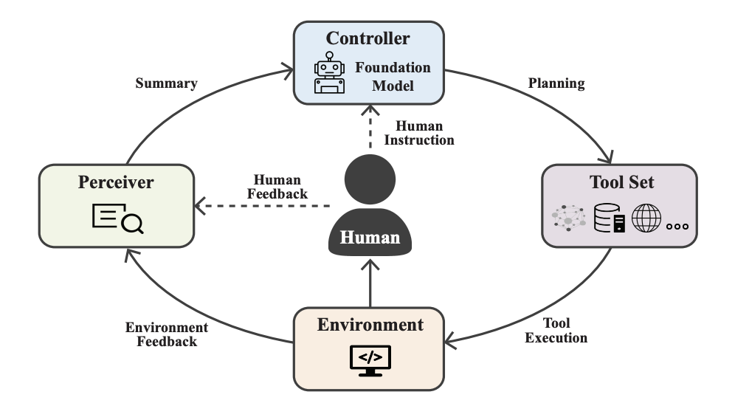
Components of Tool Learning
So how can we enable foundation models to leverage the strengths of specialized tools to accomplish complex tasks? Let’s start with understanding the basic framework first…
The tool learning framework consists of four key ingredients: (i) tool set, (ii) controller, (iii) perceiver, and (iv) environment.
Tool Learning with Foundation Models [Qin et al., 2023 Survey Paper]

Slide 11
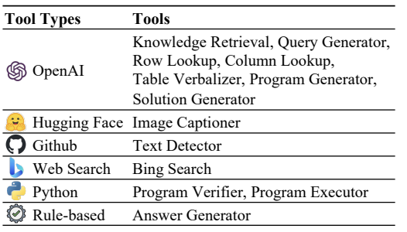
Components of Tool Learning: the Tool Set
The tool set T = {T1, T2, · · · } contains a collection of different tools that have different functionalities and serves as the fundamental ingredient of tool learning.
The tool set can consist of existing,
popular API calls.
Tool understanding, i.e., grasping what the tool is used for and how to use the tool, is crucial for the controller to plan, execute, and successfully solving tasks with tools.
Chameleon: Plug-and-Play Compositional Reasoning with Large Language Models [Lu et al., 2023]

Slide 12
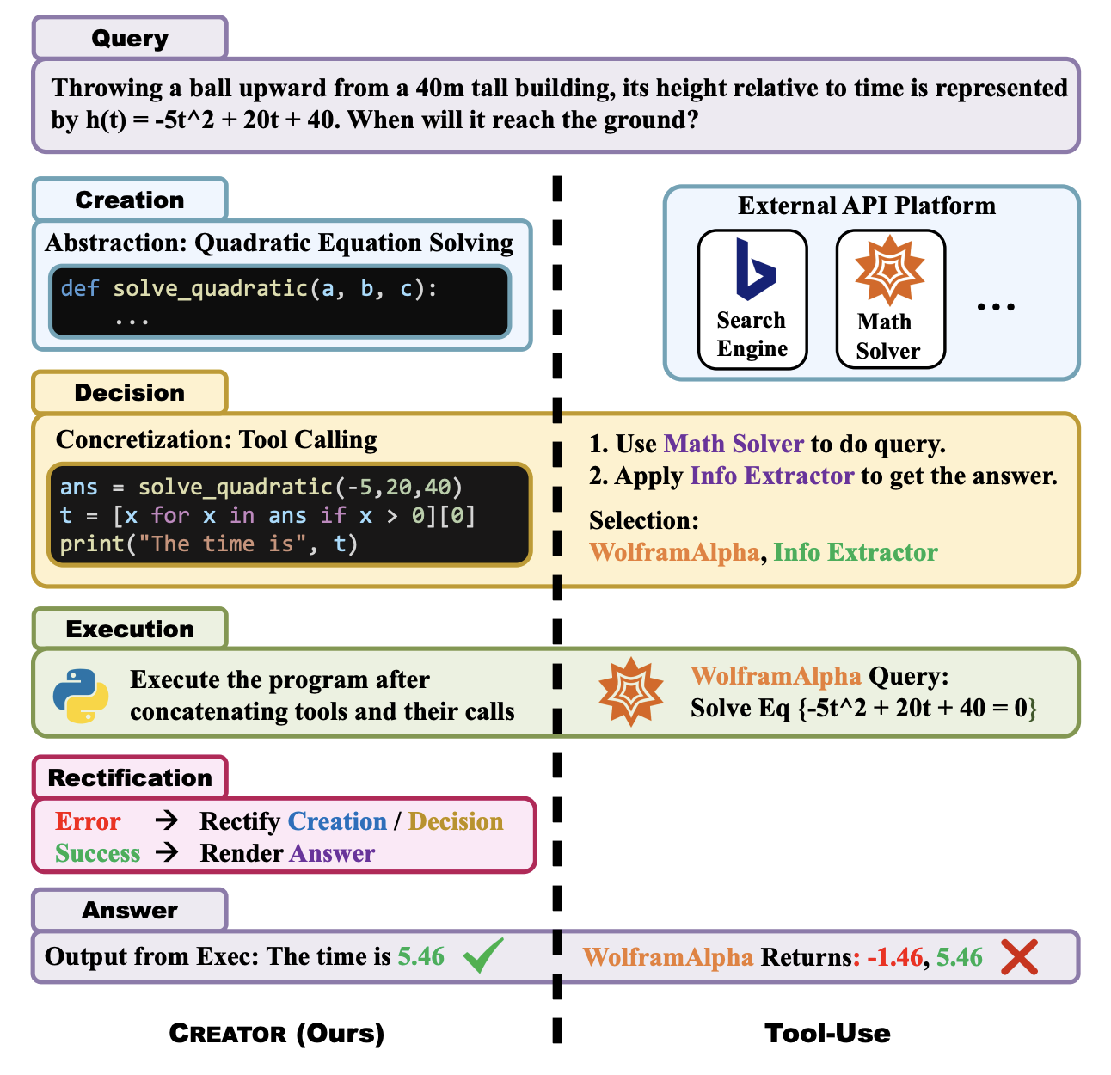
Components of Tool Learning: the Tool Set
The tool set T = {T1, T2, · · · } contains a collection of different tools that have different functionalities and serves as the fundamental ingredient of tool learning.
The tool set can consist of existing,
popular API calls.
Tool understanding, i.e., grasping what the tool is used for and how to use the tool, is crucial for the controller to plan, execute, and successfully solving tasks with tools.
Tools can also be created on the spot based on the given problem characteristics.
Chameleon: Plug-and-Play Compositional Reasoning with Large Language Models [Lu et al., 2023]
[Qian et al., 2023]

Slide 13
Components of Tool Learning
So how can we enable foundation models to leverage the strengths of specialized tools to accomplish complex tasks? Let’s start with understanding the basic framework first…
The tool learning framework consists of four key ingredients: (i) tool set, (ii) controller, (iii) perceiver, and (iv) environment.
Tool Learning with Foundation Models [Qin et al., 2023 Survey Paper]

Slide 14
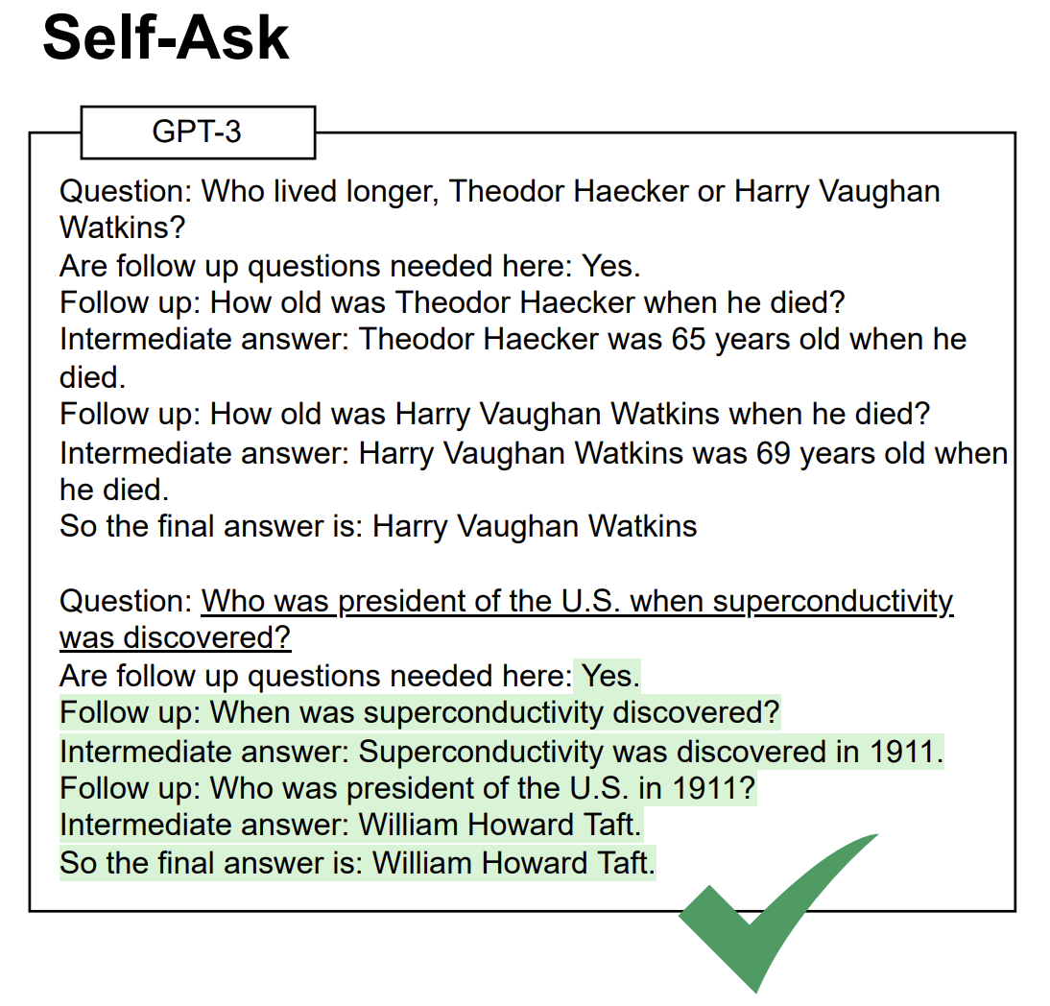
Components of Tool Learning: the Controller
The controller C serves as the “brain” in tool learning and is typically modeled using a foundation model to handle:
[Press et al., 2023]
User intent understanding --- recognizing and formalizing a natural language input q as a high-level task. This may involve the challenges of understanding vague instructions and generalizability across instruction variations. Fortunately, instruction tuning approaches can help align foundation models to better comprehend human intents.
Breaking down a query into sub-questions for reasoning

Slide 15
Components of Tool Learning: the Controller
The controller C serves as the “brain” in tool learning and is typically modeled using a foundation model to handle:
[Press et al., 2023]
User intent understanding --- recognizing and formalizing a natural language input q as a high-level task. This may involve the challenges of understanding vague instructions and generalizability across instruction variations. Fortunately, instruction tuning approaches can help align foundation models to better comprehend human intents.
Breaking down a query into sub-questions for reasoning
Module planning --- reason over the relationship between the intent and available tools, and develop a plan which selects the appropriate tools for tackling the task to fulfill the user’s request
Chamelon: Plug-and-Play Compositional Reasoning with Large Language Models [Lu et al., 2023]

Slide 16
Components of Tool Learning
So how can we enable foundation models to leverage the strengths of specialized tools to accomplish complex tasks? Let’s start with understanding the basic framework first…
The tool learning framework consists of four key ingredients: (i) tool set, (ii) controller, (iii) perceiver, and (iv) environment.
Tool Learning with Foundation Models [Qin et al., 2023 Survey Paper]

Slide 17
Components of Tool Learning: the Perceiver
The perceiver P is responsible for processing the user’s and the environment’s feedback and generating a summary (e.g., concatenated via some predefined template, etc.) for the controller.
Examples:
ReAct: Synergizing Reasoning and Acting In Language Models [Yao et al., ICLR 2023]

Slide 18
Components of Tool Learning
So how can we enable foundation models to leverage the strengths of specialized tools to accomplish complex tasks? Let’s start with understanding the basic framework first…
The tool learning framework consists of four key ingredients: (i) tool set, (ii) controller, (iii) perceiver, and (iv) environment.
Tool Learning with Foundation Models [Qin et al., 2023 Survey Paper]

Slide 19
Components of Tool Learning: the Environment
The environment E is the world where the tools operate, which provides the perceiver with the execution results of tools, and can be either virtual or real.
Tool Learning with Foundation Models [Qin et al., 2023 Survey Paper]
Notes:
a simulator that enables agents to learn abstract, text-based policies in TextWorld (Côté et al., 2018) and then execute goals from the ALFRED benchmark (Shridhar et al., 2020) in a rich visual environment.

Slide 20
Components of Tool Learning: the Environment
The environment E is the world where the tools operate, which provides the perceiver with the execution results of tools, and can be either virtual or real.
Virtual environments have the advantage of being easily accessible and replicable, allowing for more cost-effective training for models, but they may not fully replicate the complexities of the real-world environment, thereby leading to overfitting and poor generalization.
Ex1: AlfWorld [Shridlar et al., 2022], a simulated embodied environment for agents to execute goals from the ALFRED benchmark (Shridhar et al., 2020), such as put an apple in the kitchen fridge, through abstract text-based policies learnt in TextWorld (Côté et al., 2018).
Ex2: WebShop [Yao et al., 2022], a simulated e-commerce website environment with 1.18 million real-world products. In this environment, an agent needs to navigate multiple types of webpages and issue diverse actions to find, customize, and purchase a product given an instruction.
Tool Learning with Foundation Models [Qin et al., 2023 Survey Paper]
Notes:
a simulator that enables agents to learn abstract, text-based policies in TextWorld (Côté et al., 2018) and then execute goals from the ALFRED benchmark (Shridhar et al., 2020) in a rich visual environment.

Slide 21
Components of Tool Learning: the Environment
The environment E is the world where the tools operate, which provides the perceiver with the execution results of tools, and can be either virtual or real.
Virtual environments have the advantage of being easily accessible and replicable, allowing for more cost-effective training for models, but they may not fully replicate the complexities of the real-world environment, thereby leading to overfitting and poor generalization.
Ex1: AlfWorld [Shridlar et al., 2022], a simulated embodied environment for agents to execute goals from the ALFRED benchmark (Shridhar et al., 2020), such as put an apple in the kitchen fridge, through abstract text-based policies learnt in TextWorld (Côté et al., 2018).
Ex2: WebShop [Yao et al., 2022], a simulated e-commerce website environment with 1.18 million real-world products. In this environment, an agent needs to navigate multiple types of webpages and issue diverse actions to find, customize, and purchase a product given an instruction.
Real environments provide a more realistic context but may be more challenging to access and involve greater costs
Ex1: New Bing
Ex2: benchmarks that may involve executable python environment in problem solution (e.g., TabMWP)
Tool Learning with Foundation Models [Qin et al., 2023 Survey Paper]
Notes:
a simulator that enables agents to learn abstract, text-based policies in TextWorld (Côté et al., 2018) and then execute goals from the ALFRED benchmark (Shridhar et al., 2020) in a rich visual environment.

Slide 22
Training Models for Improved Tool Learning
In contrast to the prompting-based methods, which rely on the frozen foundation models’ in-context learning abilities, training-based methods optimize the model with supervision.
Analogous to infants learning a new tool, either from demonstration by an adult modeling the action or relying on their own exploration, training strategies for tool learning can be broadly categorized as follows:
Tool Learning with Foundation Models [Qin et al., 2023 Survey Paper]

Slide 23
Training Models for Improved Tool Learning
Learning from Demonstrations
Supervised Learning
Finetune models to perform tool-oriented tasks in a supervised manner through direct behavior cloning.
Toolformer: Language Models Can Teach Themselves to Use Tools [Schick et al., 2023]
Tool Learning with Foundation Models [Qin et al., 2023 Survey Paper]
Notes:
with a few demonstrations, foundation models can teach themselves how to utilize a tool

Slide 24
Training Models for Improved Tool Learning
Learning from Demonstrations
Supervised Learning
Finetune models to perform tool-oriented tasks in a supervised manner through direct behavior cloning.
Semi-supervised Learning
Employ a less-capable model to annotate pseudo-labels on unlabeled data and convert them into weakly-supervised tool-use demonstrations.
Toolformer: Language Models Can Teach Themselves to Use Tools [Schick et al., 2023]
Tool Learning with Foundation Models [Qin et al., 2023 Survey Paper]
Notes:
with a few demonstrations, foundation models can teach themselves how to utilize a tool

Slide 25
Training Models for Improved Tool Learning
Learning from Demonstrations
Supervised Learning
Finetune models to perform tool-oriented tasks in a supervised manner through direct behavior cloning.
Semi-supervised Learning
Employ a less-capable model to annotate pseudo-labels on unlabeled data and convert them into weakly-supervised tool-use demonstrations.
Self-supervised Learning
Have models teach themselves how to utilize a tool with very few demonstration examples.
Ex: the Toolformer approach which samples
token phrases and API calls, then execute and filter these API calls, and learn tool usage through bootstrapped iterations
Toolformer: Language Models Can Teach Themselves to Use Tools [Schick et al., 2023]
Tool Learning with Foundation Models [Qin et al., 2023 Survey Paper]
Notes:
with a few demonstrations, foundation models can teach themselves how to utilize a tool

Slide 26
Training Models for Improved Tool Learning
In contrast to the prompting-based methods, which rely on the frozen foundation models’ in-context learning abilities, training-based methods optimize the model with supervision.
Analogous to infants learning a new tool, either from demonstration by an adult modeling the action or relying on their own exploration, training strategies for tool learning can be broadly categorized as follows:
Tool Learning with Foundation Models [Qin et al., 2023 Survey Paper]

Slide 27
Training Models for Improved Tool Learning
Learning from Feedbacks
Types of Feedbacks:
Environment Feedbacks (either resulting or intermediate)
Human Feedbacks (either explicit or implicit)
Learning Paradigm:
Reinforcement Learning for Tool Learning
Tool Learning with Foundation Models [Qin et al., 2023 Survey Paper]

Slide 28
Outline
Background Motivation
Tool Learning Framework Overview
Recent Research Trends in Scaling LLM Tool Usage Capability Effectively & Efficiently
Benchmarks and Resources Summarization
⭐

Slide 29
Research Trends & Considerations in Tool Learning Domain
Cost & Scalability
Creating more challenging task settings for tool usage

Slide 30
Research Trends & Considerations in Tool Learning Domain
Cost & Scalability
Creating more challenging task settings for tool usage
Train open-source LLMs for tool learning instead of
relying on API calls on closed-source propriety models
Focus on task settings that require multiple reasoning traces / tool calls

Slide 31
Gorilla: Scaling LLM to Learn Tool Usage on Massive APIs
Foundation models for tool usage and/or tool creation, through zero-shot or few-shot prompting, may still experience limitations of model hallucination (e.g., wrong usage of API calls, etc.) due to inherent domain gap.
Hence, recent work explore finetuning open-source LLMs for tool usage, and creating data to support this training & evaluation.
Gorilla: Large Language Model Connected with Massive APIs [Patil et al, 2023]

Slide 32
Gorilla: Scaling LLM to Learn Tool Usage on Massive APIs
Foundation models for tool usage and/or tool creation, through zero-shot or few-shot prompting, may still experience limitations of model hallucination (e.g., wrong usage of API calls, etc.) due to inherent domain gap.
Hence, recent work explore finetuning open-source LLMs for tool usage, and creating data to support this training & evaluation.
Collect dataset by recording all (1.6k) online model cards from HuggingFace, Torch Hub, and TensorFlow Hub.
Gorilla: Large Language Model Connected with Massive APIs [Patil et al, 2023]

Slide 33
Gorilla: Scaling LLM to Learn Tool Usage on Massive APIs
Foundation models for tool usage and/or tool creation, through zero-shot or few-shot prompting, may still experience limitations of model hallucination (e.g., wrong usage of API calls, etc.) due to inherent domain gap.
Hence, recent work explore finetuning open-source LLMs for tool usage, and creating data to support this training & evaluation.
Collect dataset by recording all (1.6k) online model cards from HuggingFace, Torch Hub, and TensorFlow Hub.
Employ GPT-4 to generate synthetic instruction data in user-agent conversation that call upon the API.
Gorilla: Large Language Model Connected with Massive APIs [Patil et al, 2023]

Slide 34
Gorilla: Scaling LLM to Learn Tool Usage on Massive APIs
Foundation models for tool usage and/or tool creation, through zero-shot or few-shot prompting, may still experience limitations of model hallucination (e.g., wrong usage of API calls, etc.) due to inherent domain gap.
Hence, recent work explore finetuning open-source LLMs for tool usage, and creating data to support this training & evaluation.
Collect dataset by recording all (1.6k) online model cards from HuggingFace, Torch Hub, and TensorFlow Hub.
Employ GPT-4 to generate synthetic instruction data in user-agent conversation that call upon the API.
Finetune Gorilla, a LLaMa-7B LLM, on this data setting with and without retrieval of API documentation.
At inference, Gorilla supports two modes - with retrieval, and zero-shot. We see in the left figure that Gorilla suggest the right API call for generating the image from the user’s natural language query.
Gorilla: Large Language Model Connected with Massive APIs [Patil et al, 2023]

Slide 35
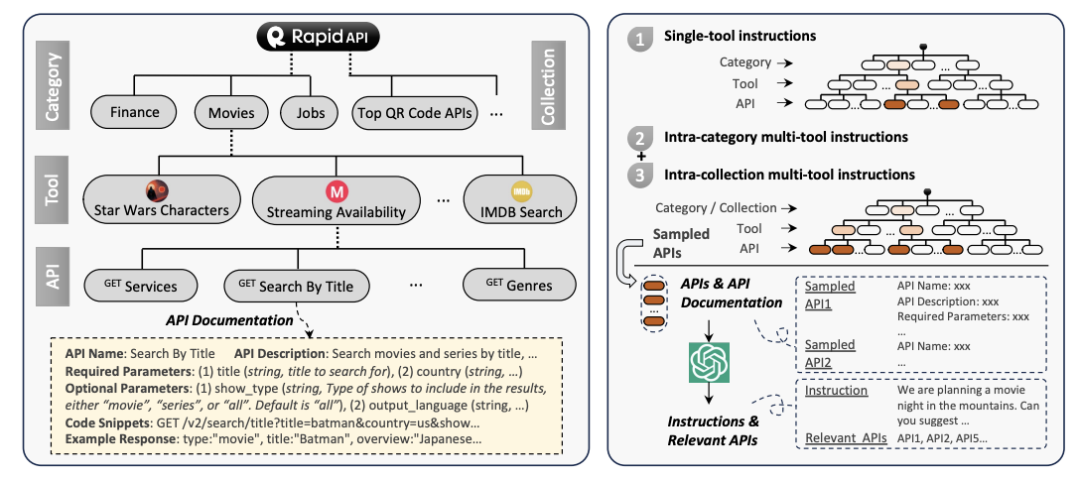
ToolLLM: Expanding to 16000+ Real-World APIs for LLMs
I. Constructing ToolBench:
Collect 16,464 real-world RESTful APIs spanning 49 categories (e.g., social media, e-commerce, weather, etc.) from RapidAPI Hub.
The hierarchy of RapidAPI is shown in the left here.
ToolLLM [Qin et al, 2023]

Slide 36
ToolLLM: Expanding to 16000+ Real-World APIs for LLMs
I. Constructing ToolBench:
Collect 16,464 real-world RESTful APIs spanning 49 categories (e.g., social media, e-commerce, weather, etc.) from RapidAPI Hub.
Prompt ChatGPT to generate diverse human instructions involving these APIs, covering both single-tool and multi-tool scenarios. This enables scenarios encompassing more complex planning and reasoning.
The hierarchy of RapidAPI is shown in the left here.
The instruction generation process is shown in the right here.
ToolLLM [Qin et al, 2023]

Slide 37
ToolLLM: Expanding to 16000+ Real-World APIs for LLMs
II. From Data Construction to Train & Inference:
ToolLLM [Qin et al, 2023]

Slide 38
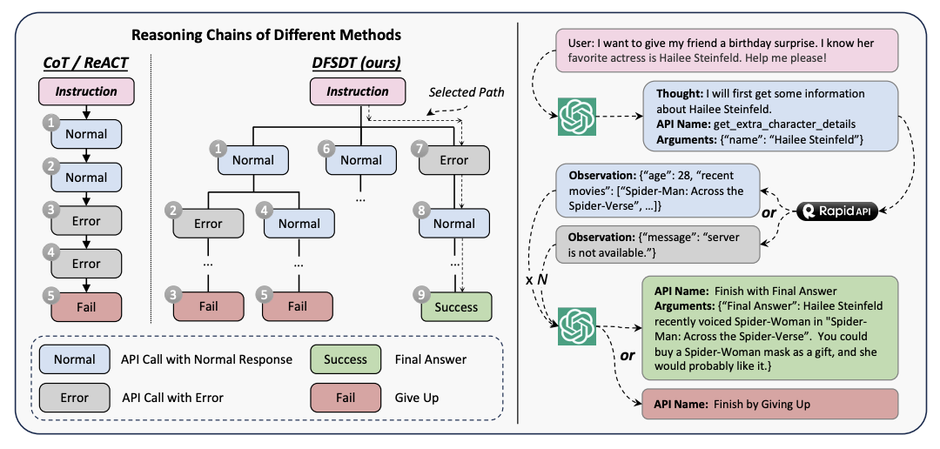
ToolLLM: Expanding to 16000+ Real-World APIs for LLMs
II. From Data Construction to Train & Inference:
Fine-tune LLaMA on ToolBench, via a novel depth-first search-
based decision tree approach for solution path finding, to
obtain ToolLLaMA.
ToolLLM [Qin et al, 2023]

Slide 39
ToolLLM: Expanding to 16000+ Real-World APIs for LLMs
II. From Data Construction to Train & Inference:
Fine-tune LLaMA on ToolBench, via a novel depth-first search-
based decision tree approach for solution path finding, to
obtain ToolLLaMA.
During inference of an instruction, the API retriever
recommends relevant APIs to ToolLLaMA, which performs
multiple rounds of API calls to derive the final answer.
ToolLLM [Qin et al, 2023]

Slide 40
ToolLLM: Expanding to 16000+ Real-World APIs for LLMs
II. From Data Construction to Train & Inference:
Fine-tune LLaMA on ToolBench, via a novel depth-first search-
based decision tree approach for solution path finding, to
obtain ToolLLaMA.
During inference of an instruction, the API retriever
recommends relevant APIs to ToolLLaMA, which performs
multiple rounds of API calls to derive the final answer.
Evaluate the whole reasoning process by ToolEval w.r.t. to
pass rate & win rate, and found that ToolLLaMA achieves higher
pass rate & win rate than GPT-4.
ToolLLM [Qin et al, 2023]

Slide 41
ToolkenGPT: Tool Embeddings on Frozen LLMs
In-context learning on module planning may perform sub-optimally when there are numerous tools to choose from and when only a few demonstration examples can fit within the input context window.
Besides finetuning a LLM backbone on tool usage, a light-weight alternative is to represent each tool as a token and learn an embedding for it, enabling tool calls in the same way as generating a regular word token.
V bv
V bv
ToolkenGPT: Augmenting Frozen Language Models with Massive Tools via Tool Embeddings [Hao et al., 2023]

Slide 42
ToolkenGPT: Tool Embeddings on Frozen LLMs
In-context learning on module planning may perform sub-optimally when there are numerous tools to choose from and when only a few demonstration examples can fit within the input context window.
Besides finetuning a LLM backbone on tool usage, a light-weight alternative is to represent each tool as a token and learn an embedding for it, enabling tool calls in the same way as generating a regular word token.
V bv
V bv
V bv
ToolkenGPT: Augmenting Frozen Language Models with Massive Tools via Tool Embeddings [Hao et al., 2023]

Slide 43
ToolkenGPT: Tool Embeddings on Frozen LLMs
In-context learning on module planning may perform sub-optimally when there are numerous tools to choose from and when only a few demonstration examples can fit within the input context window.
Besides finetuning a LLM backbone on tool usage, a light-weight alternative is to represent each tool as a token and learn an embedding for it, enabling tool calls in the same way as generating a regular word token.
V bv
V bv
V bv
V bv
V bv
ToolkenGPT: Augmenting Frozen Language Models with Massive Tools via Tool Embeddings [Hao et al., 2023]

Slide 44
ToolkenGPT: Tool Embeddings on Frozen LLMs
In-context learning on module planning may perform sub-optimally when there are numerous tools to choose from and when only a few demonstration examples can fit within the input context window.
Besides finetuning a LLM backbone on tool usage, a light-weight alternative is to represent each tool as a token and learn an embedding for it, enabling tool calls in the same way as generating a regular word token.
ToolkenGPT: Augmenting Frozen Language Models with Massive Tools via Tool Embeddings [Hao et al., 2023]

Slide 45
Outline
Background Motivation
Tool Learning Framework Overview
Recent Research Trends in Scaling LLM Tool Usage Capability Effectively & Efficiently
Benchmarks and Resources Summarization
⭐

Slide 46
Current Benchmarks & Data Resources in this Domain
(Qin et al., 2023)
Table borrowed from [Qin et al, 2023]

Slide 47
Current Benchmarks & Data Resources in this Domain
 | Overview | SOTA Method on It | Reference
ToolBench | An instruction-tuning dataset for tool use, created automatically using ChatGPT | ToolLLaMA | [Qin et al., 2023]
APIBench | Consists of HuggingFace, TorchHub, and TensorHub APIs | Gorilla, finetuned from LLaMa | [Patil et al., 2023]
API-Bank | Includes 53 commonly used API tools, a complete Tool-Augmented LLM workflow, and 264 annotated dialogues that encompass a total of 568 API calls.
WebShop |  | BOLAA, a framework that employs a controller to orchestrate multiple LAAs | [Yao et al., 2022]
Others

