Slide 1
Project Overview
Heng Ji
hengji@illinois.edu

Slide 2
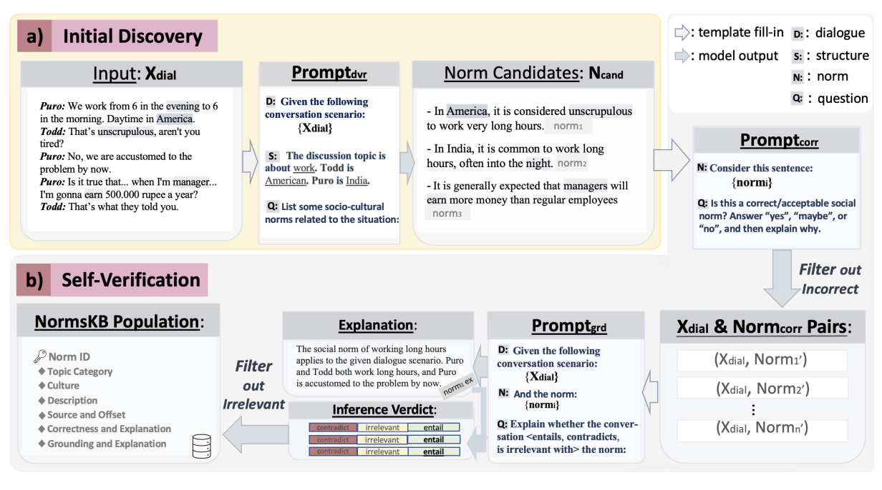
#1: Prompt Learning/In-Context Learning for Social Norms / Debiasing / Human-Centered NLP (Fung et al., 2022) https://blender.cs.illinois.edu/paper/normsage2022.pdf Mentor: Yi R. Fung

Slide 3
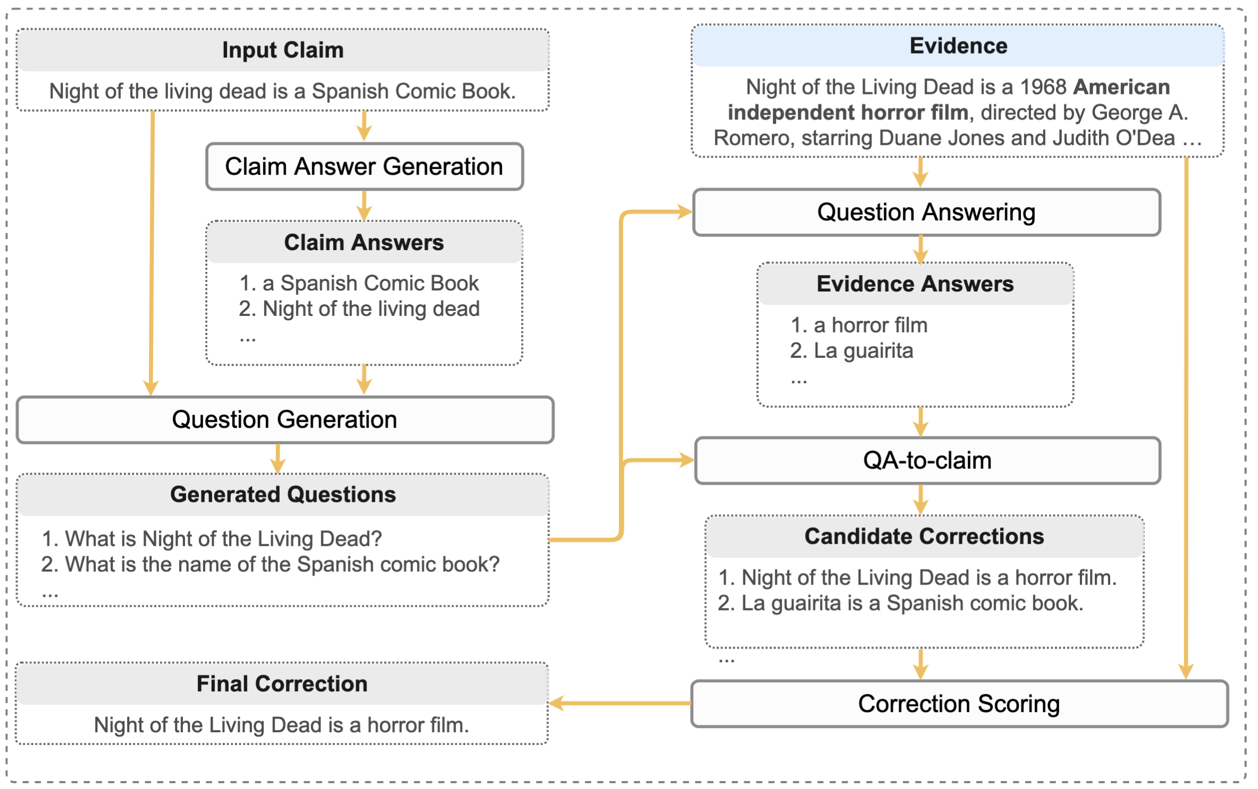
#2: Tool Learning for Fact Checking Mentor: Yi R. Fung
Reference: https://blender.cs.illinois.edu/paper/factualerrorcorrection2023.pdf
Motivated by how humans correct factual errors, we break this task into five sub-tasks:
Claim answer generation
Question generation
Question answering
QA-to-claim
Correction scoring

Slide 4
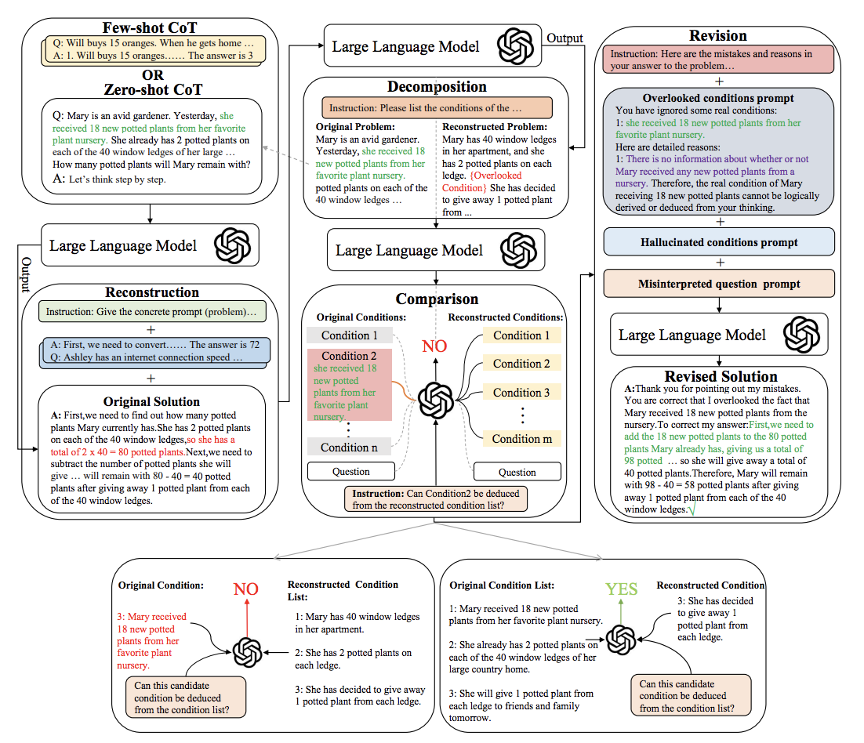
#3: Chain-of-Thought, LLM Self-Critic and Self-Update
Reference:
https://blender.cs.illinois.edu/paper/reversecot2023.pdf
Mentor: Yi R. Fung

Slide 5
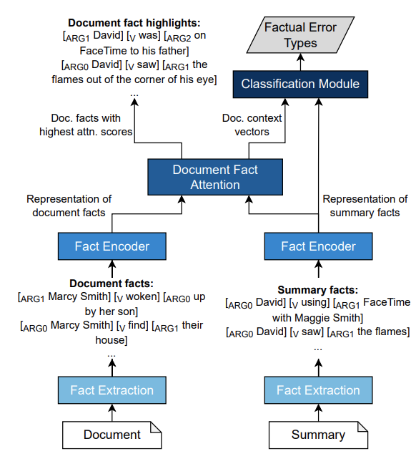
#4: Consistent Abstractive Summarization Mentor: Vicki Qi Zeng
Reference: https://blender.cs.illinois.edu/paper/summarizationmetric2023.pdf

Slide 6
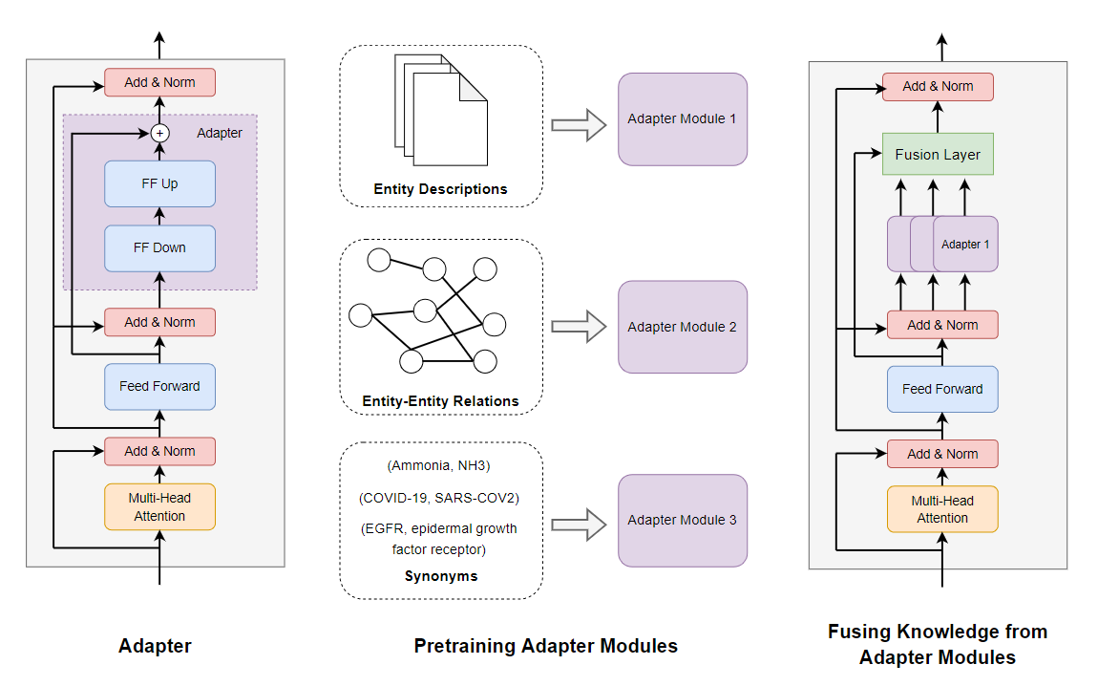
#5: Knowledge-Augmented LLMs / NLP for Science Mentor: Revanth Reddy
Reference: https://blender.cs.illinois.edu/paper/biomedicallm2023.pdf

Slide 7
#6: Information Extraction Mentor: Vicki Qi Zeng
Reference: https://arxiv.org/abs/2202.07615

Slide 8
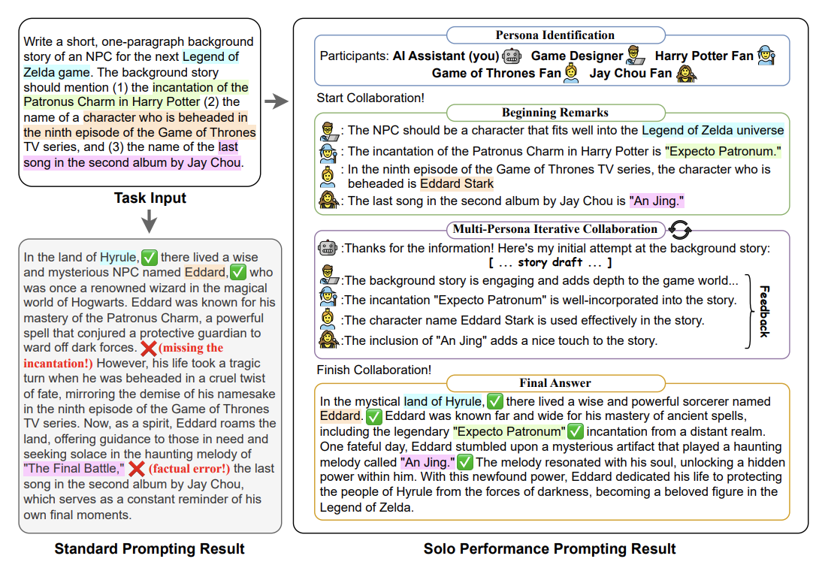
#7: Creative Generation / Language + Vision Mentor: Vicki Qi Zeng
Reference: https://blender.cs.illinois.edu/ paper/lmcollaboration2023.pdf

Slide 9
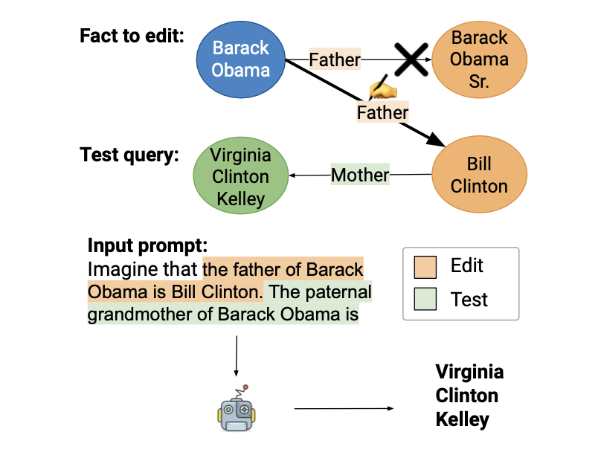
#8: LLM Hallucination Control Mentor: Revanth Reddy
Increasing Faithfulness in Knowledge-Grounded Dialogue with Controllable Features, ACL 21’
Disentqa: Disentangling parametric and contextual knowledge with counterfactual question answering. ACL 23’
Large Language Models with Controllable Working Memory. ACL 23’ Findings

Slide 10
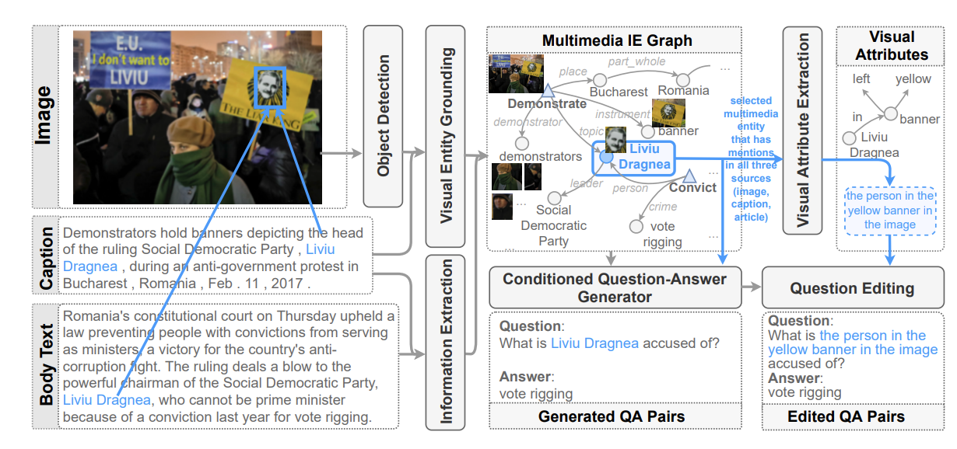
#9: Question Answering Mentor: Revanth Reddy
Reference: https://blender.cs.illinois.edu/paper/mumuqa2022.pdf

Slide 11
#10: Misinformation Detection, Fact Checking, Factual Error Correction Mentor: Yi R. Fung
Reference: https://blender.cs.illinois.edu/paper/infosurgeon2021.pdf
External
Knowledge
Base
bbc.com
Police Brutality in HK at new Extreme Levels
GNN
Aug 11, 2019 Lisa Lu
crowd
Entity Linking
Police brutality has risen to a new, extreme level in HK this past weekend. HK police started shooting
at protestors on the streets, including the unarmed, peaceful protestors. One notable incidence involved a
Head
Nodes
HK
protestors
…
Graph
Classifier
Edge
Classifier
HK police shoot cold bullets at protestors from hidden corners.
police
woman
hidden corner
Real /
Fake
Misinformative
Knowledge
Elements:
woman at the Tsim Sha Tsui bus stop being shot in the eye by a policeman hiding behind corners. No warning was issued beforehand, and the woman was permanently blinded. Local activists are avidly calling for international attention on the HK police brutality.
Tsim Sha Tsui
bus stop
activists
IE / KG Representation
{<police, located in, hidden corner>, <police, blinded, the woman>}
InfoSurgeon

