Slide 1
In-Context Learning
Heng Ji
hengji@illinois.edu

Slide 2
2
Notes:
Change low resource IL to a language which is not in wikipedia
Word-level: from bi-lingual dicts and alignment; structure-level comes from wals; multi-level alignment

Slide 3
3
Notes:
Change low resource IL to a language which is not in wikipedia
Word-level: from bi-lingual dicts and alignment; structure-level comes from wals; multi-level alignment

Slide 4
4
Notes:
Change low resource IL to a language which is not in wikipedia
Word-level: from bi-lingual dicts and alignment; structure-level comes from wals; multi-level alignment

Slide 5
5
Notes:
Change low resource IL to a language which is not in wikipedia
Word-level: from bi-lingual dicts and alignment; structure-level comes from wals; multi-level alignment

Slide 6
6
Notes:
Change low resource IL to a language which is not in wikipedia
Word-level: from bi-lingual dicts and alignment; structure-level comes from wals; multi-level alignment

Slide 7
Ground Truth Matters Little [Min et al., 2022]

Slide 8
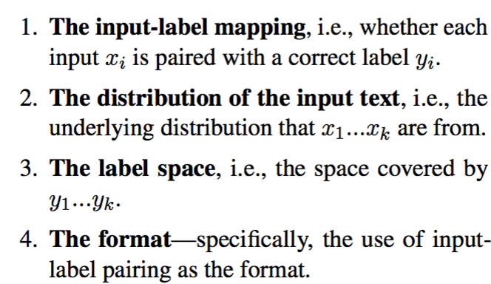
What Matters? [Min et al., 2022]

Slide 9
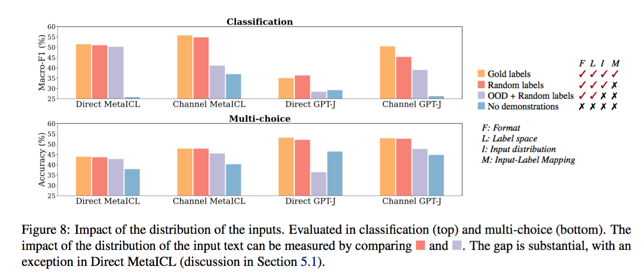
What Matters? [Min et al., 2022]

Slide 10
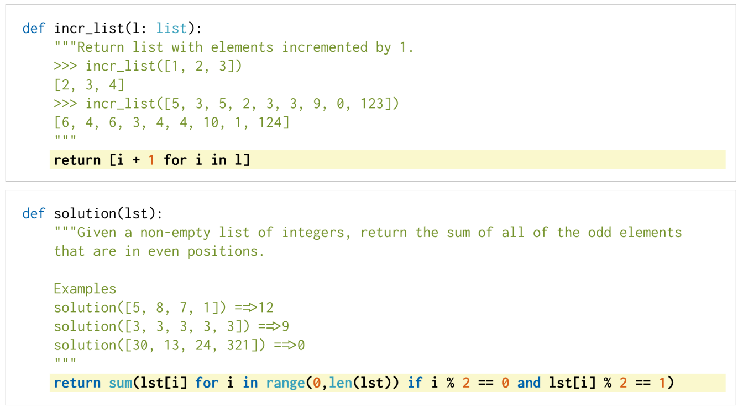
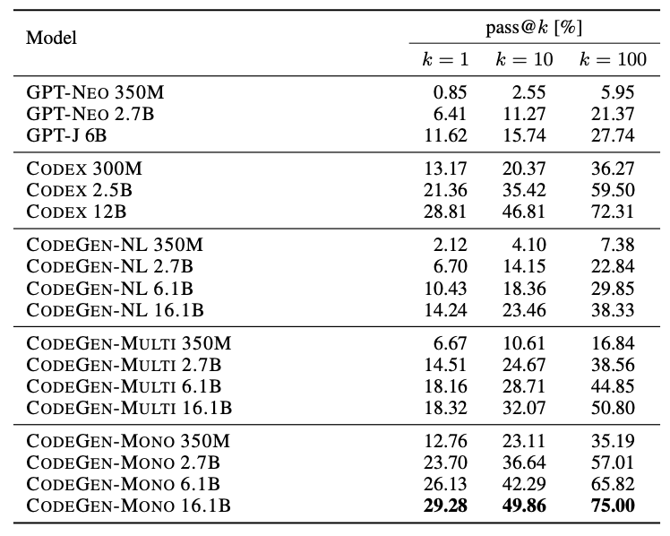
In-Context Learning via Programming Language Models
Large Language Model (LLM) trained on both code and text can already generate structured code to solve coding exercises specified in natural language (e.g., 75% on HumanEval Benchmark)
Example of coding problems in HumanEval Benchmark
Chen, Mark, et al. "Evaluating large language models trained on code." arXiv preprint arXiv:2107.03374 (2021).
HumanEval Performance
Nijkamp, Erik, et al. "A conversational paradigm for program synthesis." arXiv preprint arXiv:2203.13474 (2022).

Slide 11
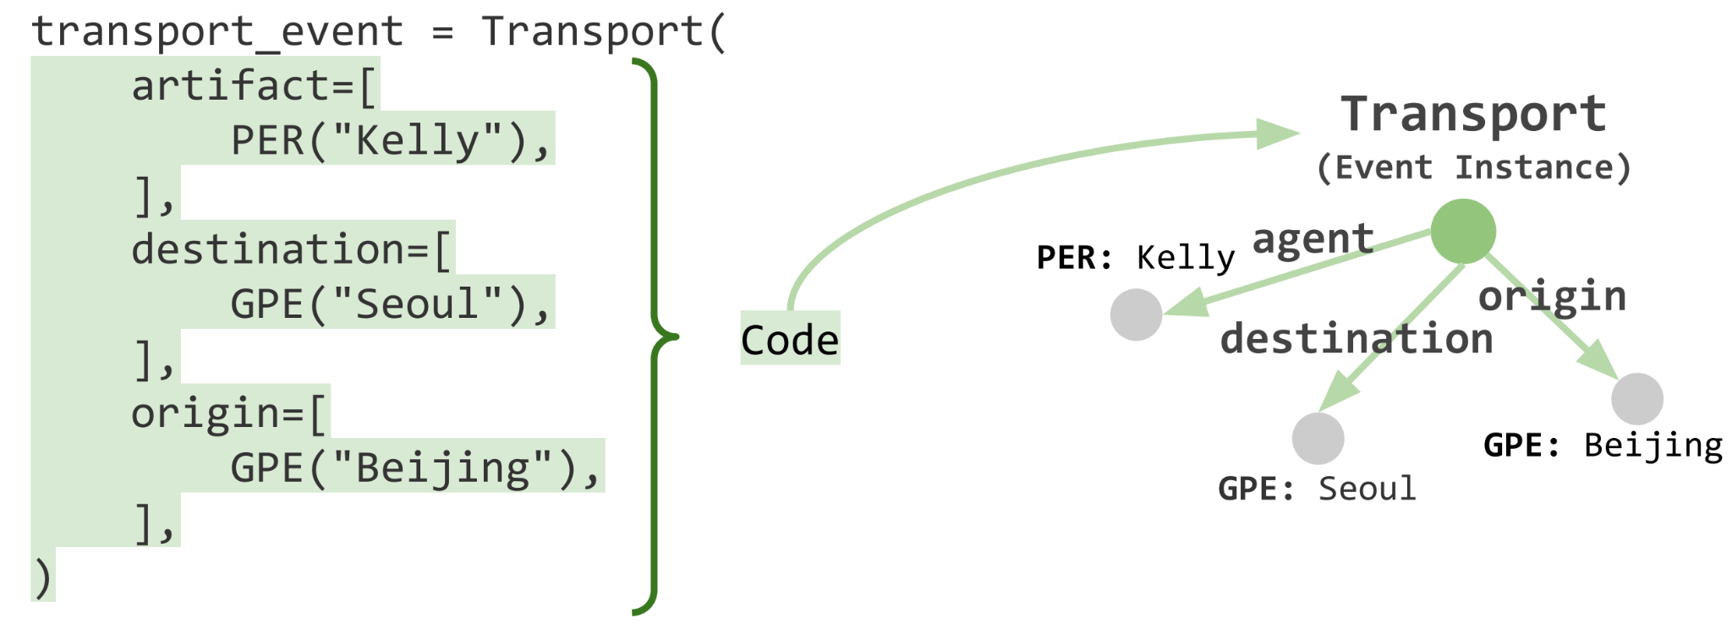
They also Fit into Structured Prediction Tasks better than natural language LMs: Case Study on Event Argument Extraction [Wang et al., ACL2023]
Insight: Leverage such text-to-code capability of LLM to solve structured prediction problems in NLP

Slide 12
Task Overview
Notes:
We convert the existing event type ontology to PYTHON class definitions.
Conditioned on these definitions, we put the input sentence for event extraction into a docstring as the prompt for code generation.
The generated code (colored in green) can be mapped to an instance graph of Transport event.

Slide 13
Task Overview (Cont’d)
We convert the existing event type ontology to PYTHON class definitions.
Notes:
We convert the existing event type ontology to PYTHON class definitions.
Conditioned on these definitions, we put the input sentence for event extraction into a docstring as the prompt for code generation.
The generated code (colored in green) can be mapped to an instance graph of Transport event.

Slide 14
Task Overview (Cont’d)
We convert the existing event type ontology to PYTHON class definitions.
Conditioned on these definitions, we put the input sentence for event extraction into a docstring as the prompt for code generation.
The generated code (colored in green) can be mapped to an instance graph of Transport event.
Notes:
We convert the existing event type ontology to PYTHON class definitions.
Conditioned on these definitions, we put the input sentence for event extraction into a docstring as the prompt for code generation.
The generated code (colored in green) can be mapped to an instance graph of Transport event.

Slide 15
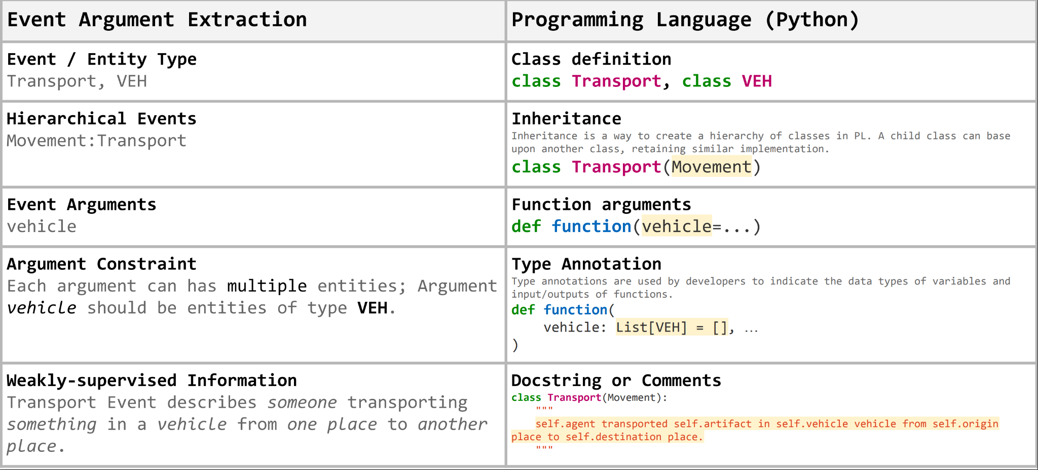
Mapping Between Event Argument Extraction and Programming Language
We can use Inheritance to represent hierarchical event relationships
We can also leverage type annotation to annotate the entity types accepted for each argument

Slide 16
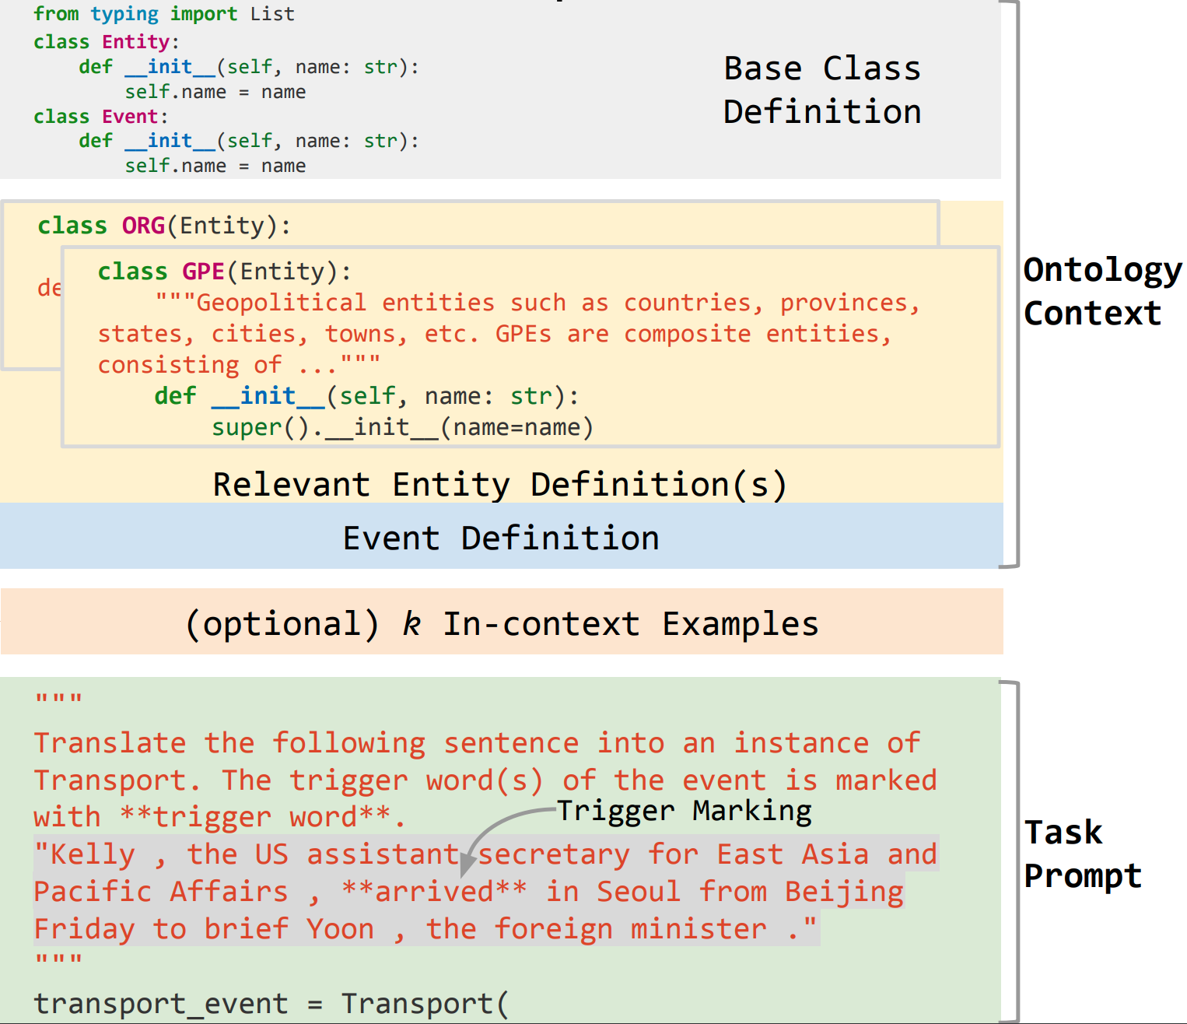
How to Prompt LLM for EAE?
Each prompt has 3 components:
(1) Ontology context;
(2) K-shot examples for in-context learning
(3) Task prompt
Notes:
(1) Ontology code context contains definitions of entity and event classes, colored in yellow and blue (§2.1)
(2) K-shot examples for in-context learning, colored in orange (§2.3).
(3) The task prompt, appended at the end with partial class instantiation for LLM completion, colored in green (§2.2).

Slide 17
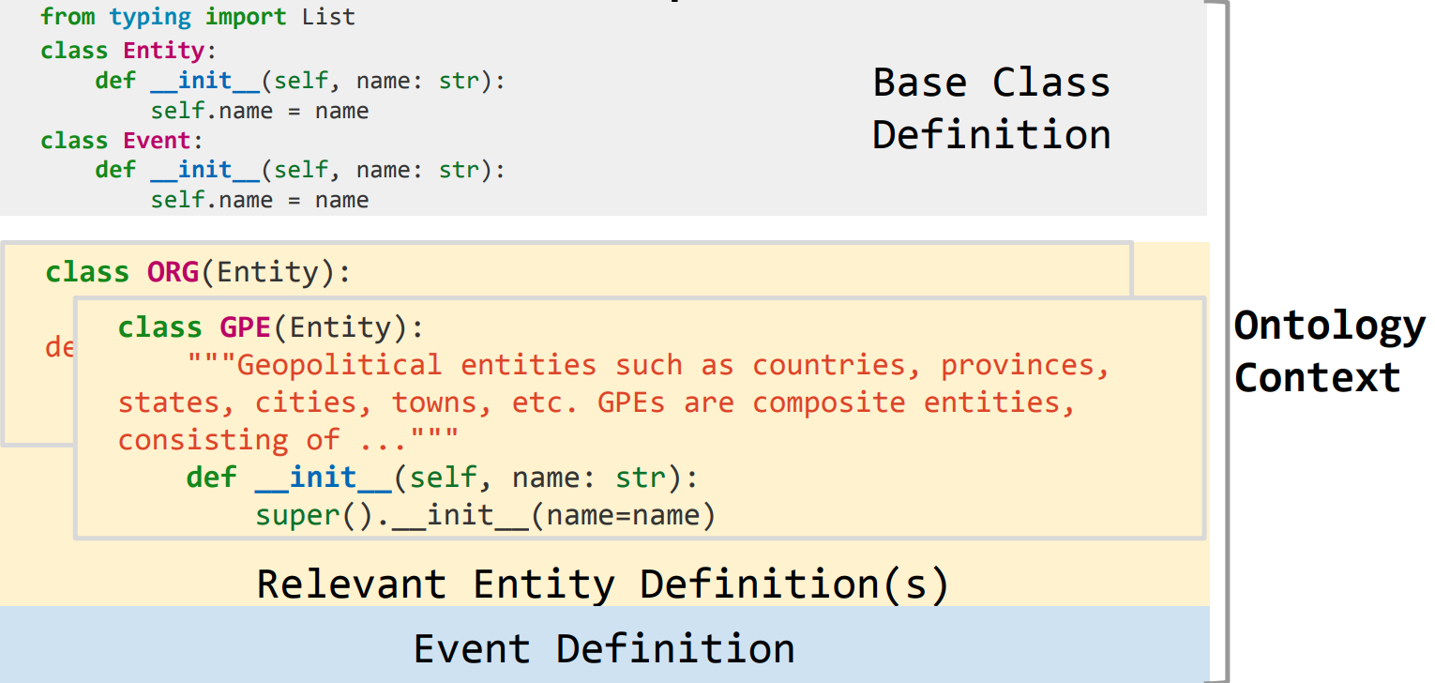
How to Prompt LLM for EAE? (Cont’d)
(1) Ontology context consists of:
Base Class Definition
Entity Class Definition
Event Class Definition
Notes:
(1) Ontology code context contains definitions of entity and event classes, colored in yellow and blue (§2.1)
(2) K-shot examples for in-context learning, colored in orange (§2.3).
(3) The task prompt, appended at the end with partial class instantiation for LLM completion, colored in green (§2.2).

Slide 18
How to Prompt LLM for EAE? (Cont’d)
(1) Ontology context
Base Class Definition
Following conventions in Object-Oriented Programming (OOP), we first define base type Entity and Event to be inherited by other classes for distinction.
Notes:
(1) Ontology code context contains definitions of entity and event classes, colored in yellow and blue (§2.1)
(2) K-shot examples for in-context learning, colored in orange (§2.3).
(3) The task prompt, appended at the end with partial class instantiation for LLM completion, colored in green (§2.2).

Slide 19
How to Prompt LLM for EAE? (Cont’d)
(1) Ontology context
Base Class Definition
Entity Class Definition
Use entity type definitions from the Automatic Content Extraction (ACE) program.
Construct Python classes that inherit from Entity (i.e., a base entity class) and use the entity type as class name (e.g., class GPE(Entity)).
Add a natural language description as a docstring of the defined Class for each entity type.
Only include entities that are later used by event definitions in the prompt.
Notes:
(1) Ontology code context contains definitions of entity and event classes, colored in yellow and blue (§2.1)
(2) K-shot examples for in-context learning, colored in orange (§2.3).
(3) The task prompt, appended at the end with partial class instantiation for LLM completion, colored in green (§2.2).

Slide 20
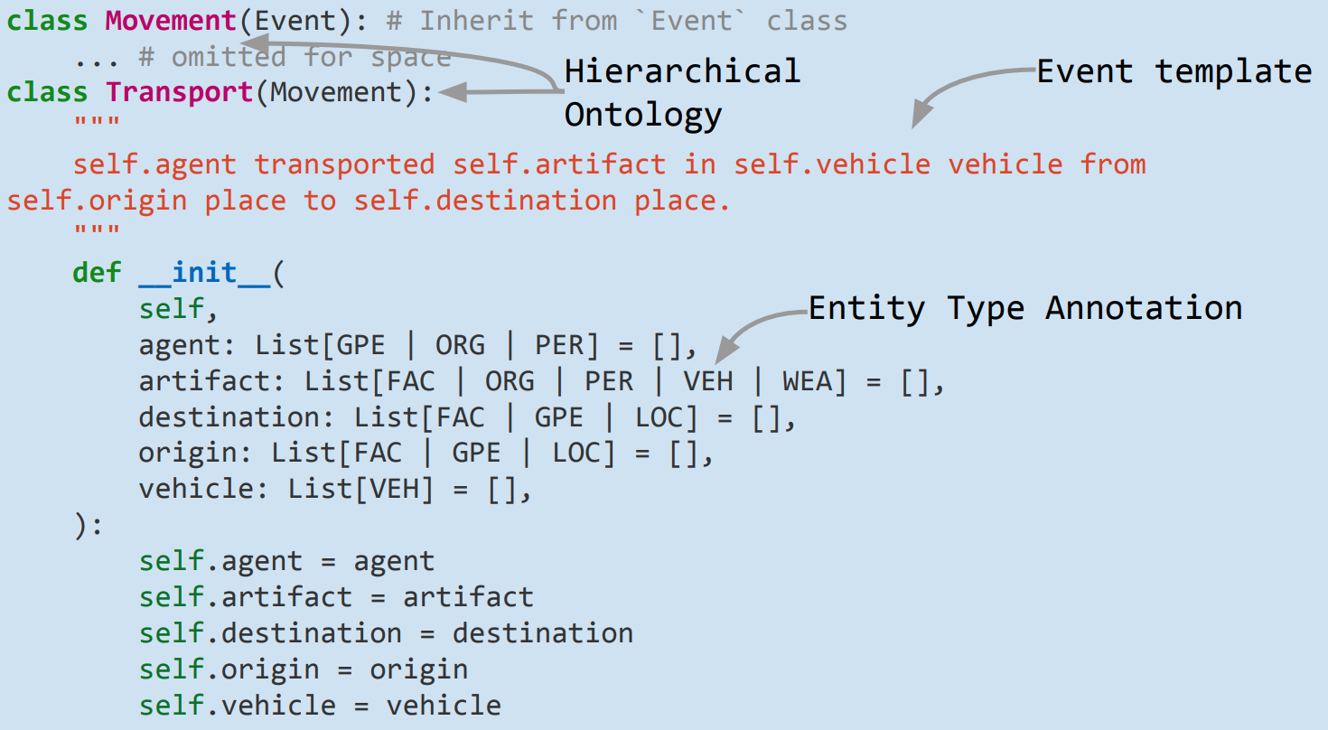
How to Prompt LLM for EAE? (Cont’d)
(1) Ontology context
Base Class Definition
Entity Class Definition
Event Class Definition
Inherit the event class definition from its parent or Event if the event class does not has a parent.
Include event description templates into a docstring of the class definition.
Define the argument roles (e.g., destination of Transport) as input arguments of the constructor function __init__.
Specify the entity type of each argument role using Python type annotation (e.g., agent: List[GPE | ORG |PER] )

Slide 21
How to Prompt LLM for EAE? (Cont’d)
(3) Task prompt
The task prompt consists of a docstring describing the task and an incomplete event instantiation code for completion.
The text-based docstring contains a task instruction and an input sentence. We mark the ground truth trigger words for the input text by surrounding them with **.
Notes:
We choose to use ** as it is used to set text to bold in Markdown (a markup language for creating formatted text), which is commonly found in code bases and web data on which our LLM is trained. The incomplete code prompt assigns a partial instantiation of an event class to a variable to trigger the model for completion, for example, transport_event = Transport(.
We observed that CODEX tends to generate more novel sentences paired with extracted arguments if no stopping constraint is applied. To focus on the EAE task, we stop the code generation whenever any of the pattern """, class, print, or # is generated by the model. We note that this capability to generate novel content (e.g., class definitions for new event types, new sentences paired with extracted arguments) has the potential to discover new event types and generate new training examples to enhance the model’s EAE performance.

Slide 22
How to Prompt LLM for EAE? (Cont’d)
(2) K-shot examples for in-context learning
Optionally, we can include in-context learning examples which are task prompts paired with completed event instantiations using ground-truth arguments.
For k-shot learning, we concatenate k such examples together.
Given a task prompt, we gather incontext learning examples by collecting training instances with the same event type, following the order of occurrences in the training set.

Slide 23
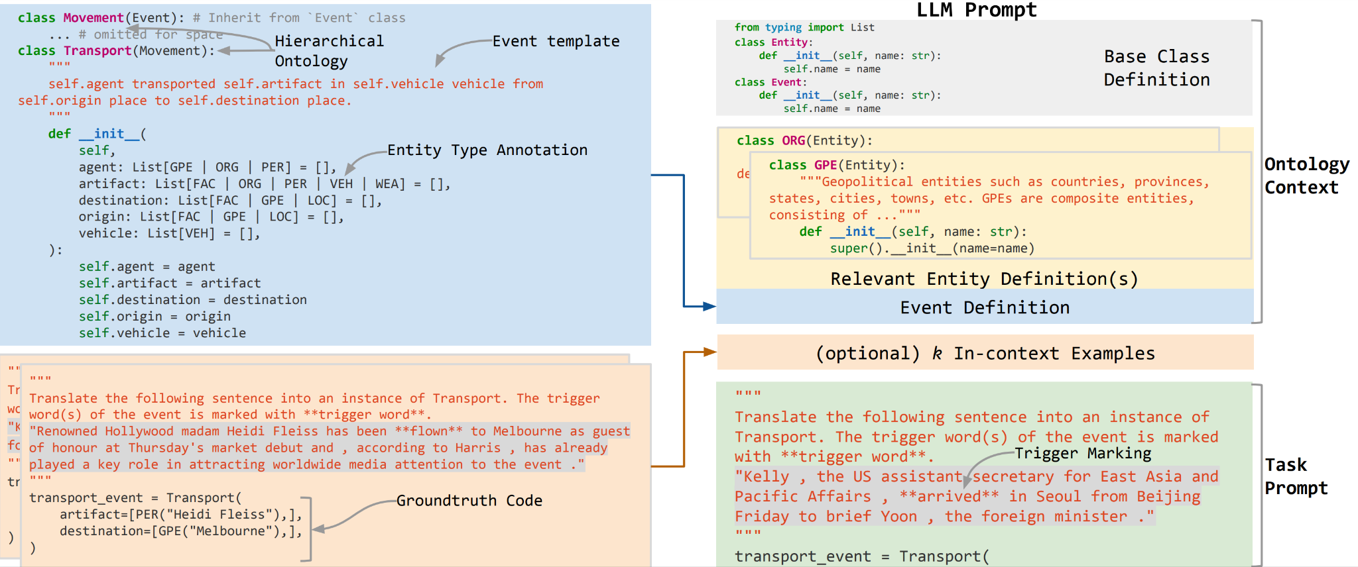
How to Prompt LLM for EAE? (Cont’d)
Putting them all together:

Slide 24
Experimental Setup
Choice of Large Language Model (LLM)
Use CODEX, a 12B GPT-3 model finetuned on publicly available code from Github.
Access CODEX through OpenAI API, which supports an input length of up to 8k tokens.
Compare with GPT-3 (text-davinci-002) through OpenAI API.
EAE Task Setup
We use ground truth event type and gold-standard trigger words to perform EAE.
We also evaluate our model’s performance on Entity Classification (e.g., predicts entity “Kelly” as a PER) for extracted arguments since our approach natively supports it
Notes:
\

Slide 25
Datasets and Metrics
Evaluate on the English subset of Automatic Content Extraction 2005 dataset (ACE05-E).
Metrics
Arg-I F1: Whether LLM can identify an argument correctly (e.g., Kelly, Seoul, Beijing)
Arg-C F1: Whether LLM can match correctly identified argument with a correct role (e.g. agent=Kelly)
Arg-C+E F1: Can LLM predict entity type for correctly identified and classified arguments? (e.g., agent=PER(Kelly) )
Notes:
\

Slide 26
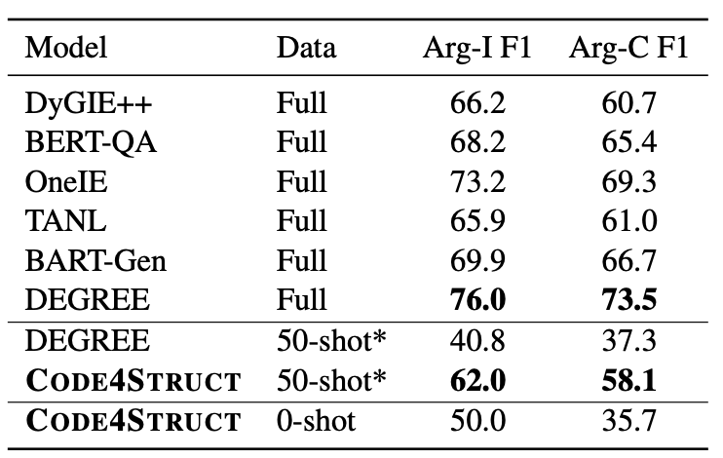
How does Code4Struct Perform on EAE?
Comparison with Supervised Method
50-shot Code4Struct rivals fully-supervised approaches trained on 4,202 instances of the training data
In 50-shot setting, it surpass current SOTA by a large margin (20.8% absolute F1 difference on Arg-C)
0-shot can already achieve higher Arg-I performance than 50-shot DEGREE
Notes:
In the few-shot setting, CODE4STRUCT can surpass DEGREE, the current state-of-the-art, by a large margin (20.8% absolute F1 difference on Arg-C).
Our zero-shot CODE4STRUCT model can already achieve higher Arg-I performance than the 50-shot DEGREE.
Despite only using 39 examples per event type on average, our approach achieves comparable performance with other fully supervised models trained on 100% of the training data (4,202 instances).

Slide 27
How does Code4Struct Perform on EAE? (Cont’d)
F1 scores increase with more in-context learning examples, but with diminishing returns.
The initial in-context example (k=1) contributes to the largest absolute performance gain (about 13 F1 in Arg-C).
We stop at 50 in-context examples (k = 50) as including more examples would exceed the input length limitation imposed by CODEX.
Notes:
We observe that F1 scores for all tasks increase when providing more in-context learning examples, but with diminishing returns.
The initial in-context example (k = 1) brings the largest absolute performance gain (about 13 F1 in Arg-C). We stop at 50 in-context examples (k = 50) as including more examples would exceed the input length limitation imposed by CODEX.

Slide 28
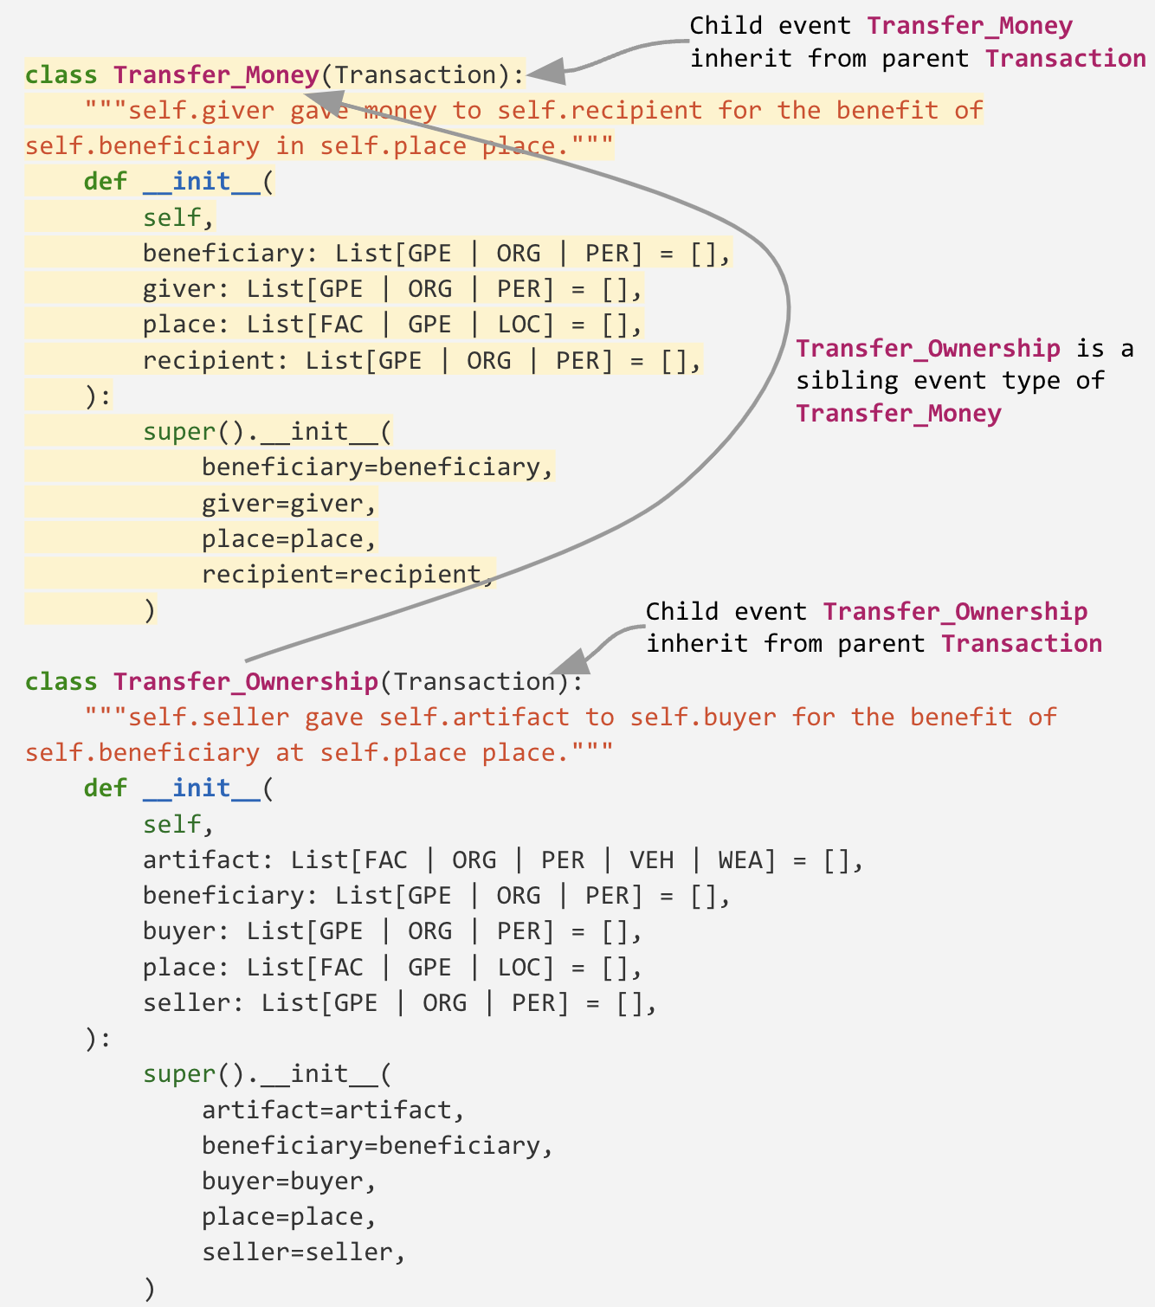
Cross-Sibling Transfer
Events are hierarchical. e.g., Transfer_Ownership and its sibling Transfer_Money are both child events of the same parent Transaction.
Experiments show we can improve the prediction of an event type (e.g., Transfer_Ownership) by using examples from a sibling event type (e.g., Transfer_Money) for in-context learning.
This allows low-resource event types that have no annotated data to exploit the event type hierarchy and benefit from their high-resource siblings.
Example of Hierarchical Event Definitions

Slide 29
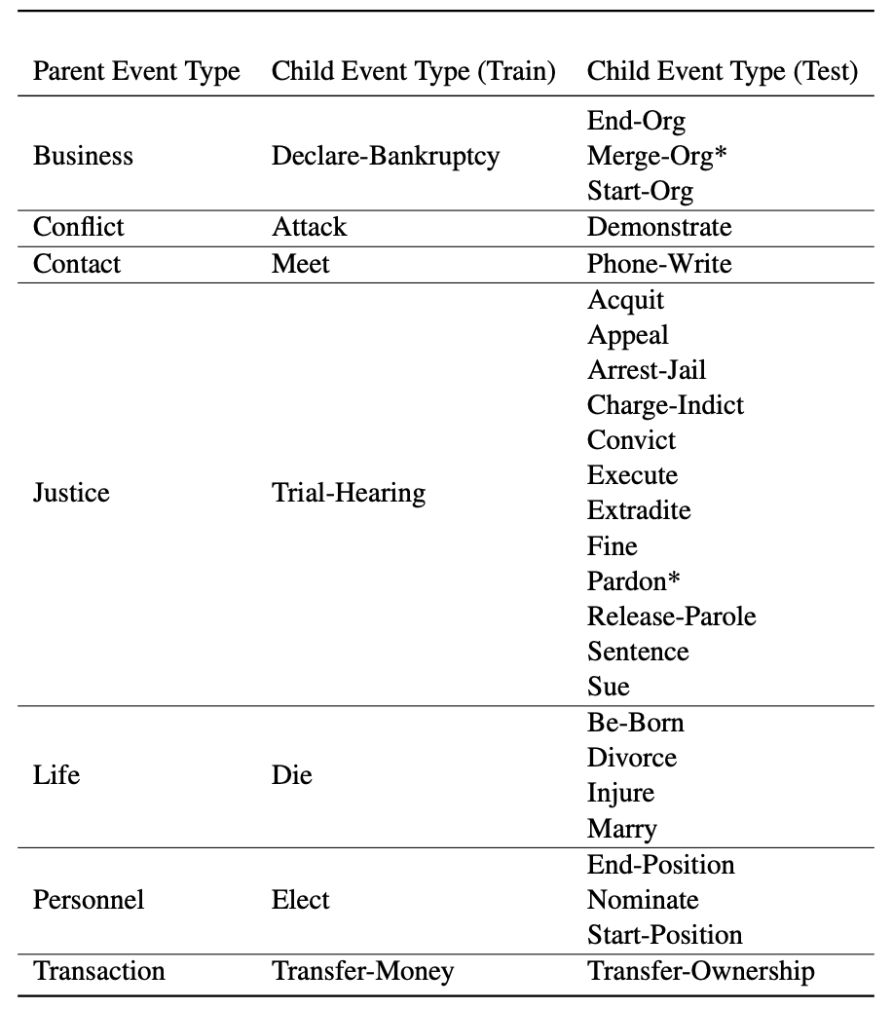
Cross-Sibling Transfer
Which sibling event types to use for in-context learning?
We split all child types under each parent type into:
one training type: a high-resource child event type with the largest amount of training instances
testing type(s): the rest of child event types (under the same parent)
For each testing type, we use annotated data from its corresponding training type for in-context learning.
Train/Test split for each parent event type.
* denotes child event types that do not have examples in the ACE05-E test set.

Slide 30
Cross-Sibling Transfer
How good is using sibling examples?
To demonstrate the effectiveness of using data from sibling event types, we compare it with using training instances from the testing event type itself for in-context learning.
To ensure a fair comparison, (micro) F1 scores are aggregated from 23 test event types (out of 25) that contains more than 10 training instances.
Train/Test split for each parent event type.
* denotes child event types that do not have examples in the ACE05-E test set.

Slide 31
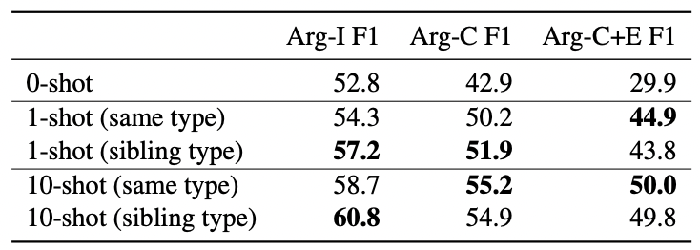
Cross-Sibling Transfer
Using sibling examples helps!
Using examples from a sibling event type (e.g., Transfer_Money) for in-context learning improves performance compared to 0-shot
Sibling examples are just as useful as annotated example from the predict event type!
Sibling event examples (e.g., Transfer_Money) perform on par with using examples from the predicted event type itself (e.g., Transfer_Ownership)
Notes:
Sibling event examples (e.g., Transfer_Money) perform on par with using examples from the predicted event type itself (e.g., Transfer_Ownership)

Slide 32
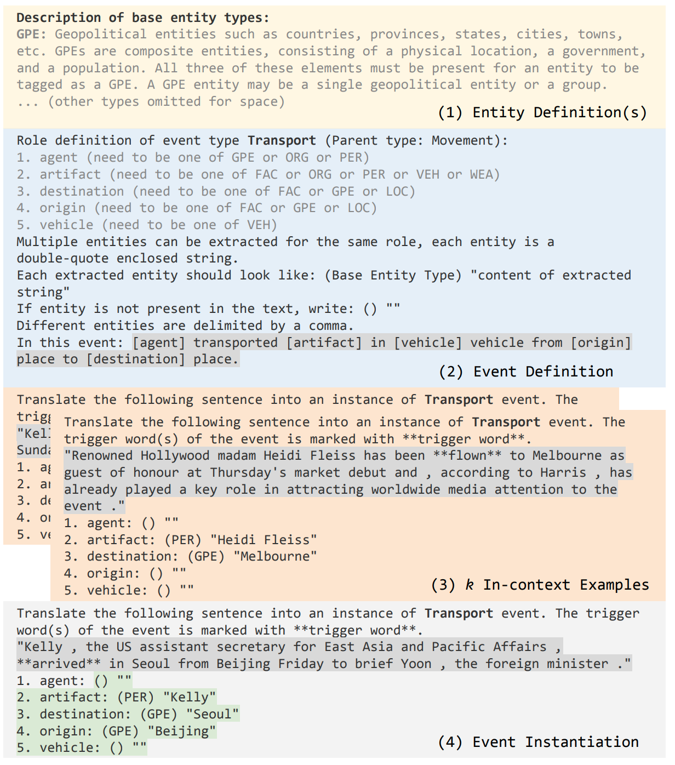
Is Code Prompt any better than Text Prompt?
To compare our code-based prompt with text-style GPT-3 prompt, we design a text prompt mimicking our code prompt.
The text prompt relies on natural language to define the requirement and format of the desired output, while the code prompt utilizes Programming Language syntax.
We compare the performance of text prompt and code prompt on GPT-3 (text-davinci-002) and Codex (code-davinci-002) through OpenAI API.
Notes:
Sibling event examples (e.g., Transfer_Money) perform on par with using examples from the predicted event type itself (e.g., Transfer_Ownership)

Slide 33
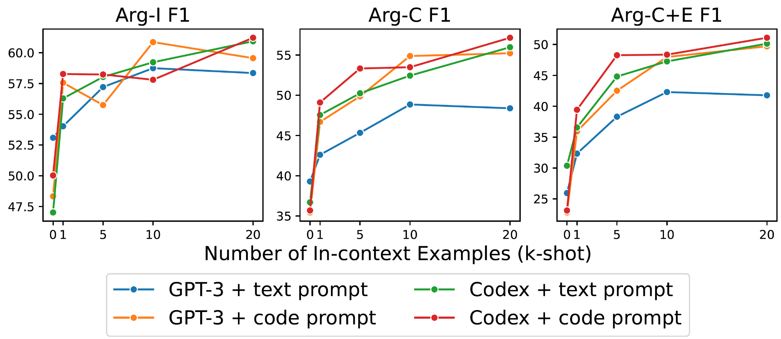
Is Code Prompt any better than Text Prompt? (Cont’d)
Our findings
(1) Codex + code outperforms all text prompts on Arg-C and Arg-C+E under few-shot settings. The performance gap is most significant on Arg-C F1 (8.7% absolute F1 difference when compared to GPT-3 + text prompt).
(2) Zero-shot code prompt underperforms text prompt on Arg-C for both Codex and GPT-3.
(3) GPT-3 + code prompt quickly catch-up with Codex + code prompt performance given adequate training examples.
Notes:
Sibling event examples (e.g., Transfer_Money) perform on par with using examples from the predicted event type itself (e.g., Transfer_Ownership)

Slide 34
Is Code Prompt any better than Text Prompt? (Cont’d)
Compared to text, code could be a better way to represent structures
Interestingly, we observe a much smaller gap between Codex + code prompt and GPT-3 + text prompt on Arg-I compared to Arg-C.
That is, GPT-3 + text prompt can successfully identify an entity (e.g., Kelly) yet often fails to associate it to the corresponding role (e.g., agent=Kelly). This suggests that code is a better medium for representing relations between the event and arguments.
Notes:
Sibling event examples (e.g., Transfer_Money) perform on par with using examples from the predicted event type itself (e.g., Transfer_Ownership)

Slide 35
Is Code Prompt any better than Text Prompt? (Cont’d)
Pretraining on code also help text prompt
Pretraining on code can also grant the model the ability to handle relations better, as shown by the good performance of Codex + text prompt compared to GPT-3 + text prompt.

Slide 36
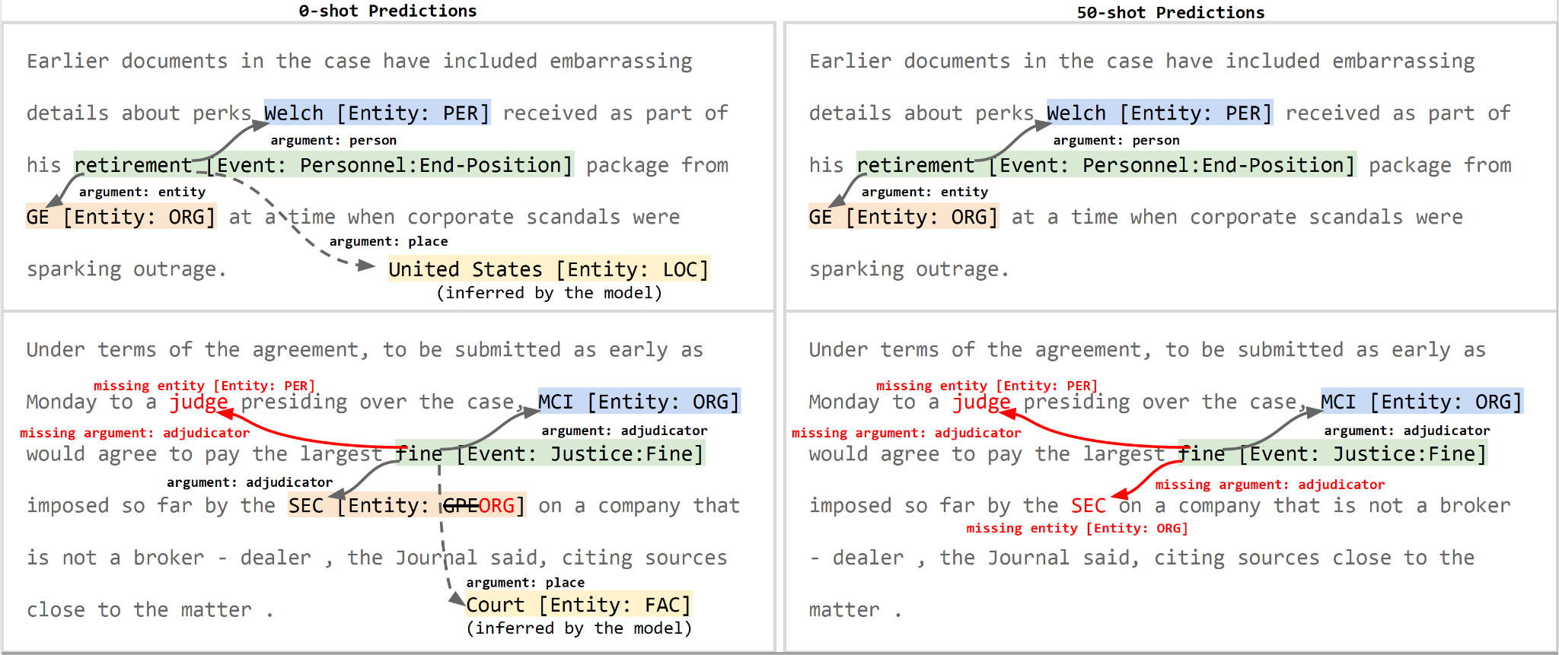
Qualitative Examples
Code-LLM can infer implicit entities that do not present in the text as an argument under zero-shot (e.g., United States, Court). It predicts fewer arguments when increased to 50-shot.
Codex inferred the place of Welch’s retirement is in the United States.
This is a reasonable guess since Welch, in this example, is the former CEO of General Electric (GE), whose headquarter is in the United States.

Slide 37
Qualitative Examples (Cont’d)
Code-LLM can infer implicit entities that do not present in the text as an argument under zero-shot (e.g., United States, Court). It predicts fewer arguments when increased to 50-shot.
Codex also inferred that the Justice:Fine event should take place in a court, which matches our commonsense knowledge.

Slide 38
Within-Class Exercises
Design In-Context Learning for New Tasks:
Name Tagging (person, organization, location)
Drug and Disease Relation Extraction
Personalized Product Recommendation
Math Problems

