Slide 1
Chain-of-Thought, LLM Self-Critic and Self-Update
Heng Ji
hengji@illinois.edu
Acknowledgement: some slides from Jesse Mu and Huan Sun

Slide 2
Basic Idea: Demonstrate Step-by-Step Reasoning [Wei et al., 2022]
2
Notes:
Change low resource IL to a language which is not in wikipedia
Word-level: from bi-lingual dicts and alignment; structure-level comes from wals; multi-level alignment

Slide 3
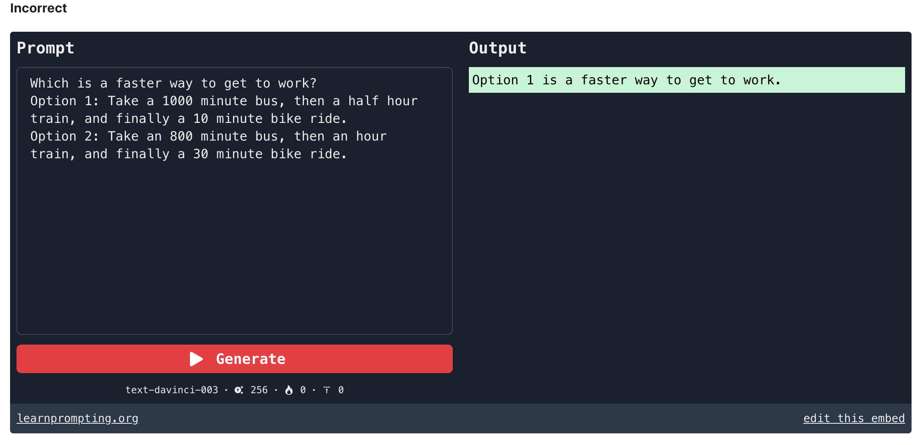
Math Reasoning
3
Notes:
Change low resource IL to a language which is not in wikipedia
Word-level: from bi-lingual dicts and alignment; structure-level comes from wals; multi-level alignment

Slide 4
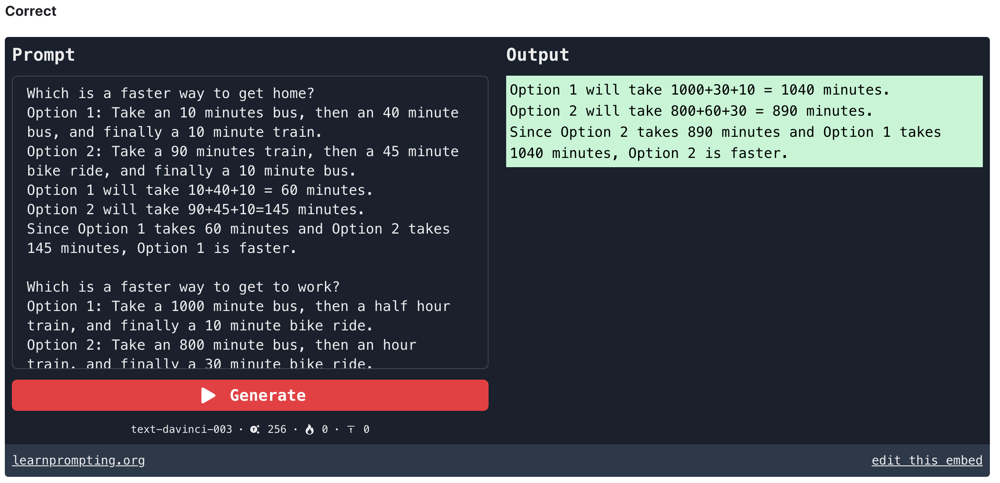
4
Notes:
Change low resource IL to a language which is not in wikipedia
Word-level: from bi-lingual dicts and alignment; structure-level comes from wals; multi-level alignment

Slide 5
Commonsense Reasoning
5
Notes:
Change low resource IL to a language which is not in wikipedia
Word-level: from bi-lingual dicts and alignment; structure-level comes from wals; multi-level alignment

Slide 6
6
Notes:
Change low resource IL to a language which is not in wikipedia
Word-level: from bi-lingual dicts and alignment; structure-level comes from wals; multi-level alignment

Slide 7
Zero-shot Chain-of-Thought Prompting
7
Notes:
Change low resource IL to a language which is not in wikipedia
Word-level: from bi-lingual dicts and alignment; structure-level comes from wals; multi-level alignment

Slide 8
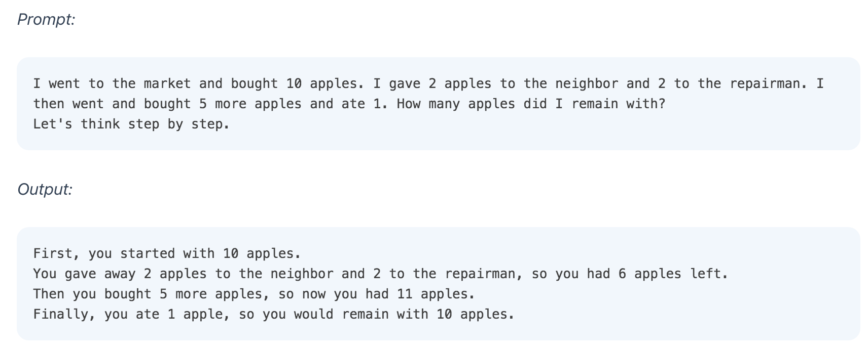
Zero-shot Chain-of-Thought Prompting
8
Notes:
Change low resource IL to a language which is not in wikipedia
Word-level: from bi-lingual dicts and alignment; structure-level comes from wals; multi-level alignment

Slide 9
9
Notes:
Change low resource IL to a language which is not in wikipedia
Word-level: from bi-lingual dicts and alignment; structure-level comes from wals; multi-level alignment

Slide 10
10
Notes:
Change low resource IL to a language which is not in wikipedia
Word-level: from bi-lingual dicts and alignment; structure-level comes from wals; multi-level alignment

Slide 11
11
Notes:
Change low resource IL to a language which is not in wikipedia
Word-level: from bi-lingual dicts and alignment; structure-level comes from wals; multi-level alignment

Slide 12
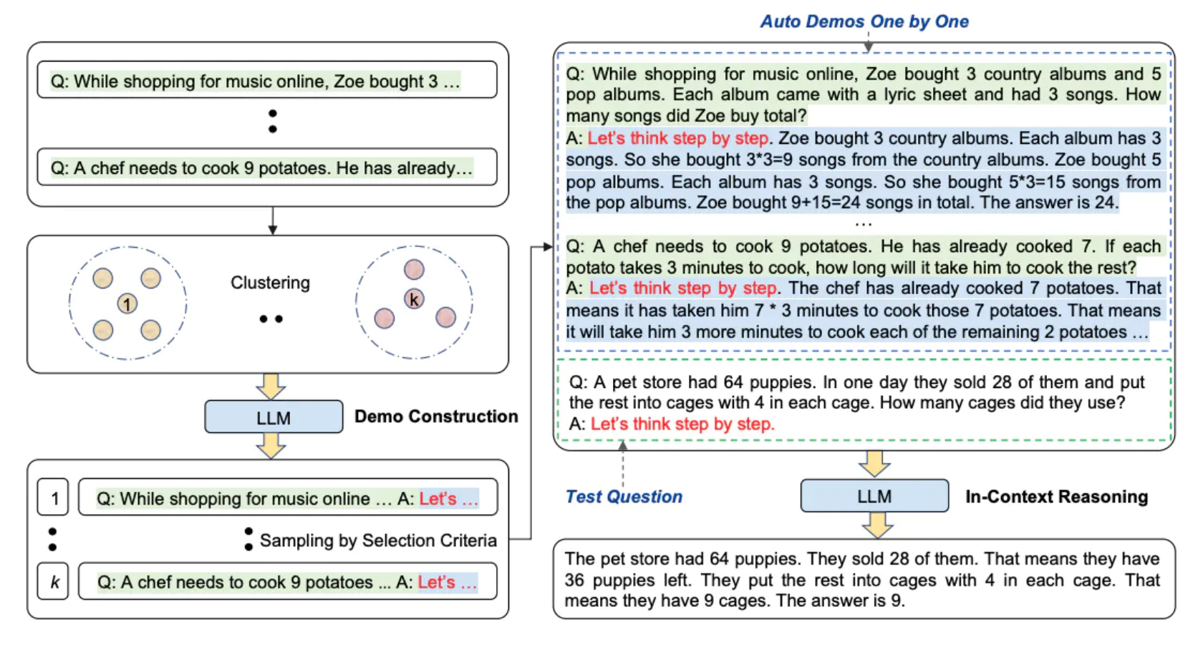
Automatic Chain-of-Thought [Zhang et al., 2022]
12
Notes:
Change low resource IL to a language which is not in wikipedia
Word-level: from bi-lingual dicts and alignment; structure-level comes from wals; multi-level alignment

Slide 13
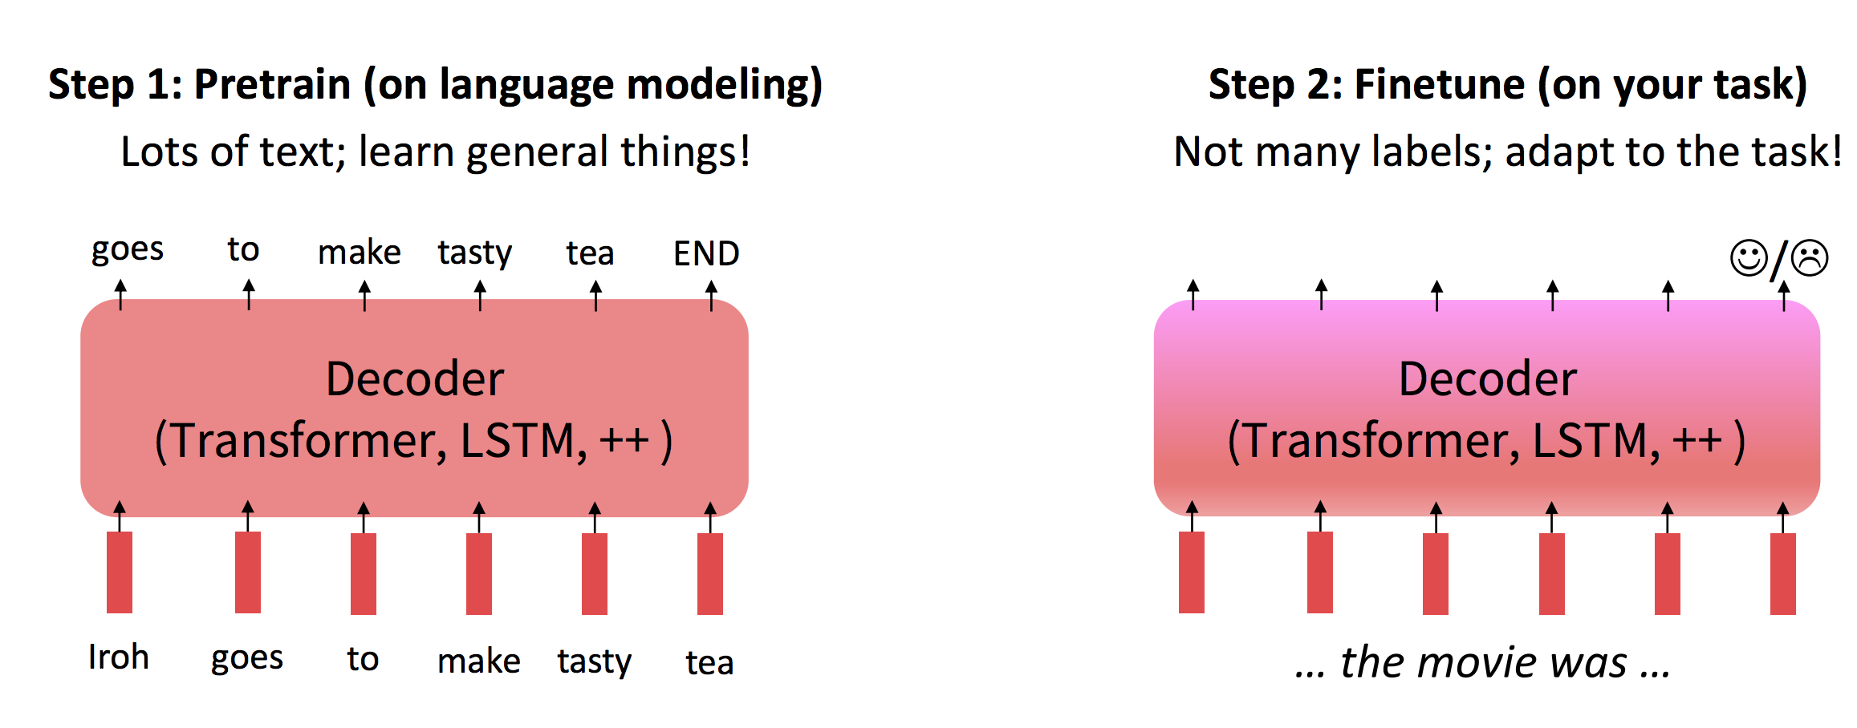
Recall: Fine-tuning
13
Notes:
Change low resource IL to a language which is not in wikipedia
Word-level: from bi-lingual dicts and alignment; structure-level comes from wals; multi-level alignment

Slide 14
14
Notes:
Change low resource IL to a language which is not in wikipedia
Word-level: from bi-lingual dicts and alignment; structure-level comes from wals; multi-level alignment

Slide 15
15
Notes:
Change low resource IL to a language which is not in wikipedia
Word-level: from bi-lingual dicts and alignment; structure-level comes from wals; multi-level alignment

Slide 16
16
Notes:
Change low resource IL to a language which is not in wikipedia
Word-level: from bi-lingual dicts and alignment; structure-level comes from wals; multi-level alignment

Slide 17
17
Notes:
Change low resource IL to a language which is not in wikipedia
Word-level: from bi-lingual dicts and alignment; structure-level comes from wals; multi-level alignment

Slide 18
18
Notes:
Change low resource IL to a language which is not in wikipedia
Word-level: from bi-lingual dicts and alignment; structure-level comes from wals; multi-level alignment

Slide 19
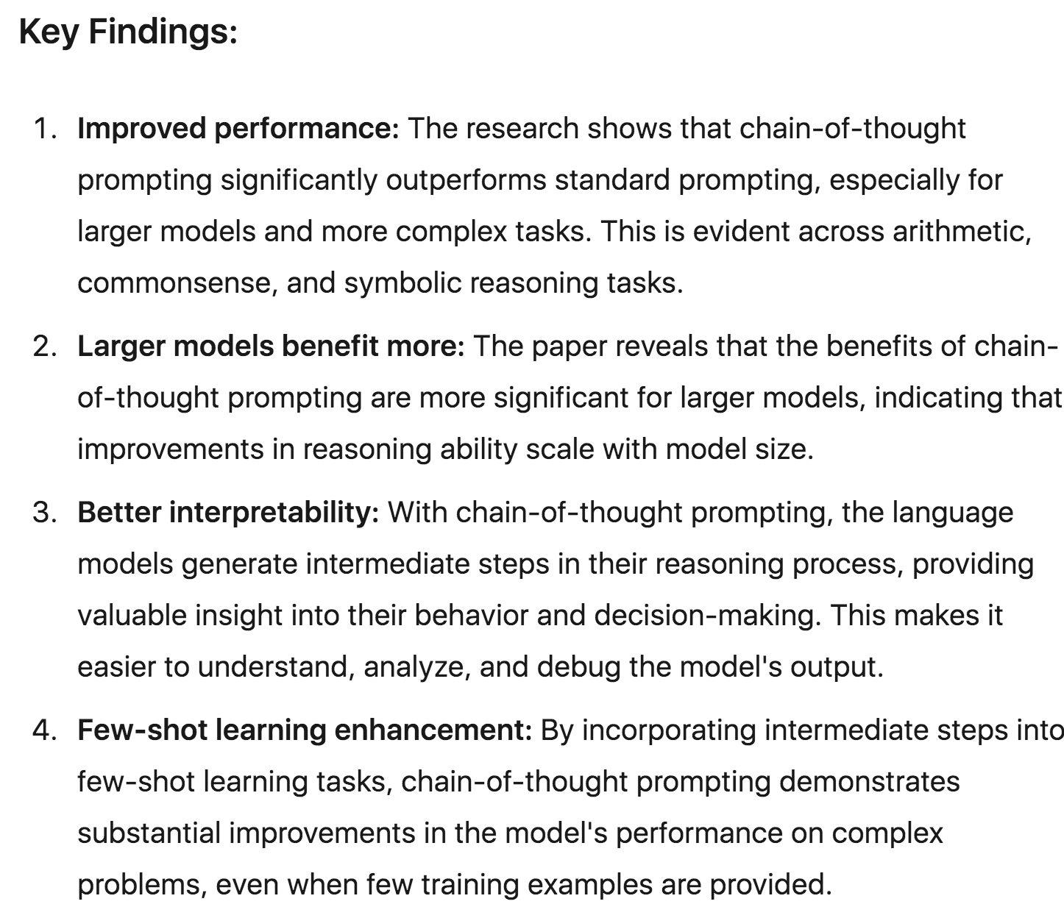
19
Notes:
Change low resource IL to a language which is not in wikipedia
Word-level: from bi-lingual dicts and alignment; structure-level comes from wals; multi-level alignment

Slide 20
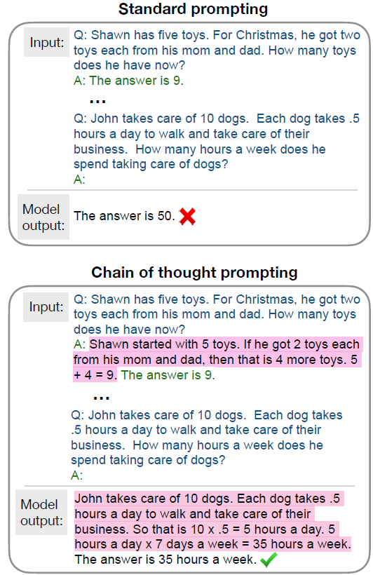
Towards Understanding Chain-of-Thought Prompting: An Empirical Study of What Matters (Min et al., ACL2023)
Standard prompting
query | answer
Chain-of-Thought (CoT) prompting
query | rationale, answer
improves large LMs on complex multi-step reasoning
“Emergent” ability from scaling
Wei et al. Chain-of-Thought Prompting Elicits Reasoning in Large Language Models. NeurIPS-22.

Slide 21
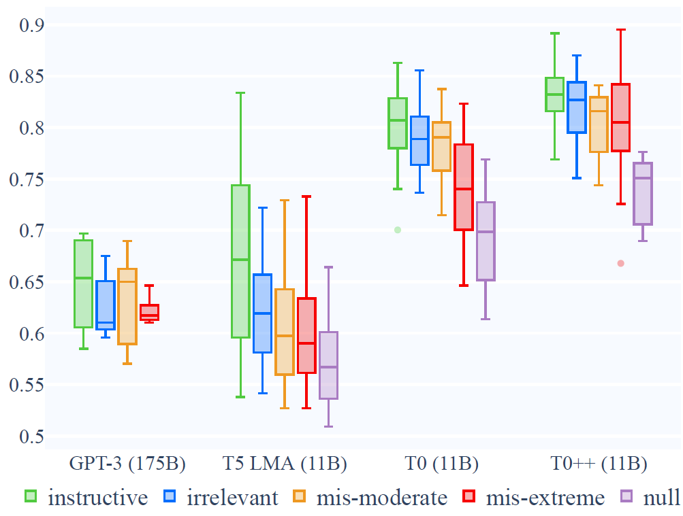
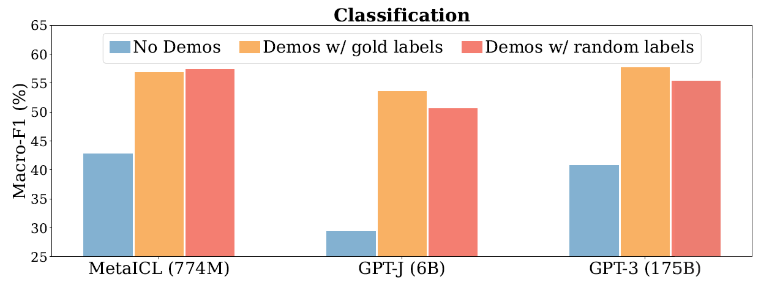
Caveats from Recent Findings
Prompting w/ random labels marginally hurts (Min et al., 2022)
Performance drop is small w/ misleading instructions (Webson et al. 2022)
Min et al. Rethinking the Role of Demonstrations: What Makes In-Context Learning Work? EMNLP-22.
Webson et al. Do Prompt-Based Models Really Understand the Meaning of Their Prompts? NAACL-22.

Slide 22
Understanding Chain-of-Thought
Approach: a series of controlled ablations to reveal the impact of different aspects of a CoT rationale
Datasets: GSM8K (mathematics) and Bamboogle (multi-hop QA)
Two of the benchmarks where CoT brings largest improvements
Follow-up work (Schaeffer et al., 23) finds that our results also applies largely to BIG-Bench-Hard
Models (greedy decoding):
GPT-3.5 (davinci-002/003), PaLM & Flan-PaLM
Schaeffer et al. Invalid Logic, Equivalent Gains: The Bizarreness of Reasoning in Language Model Prompting. In ICML-23 workshop on Knowledge and Logical Reasoning in the Era of Data-driven Learning.

Slide 23
Components of a CoT Rationale
Bridging objects
key objects that the model needs to traverse to research the final answer (math: numbers & equations; multi-hop QA: entities)
Language templates
complementary parts of bridging objects
hints & predicates that guide the model to derive the bridging objects
Q: Leah had 32 chocolates and her sister had 42. If they ate 35, how many pieces do they have left in total?
A: Originally, Leah had 32 chocolates and her sister had 42. So in total they had 32 + 42 = 74. After eating 35, they had 74 - 35 = 39 pieces left in total. The answer is 39.
Q: Who is the grandchild of Dambar Shah?
A: Dambar Shah was the father of Krishna Shah. Rudra Shah was the child of Krishna Shah. So the final answer is: Rudra Shah.

Slide 24
Research Questions
In CoT, correct bridging objects and language templates are provided to show the LLM how to reason
Are ground truth bridging objects/language templates important?
If not, what would be the key aspects that are needed for the LLM to reason properly?

Slide 25
Does Valid Reasoning Matter?
Manually write invalid rationales for all in-context examples
We apply drastic changes to break almost all valid reasoning
Q: Leah had 32 chocolates and her sister had 42. If they ate 35, how many pieces do they have left in total?
CoT: Originally, Leah had 32 chocolates and her sister had 42. So in total they had 32 + 42 = 74. After eating 35, they had 74 - 35 = 39 pieces left in total. The answer is 39.
Invalid CoT: Originally, Leah had 32 chocolates and her sister had 42. So her sister had 42 - 32 = 10 chocolates more than Leah has. After eating 35, since 10 + 35 = 45, they had 45 - 6 = 39 pieces left in total. The answer is 39.

Slide 26
Does Valid Reasoning Matter?
Manually write invalid rationales for all in-context examples
We apply drastic changes to break almost all valid reasoning
Keep premise steps
(copies/paraphrases of facts from the query)
CoT: Originally, Leah had 32 chocolates and her sister had 42. So in total they had 32 + 42 = 74. After eating 35, they had 74 - 35 = 39 pieces left in total. The answer is 39.
Invalid CoT: Originally, Leah had 32 chocolates and her sister had 42. So her sister had 42 - 32 = 10 chocolates more than Leah has. After eating 35, since 10 + 35 = 45, they had 45 - 6 = 39 pieces left in total. The answer is 39.

Slide 27
Does Valid Reasoning Matter?
Manually write invalid rationales for all in-context examples
We apply drastic changes to break almost all valid reasoning
Change inference steps s.t. they don’t logically derive the answer
CoT: Originally, Leah had 32 chocolates and her sister had 42. So in total they had 32 + 42 = 74. After eating 35, they had 74 - 35 = 39 pieces left in total. The answer is 39.
Invalid CoT: Originally, Leah had 32 chocolates and her sister had 42. So her sister had 42 - 32 = 10 chocolates more than Leah has. After eating 35, since 10 + 35 = 45, they had 45 - 6 = 39 pieces left in total. The answer is 39.

Slide 28
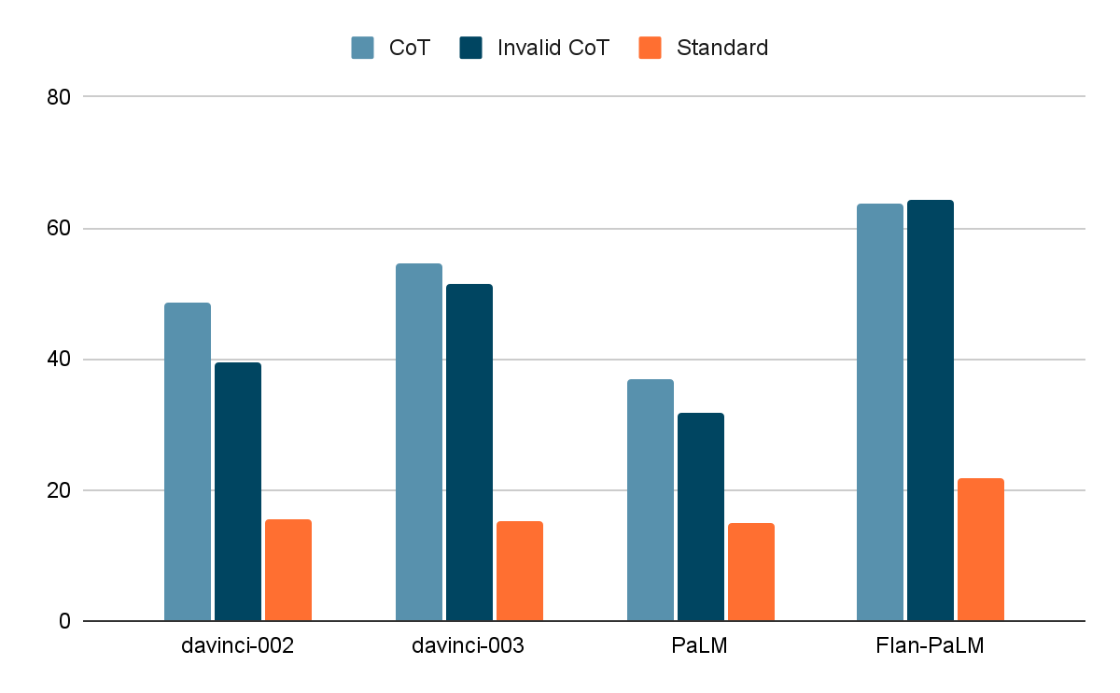
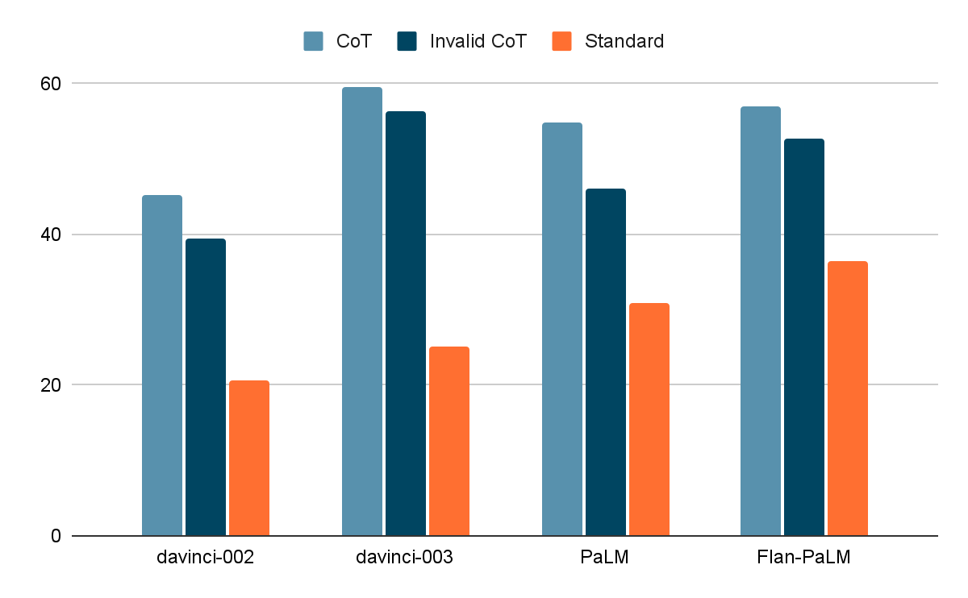
Does Valid Reasoning Matter?
Effect on performance is small (even smaller under intermediate evaluation)
The gap is smaller for more recent models (Davinci-003, Flan-PaLM)
GSM8K
Bamboogle

Slide 29
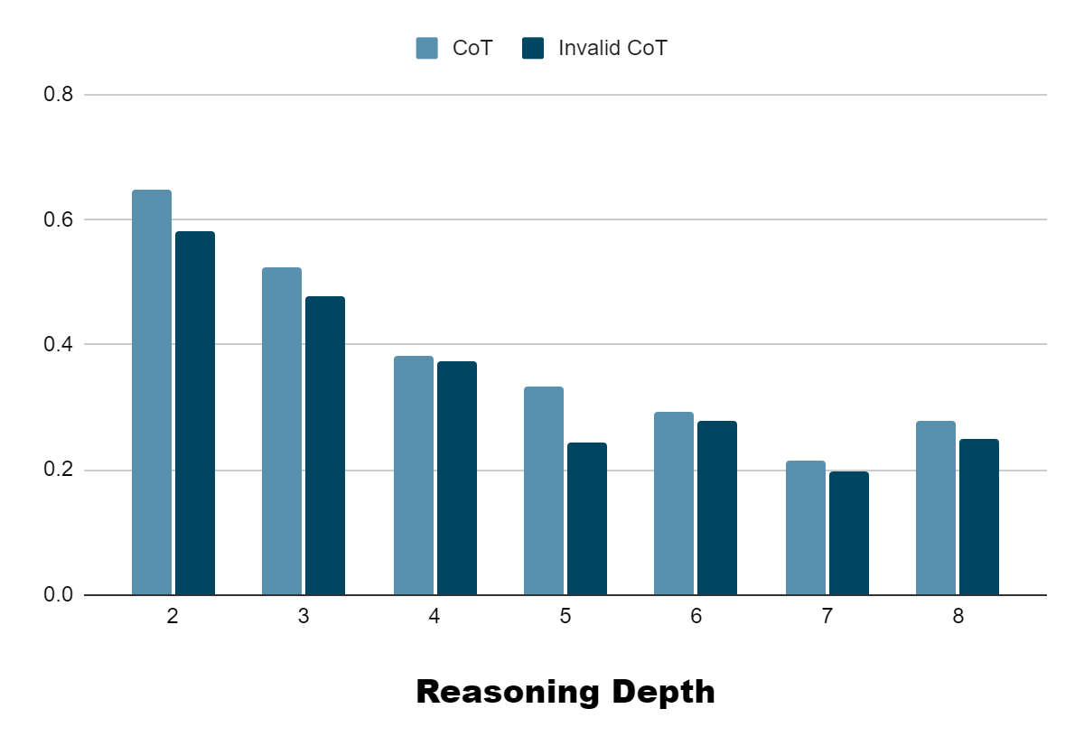
Does Valid Reasoning Matter?
Performance among different reasoning depth (davinci-002, GSM8K)

Slide 30
Does Valid Reasoning Matter?
Qualitative
LLM still tries and manages to generate logically sound reasoning decently (drastically different from given demonstrations)
Distribution of error types also highly similar

Slide 31
Does Valid Reasoning Matter?
Summary
small performance degradation when ablating the reasoning validity
no systematic difference b/w CoT and the invalid reasoning setting
If valid reasoning is not required, what are the key aspects that determine the effectiveness of CoT prompting?

Slide 32
What are the Key Aspects of CoT?
Re-examining the invalid reasoning setting
Relevance to query
Starting from the bridging objects in the query
Q: Leah had 32 chocolates and her sister had 42. If they ate 35, how many pieces do they have left in total?
Invalid CoT: Originally, Leah had 32 chocolates and her sister had 42. So her sister had 42 - 32 = 10 chocolates more than Leah has. After eating 35, since 10 + 35 = 45, they had 45 - 6 = 39 pieces left in total. The answer is 39.

Slide 33
What are the Key Aspects of CoT?
Re-examining the invalid reasoning setting
Relevance to query
Language templates also related to the query
Q: Leah had 32 chocolates and her sister had 42. If they ate 35, how many pieces do they have left in total?
Invalid CoT: Originally, Leah had 32 chocolates and her sister had 42. So her sister had 42 - 32 = 10 chocolates more than Leah has. After eating 35, since 10 + 35 = 45, they had 45 - 6 = 39 pieces left in total. The answer is 39.

Slide 34
What are the Key Aspects of CoT?
Re-examining the invalid reasoning setting
Relevance to query
Tries to seek the answer to the question
Q: Leah had 32 chocolates and her sister had 42. If they ate 35, how many pieces do they have left in total?
Invalid CoT: Originally, Leah had 32 chocolates and her sister had 42. So her sister had 42 - 32 = 10 chocolates more than Leah has. After eating 35, since 10 + 35 = 45, they had 45 - 6 = 39 pieces left in total. The answer is 39.

Slide 35
What are the Key Aspects of CoT?
Re-examining the invalid reasoning setting
Coherence among steps
The steps (bridging objects & language templates) still follow their order
Q: Leah had 32 chocolates and her sister had 42. If they ate 35, how many pieces do they have left in total?
Invalid CoT: Originally, Leah had 32 chocolates and her sister had 42. So her sister had 42 - 32 = 10 chocolates more than Leah has. After eating 35, since 10 + 35 = 45, they had 45 - 6 = 39 pieces left in total. The answer is 39.

Slide 36
Ablating Relevance
Substitute with random alternatives & keep coherence
Bridging objects: sample a random number/random entity directly
Language templates: use template from another sample
Hence also does not attempt to answer the question
E.g.:
Q: Leah had 32 chocolates and her sister had 42. If they ate 35, how many pieces do they have left in total?
No relevance for bridging objects: Originally, Leah had 32->19 chocolates and her sister had 42->31. So in total they had 19 + 31 = 50. After eating 35->29, they had 50 - 29 = 21 pieces left in total. The answer is 21.

Slide 37
Ablating Coherence
Randomly shuffle the components and permute their orderings

Slide 38
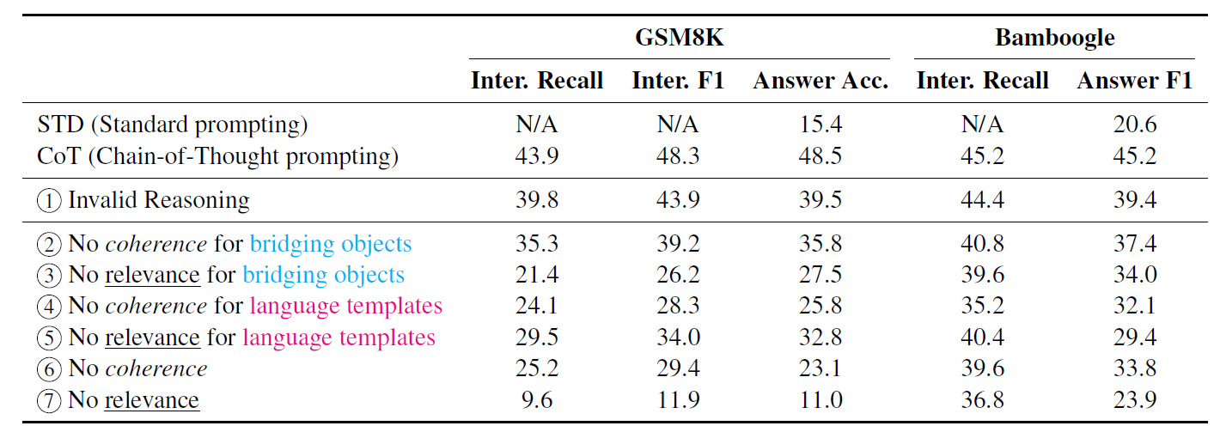
Impact of Relevance & Coherence
Overall, Relevance & Coherence are key
(davinci-002)

Slide 39
Impact of Relevance & Coherence
Keeping (some level of) relevance is vital
(davinci-002)

Slide 40
Impact of Relevance & Coherence
Coherence of templates & Relevance of objects are important
(davinci-002)

Slide 41
Thoughts & Reflections
Do LLMs learn to reason from CoT demonstrations on the evaluated tasks?
No - due to the surprisingly high performance obtained by ablating the validity of reasoning
Rather, the LLM has already gained the reasoning ability for these tasks from pretraining
Provided reasoning steps serve more as the role of an output format/space, that regularizes the LLM to generate rationales that look step-by-step while being relevant and in order

Slide 42
Thoughts & Reflections
Can LLMs learn to reason from CoT demonstrations?
What we find does not in any way diminish the potential of learning to reason in context (Garg et al., Akyürek et al.)
A wrong take of our findings: “LLMs don’t need valid demonstrations to learn how to reason”
Garg et al. What can transformers learn incontext? A case study of simple function classes. NeurIPS-22.
Akyürek et al. What learning algorithm is in-context learning? Investigations with linear models. ICLR-23.

Slide 43
Thoughts & Reflections
Reflections on benchmarking few-shot reasoning
Existing success cannot establish that LLMs are good learners of reasoning
Need to test on alternative benchmarks to assess how much can LLMs truly extrapolate from pretraining
More broadly: measure of intelligence (Chollet. 2019)
Need quantification of the level of prior knowledge/skill
Chollet. On the Measure of Intelligence. arXiv-19.

