Slide 1






Deep Learning on Graphs for
Natural Language Processing
Lingfei Wu, Yu Chen, Heng Ji, and Bang Liu
SIGIR-2021 Tutorial
July 11th, 2021

Slide 2
Outline
DLG4NLP
Introduction, Foundations, Applications
DLG4NLP
Demos
DLG4NLP Future Directions
DLG4NLP
Introduction
Why Graphs for NLP?
Conventional ML for NLP
DLG4NLP
Foundations
Graph Construction for NLP
Graph Representation Learning for NLP
DLG4NLP
Applications
Information Extraction
Semantic Parsing and Machine Reading Comprehension
Deep Learning on Graphs: Foundations and Models
Graph Encoder-Decoder Models for NLP
Natural Language Generation and Machine Translation

Slide 3
DLG4NLP
Introduction

Slide 4
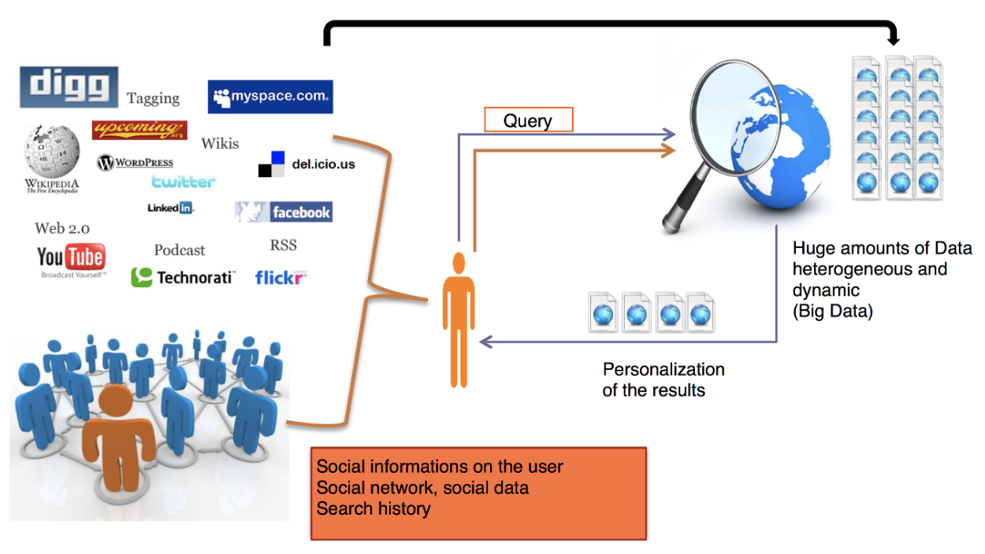
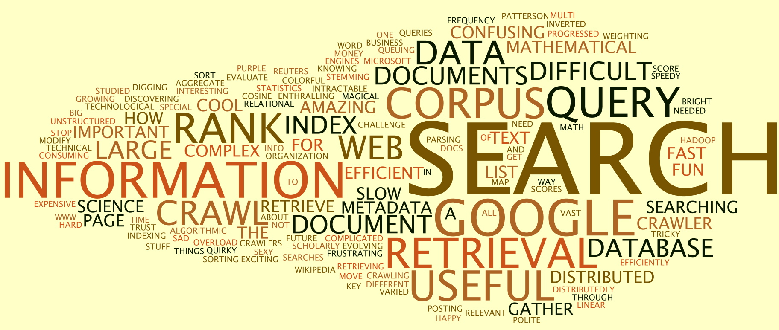
Why graphs?
Source from Laboratoire Hubert Curien - Université Jean Monnet
Graphs are a general language for describing and modeling complex systems
Graph!
Graph Topology + Node Attributes + Node Types

Slide 5
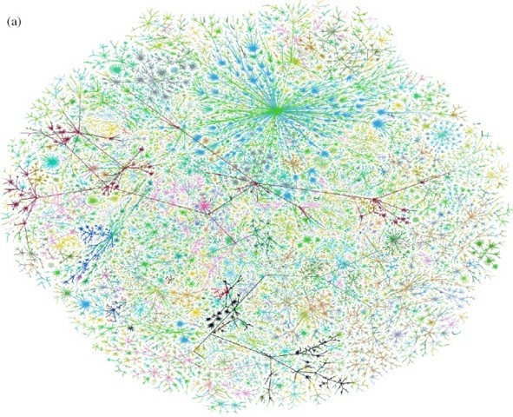
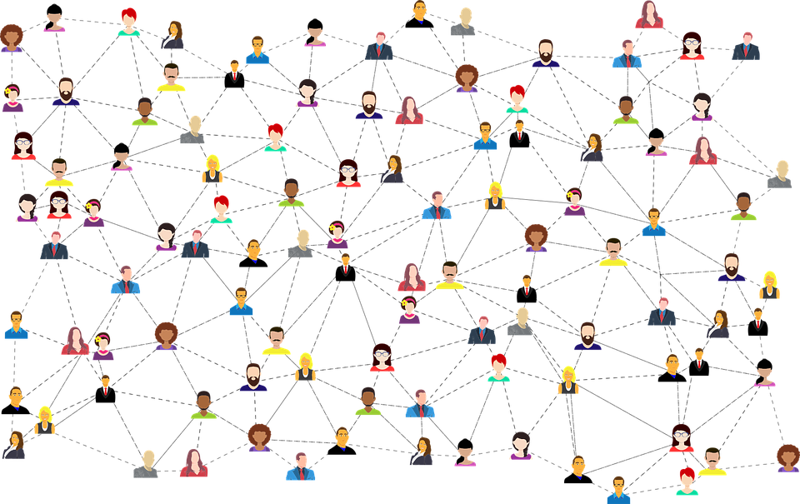

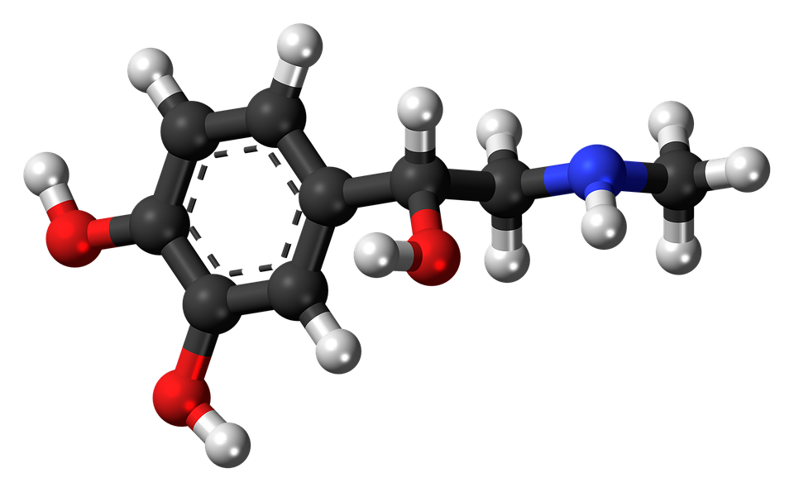
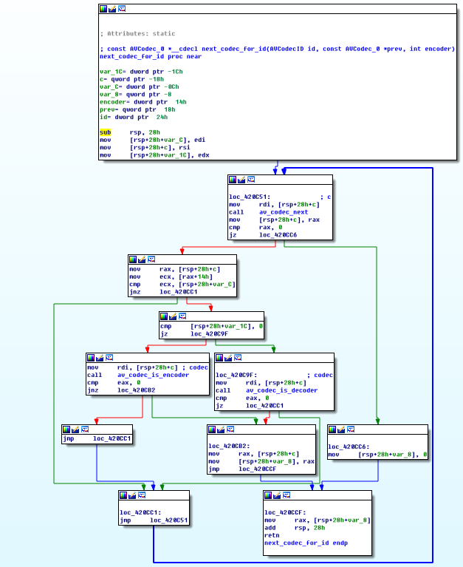
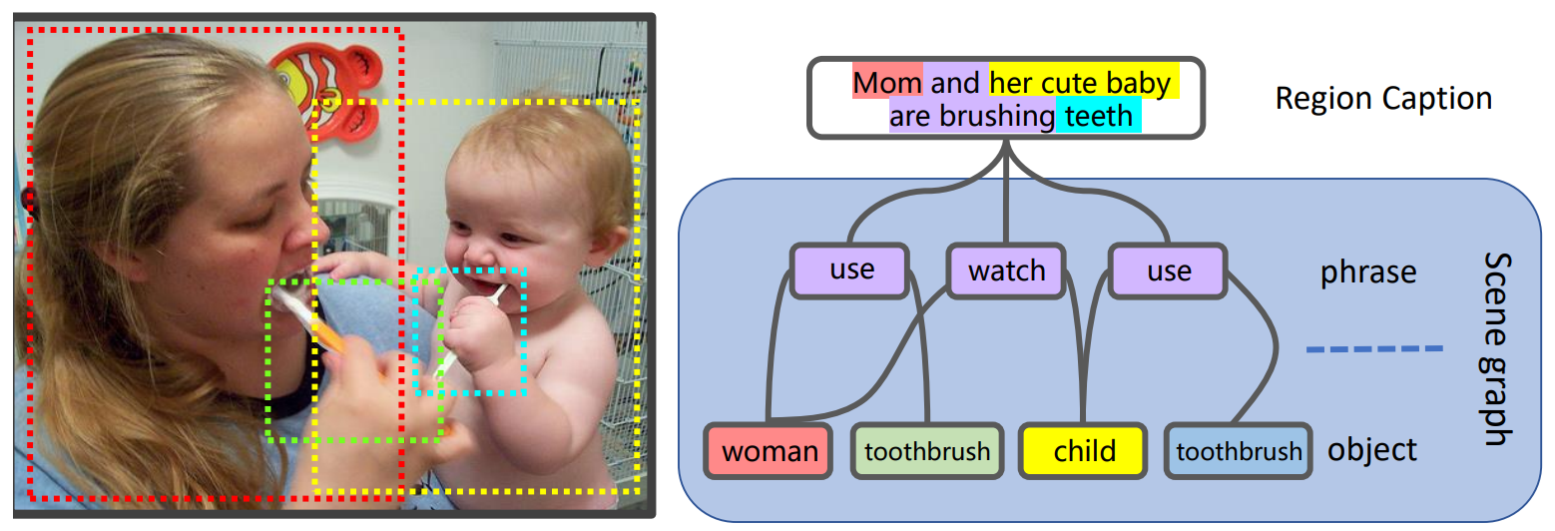
Graph-structured data are ubiquitous
Internet
Social networks
Information retrieval
Biomedical graphs
Scene graphs
Program graphs

Slide 6
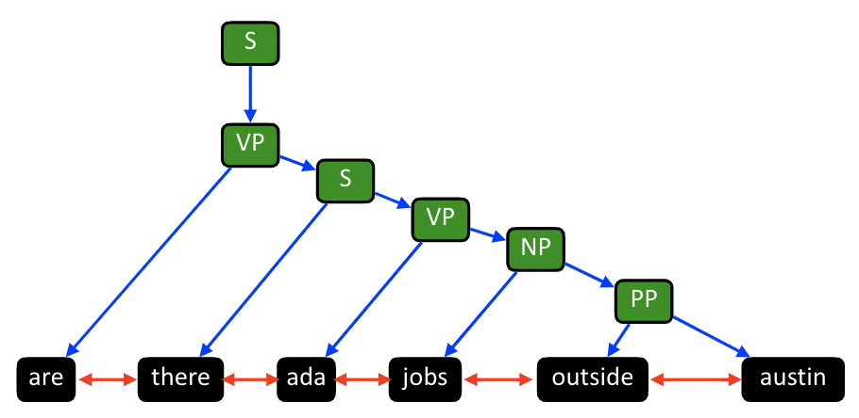
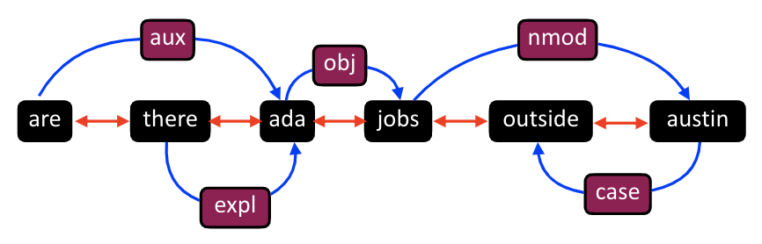
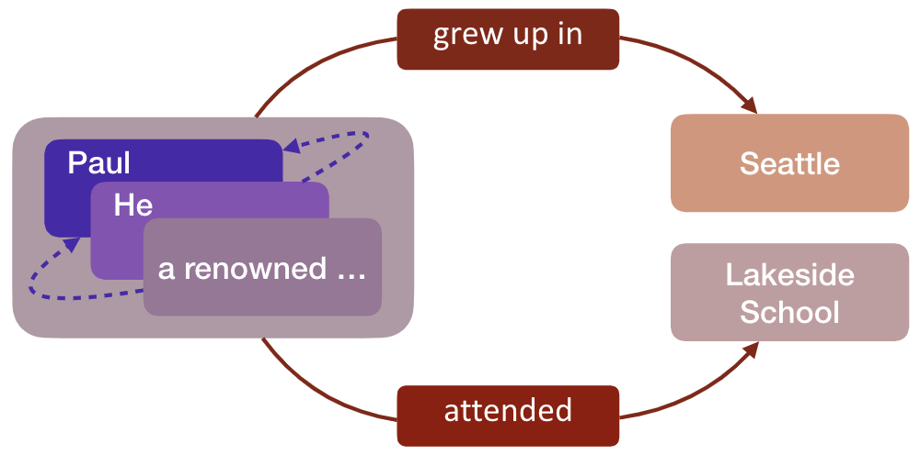
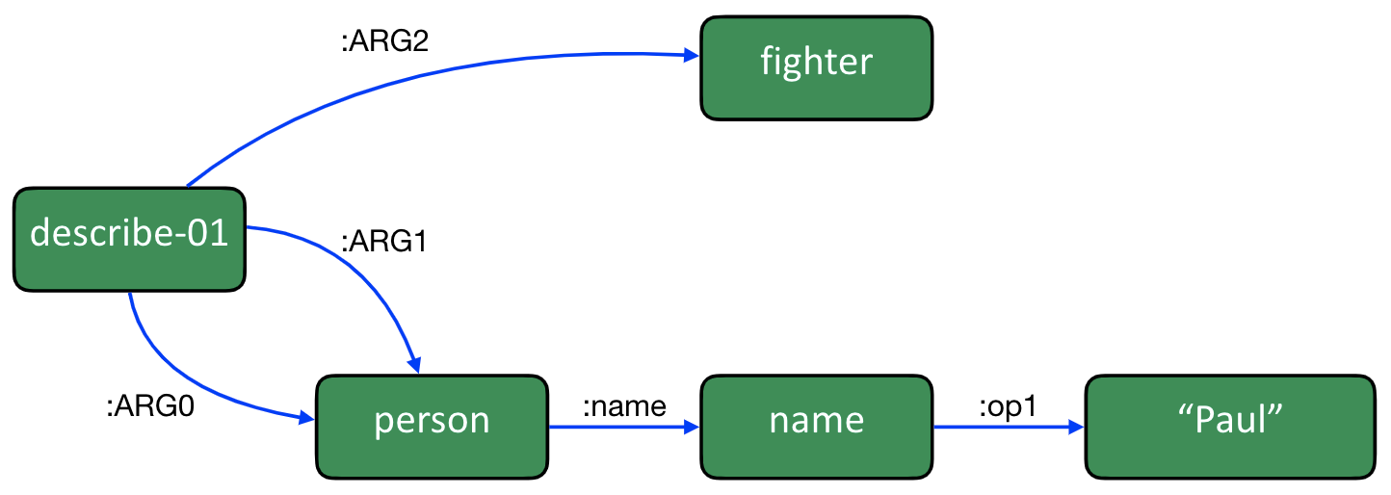
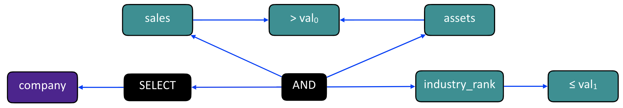
Graphs are ubiquitous in NLP As Well
Constituency graph
Dependency graph
AMR graph
IE graph
SQL graph

Slide 7
Machine Learning on Graphs for NLP

Slide 8
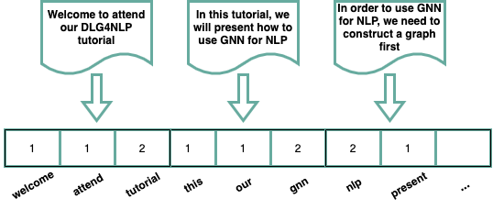
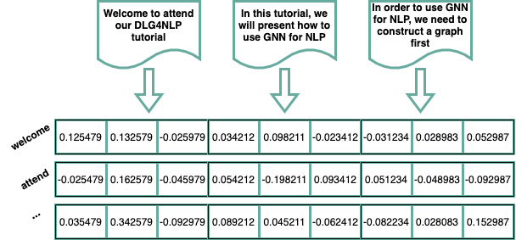
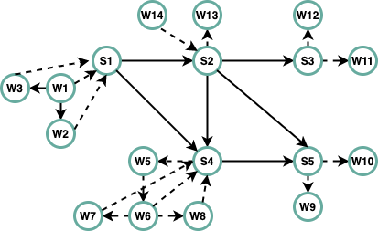
Natural Language Processing: A Graph Perspective
Represent natural language as a bag of tokens
  BOW, TF-IDF
  Topic Modeling: text as a mixture of topics
Represent natural language as a sequence of tokens
  Linear-chain CRF
  Word2vec, Glove
Represent natural language as a graph
  Dependency graphs, constituency graphs, AMR graphs, IE graphs, and knowledge graphs
  Text graph containing multiple hierarchies of elements, i.e. document, sentence and word

Slide 9
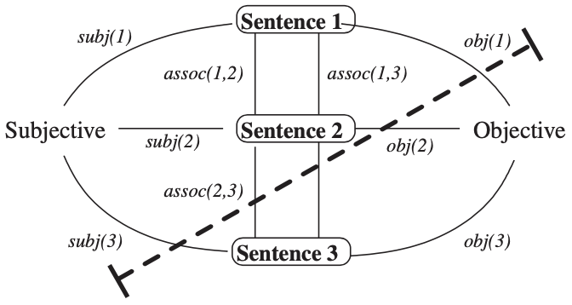
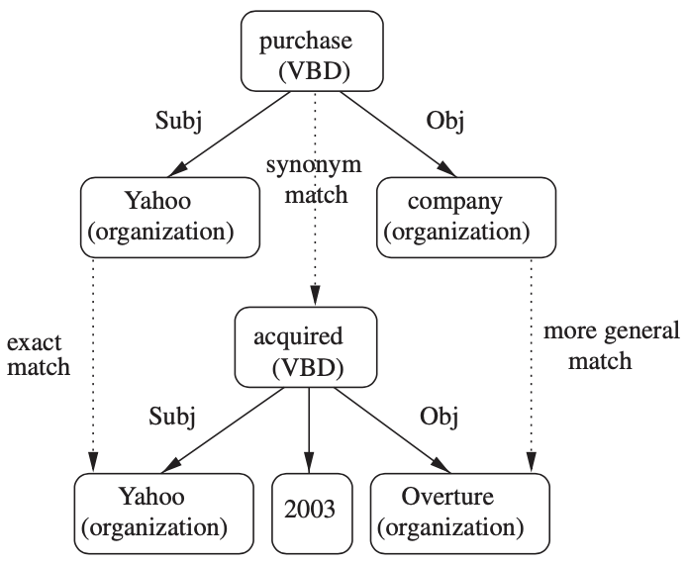
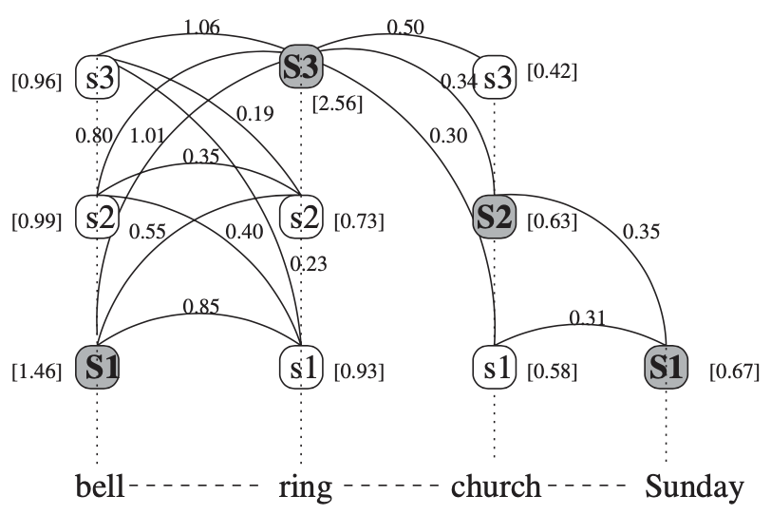
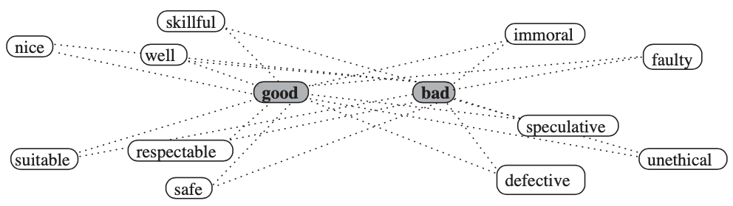
Graph Based Methods for NLP
[Mihalcea and Radev, 2011]
Random Walk Algorithms
  Generate random paths, one can obtain a stationary distribution over all the nodes in a graph
  Applications: semantic similarity of texts, name disambiguation
Graph Clustering Algorithms
  Spectral clustering, random walk clustering and min-cut clustering for text clustering
Graph Matching Algorithms
  Compute the similarity between two graphs for textual entailment task
Label Propagation Algorithms
  Propagate labels from labeled data points to previously unlabeled data points
  Applications: word-sense disambiguation, sentiment analysis

Slide 10
Deep Learning on Graphs: Foundations and Models

Slide 11
Machine Learning Lifecycle
(Supervised) Machine Learning Lifecycle: feature learning is the key
Raw Data
Structured Data
Learning Algorithm
Model
Feature Engineering
Automatically learn the features
Downstream prediction task

Slide 12
Feature Learning in Graphs
Our Goal: Design efficient task-independent/ task-dependent feature learning for machine learning in graphs!
node
v
f:v → ℝ^{d}
vector
12
_{ℝ}d
Feature representation, embedding

Slide 13




Graph Neural Networks: Foundations
Learning node embeddings:
Learning graph-level embeddings:
A graph filter
adjacency matrix
- Spectral-based
- Spatial-based
- Attention-based
Updated node embeddings
Input node embeddings
- Recurrent-based
Flat Graph Pooling (i.e. Max, Ave, Min)
Hierarchical Graph Pooling (i.e. Diffpool)
A small graph w/
fewer nodes
Input node embeddings
Input graph
New node embeddings
Notes:
The specific models differ only in how 𝑓_filter(·,·) is chosen and parameterized.

Slide 14







Graph Neural Networks: Basic Model
Key idea: Generate node embeddings based on local neighborhoods.
A
TARGET NODE
B
B
C
A
B
A
C
A
C
E
F
D
F
E
D
INPUT GRAPH
A

Slide 15
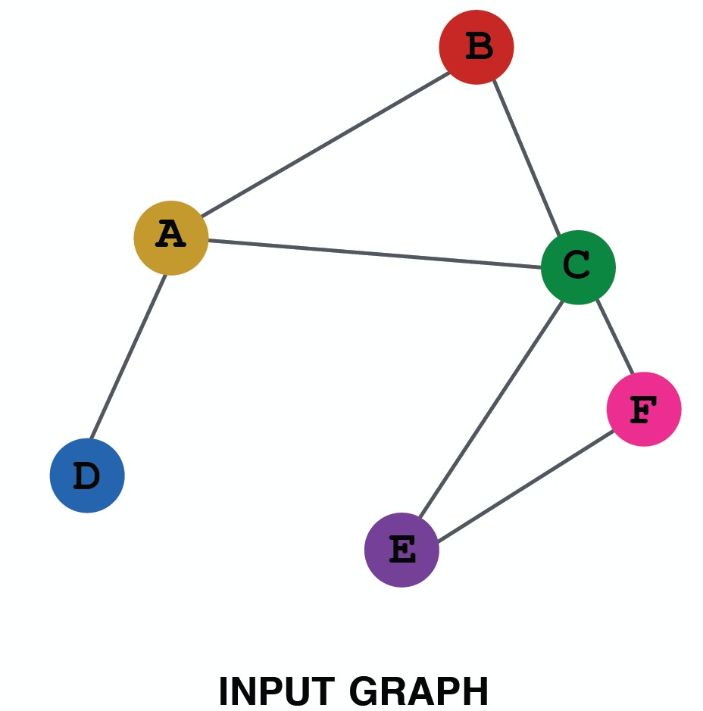
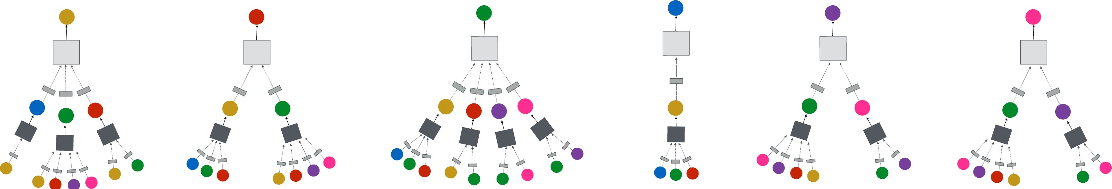
Neighborhood Aggregation
Intuition: Network neighborhood defines a computation graph
Every node defines a unique
computation graph!

Slide 16
Neighborhood Aggregation
Nodes have embeddings at each layer.
Model can be arbitrary depth.
“layer-0” embedding of node i is its input feature, i.e. x_{i}.
Layer-0
Layer-1
A
X_{A}
TARGET NODE
B
C
X_{C}
B
Layer-2
A
B
X_{A}
A
C
X_{B}
A
C
X_{E}
E
F
X_{F}
D
F
E
D
INPUT GRAPH
A
X_{A}

Slide 17
Overview of GNN Model
1) Define a neighborhood aggregation function
A
TARGET NODE
B
B
C
A
B
A
C
Z_{A}
A
C
E
F
D
F
E
D
INPUT GRAPH
A
2) Define a loss function on the embeddings, L(z_{v})

Slide 18
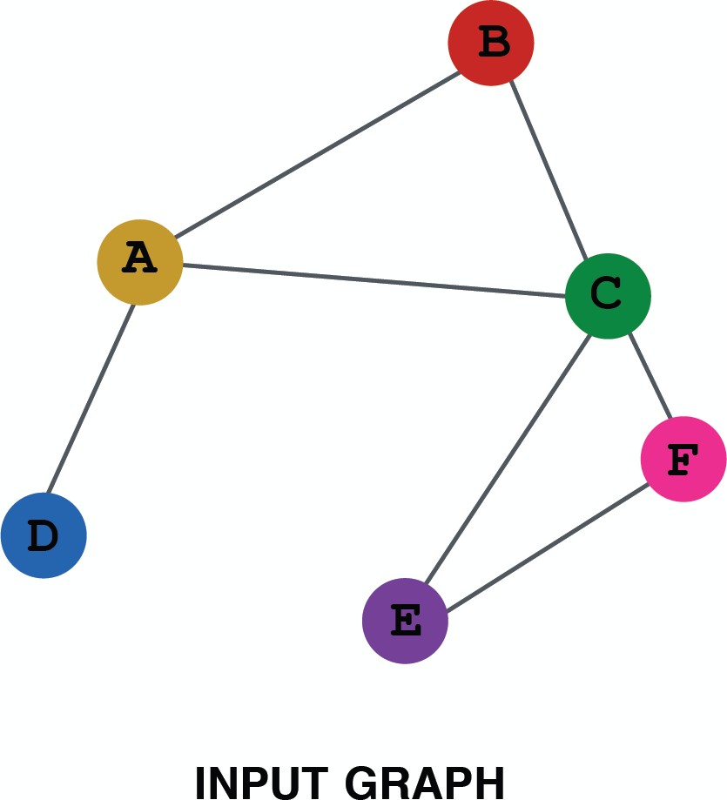
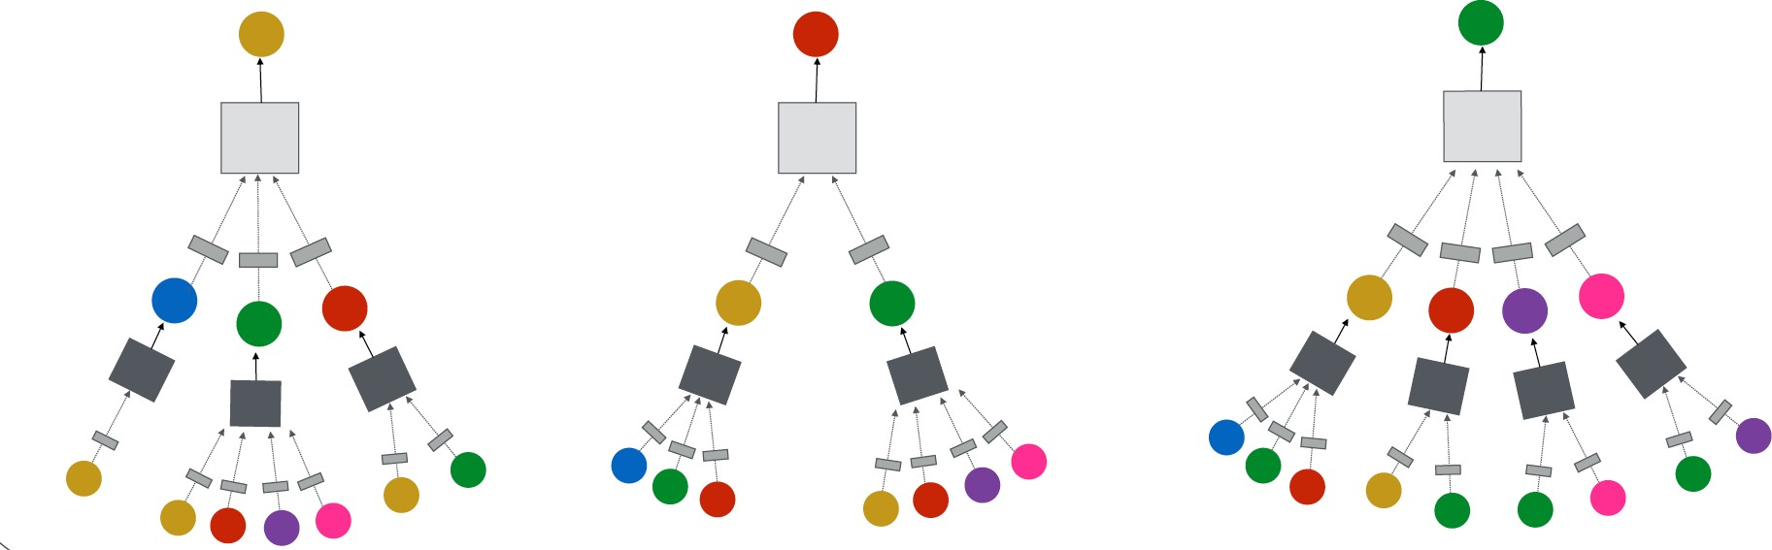
Overview of GNN Model
3) Train on a set of nodes, i.e., a batch of computation graphs

Slide 19
Overview of GNN Model
4) Generate embeddings for nodes as needed
Even for nodes we
never trained on!
19

Slide 20
GNN Model: A Case Study
Basic approach: Average neighbor information and apply a neural network
1) average messages
from neighbors
A
TARGET NODE
B
B
C
A
B
A
C
A
C
E
F
D
F
E
D
INPUT GRAPH
A
2) apply neural network

Slide 21
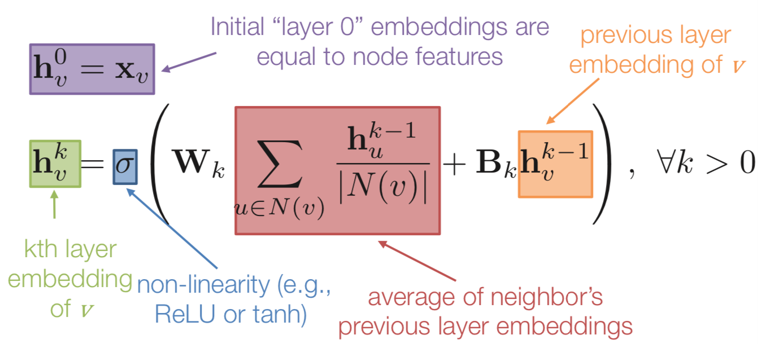
GNN Model: A Case Study
Basic approach: Average neighbor information and apply a neural network.
21

Slide 22
GNN Model: Quick Summary
Key idea: generate node embeddings by aggregating neighborhood information.
  Allows for parameter sharing in the encoder
  Allows for inductive learning

Slide 23
Graph Neural Networks: Popular Models
Spectral-based Graph Filters
  GCN (Kipf & Welling, ICLR 2017), Chebyshev-GNN (Defferrard et al. NIPS 2016)
Spatial-based Graph Filters
  MPNN (Gilmer et al. ICML 2017), GraphSage (Hamilton et al. NIPS 2017)
  GIN (Xu et al. ICLR 2019)
Attention-based Graph Filters
  GAT (Velickovic et al. ICLR 2018)
Recurrent-based Graph Filters
  GGNN (Li et al. ICLR 2016)

Slide 24
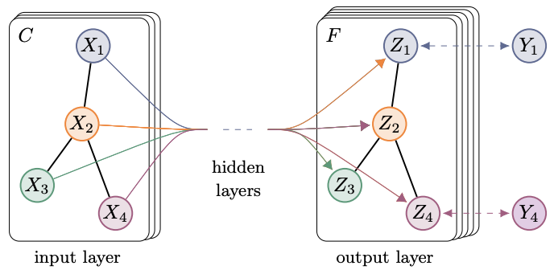

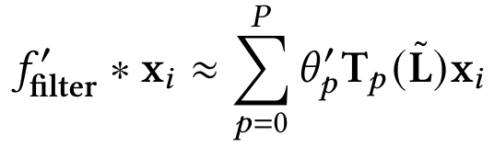


Graph Convolution Networks (GCN)
Key idea: spectral convolution on graphs
Eigen-decomposition
is expensive
Chebyshev polynomials
accelerates but still not
powerful
GCN in NLP Tasks:
Text classification
Question Answering
Text Matching
Topic Modeling
Information Extration
First-order approxima-
tion fast and powerful
Renormalization trick
stabilizes the numerical
computation

Slide 25
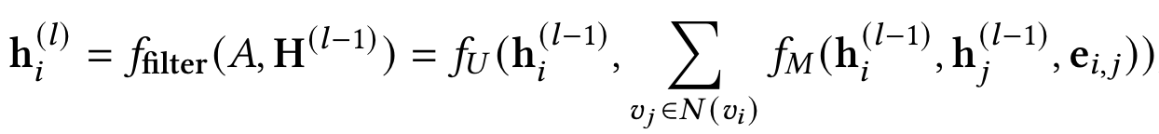
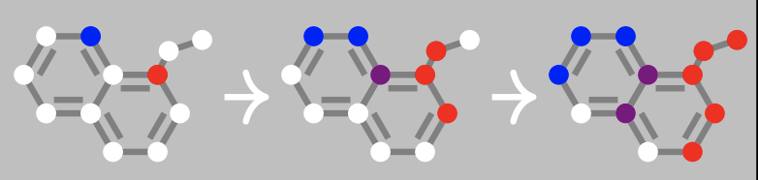
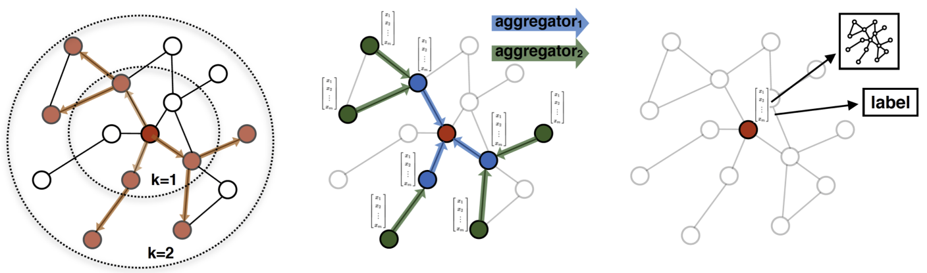
Message Passing Neural Network (MPNN)
Key idea: graph convolutions as a message passing process
MPNN:
expensive if the number of nodes are large
Node and edge embeddings
Update and aggregation functions
GraphSage:
sampling to
obtain a fixed
number of
neighbors
MPNN and GraphSage
in NLP Tasks:
Knowledge graph
Information extraction
Semantic parsing
Node embeddings
Aggregation functions

Slide 26
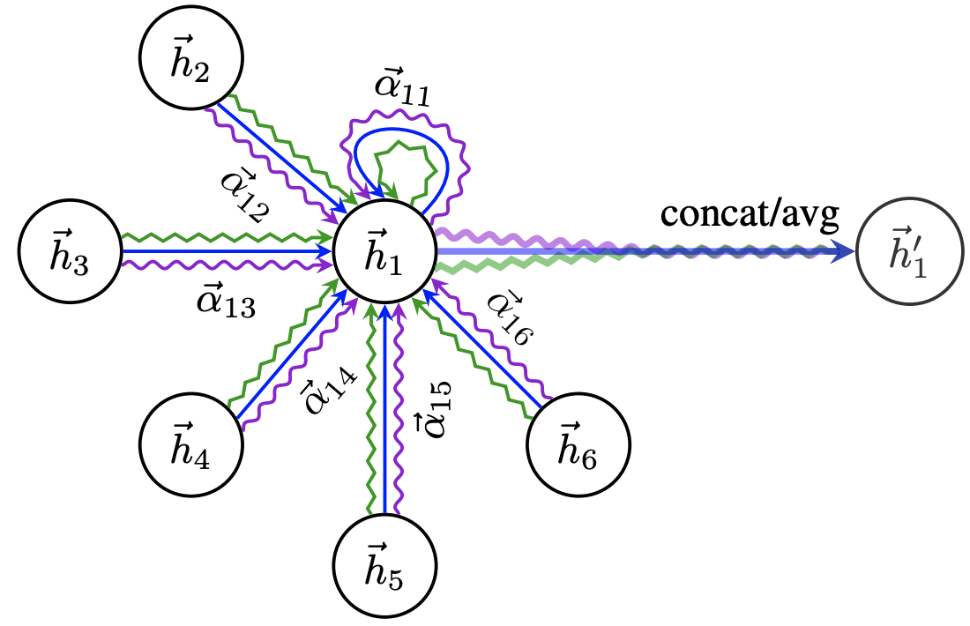
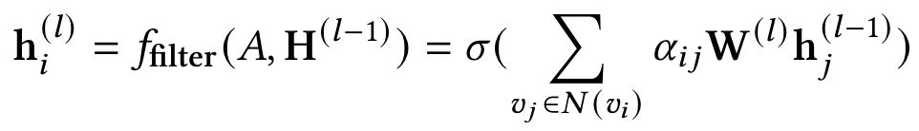
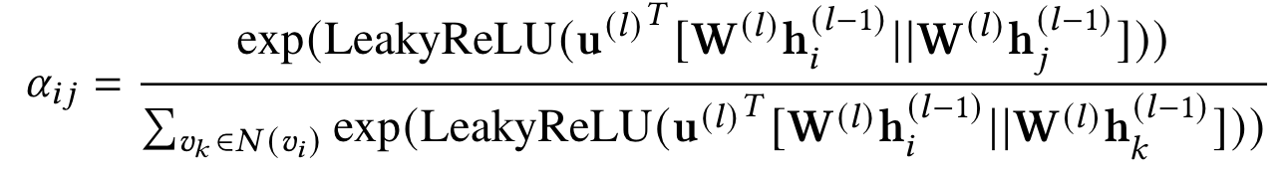
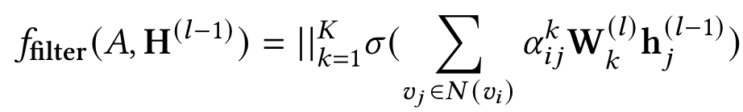
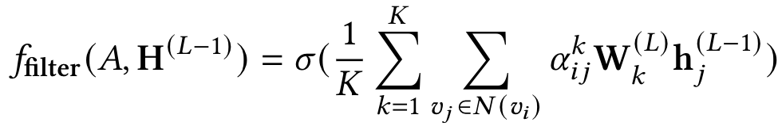
Graph Attention Network (GAT)
Key idea: dynamically learn the weights (attention scores) on the edges when performing message passing
Weighted sum of node embeddings
Learned local weights with self-attention
GAT in NLP Tasks:
Text classification
Question Answering
Knowledge graph
Information extraction
Semantic parsing
Intermediate node embeddings
Final node embeddings

Slide 27
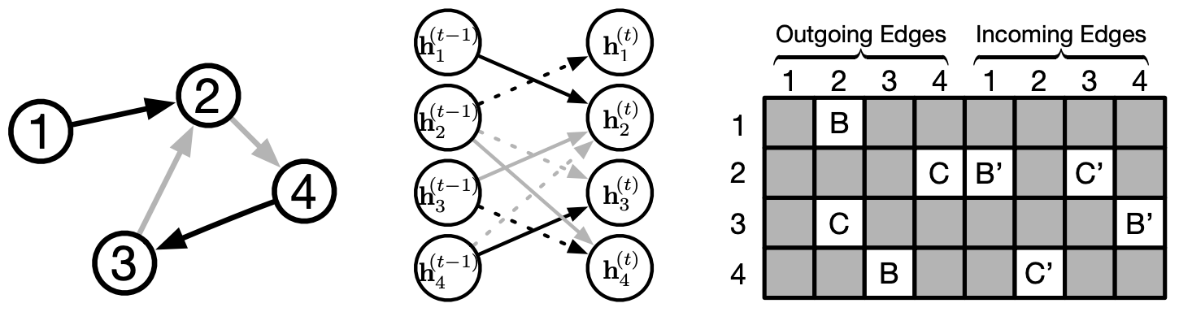
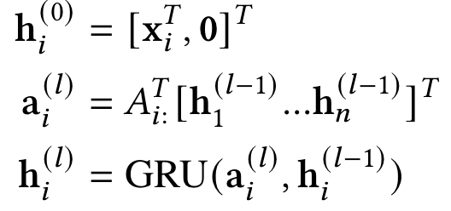
Gated Graph Neural Networks (GGNN)
Key idea: the use of Gated Recurrent Units while taking into account edge type and directions
Zero-padding input node embeddings
Incoming & outcoming edges for node v_{i}
GGNN in NLP Tasks:
Semantic parsing
Machine translation
GRU for fusing node embeddings

Slide 28
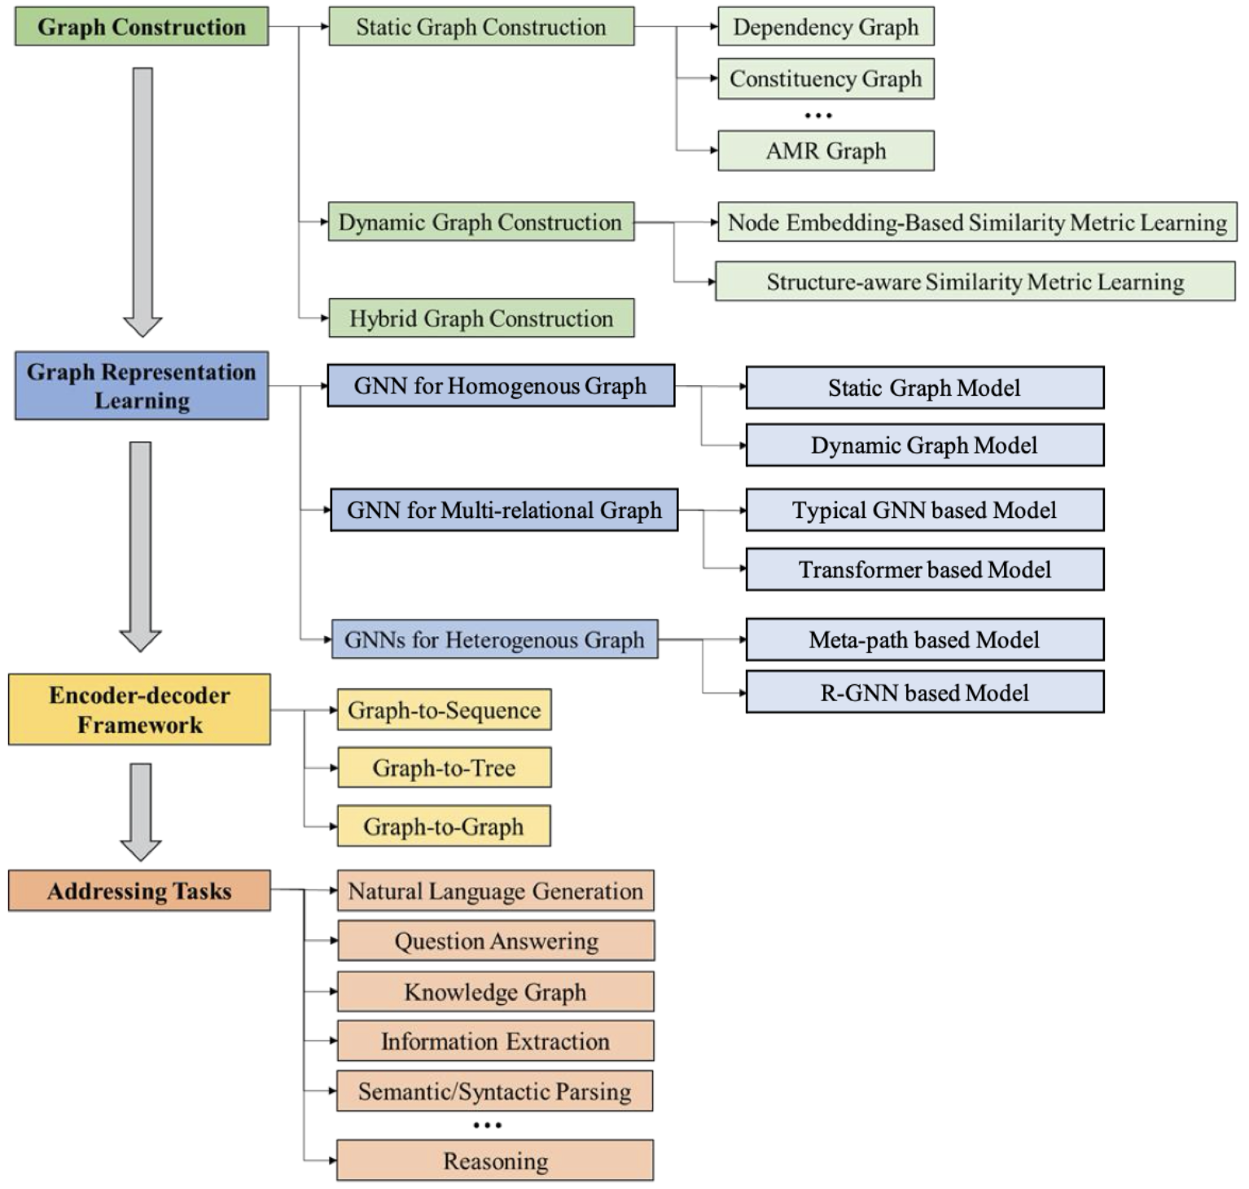
DLG4NLP:
A Roadmap
DLG4NLP Key Foundations
DLG4NLP Key Libraries
DLG4NLP Future Directions

Slide 29
DLG4NLP
Foundations

Slide 30
Graph Construction for NLP

Slide 31

Why Graph Construction for NLP?
Representation power: graph > sequence > bag
Different NLP tasks require different aspects of text , e.g., syntax, semantics.
Different graphs capture different aspects of the text
Two categories: static vs dynamic graph construction
Goal: good downstream task performance
Text
GNs
convert to graph
many more graph options…
Notes:
1m
As we previously introduced, there are three typical ways of representing text which are bag, sequence and graph. Among all the three approaches, graph has the strongest representation power because it can capture rich and diverse information about text.
(c)We know that different NLP tasks require different aspects of text such as syntax, semantics. In the meanwhile, different graphs capture different aspects of the text.
Therefore, how to convert text to graph is an important yet challenging question which really depends on what aspects of information we want to capture in a text graph. In general, we group various graph construction approaches into two categories: static graph construction & dynamic graph construction. We will introduce each of them and summarize their properties next.
Note that the primary goal of graph construction we are taking about in this tutorial is to achieve good downstream task performance.

Slide 32
Static Graph Construction
Problem setting:
  Input: raw text (e.g., sentence, paragraph, document, corpus)
  Output: graph
Conducted during preprocessing by augmenting text with domain knowledge
Notes:
1m
Let’s first talk about static graph construction. It aims to convert the raw text to a graph where text can be sentence, paragraph, document or corpus.
it’s usually conducted during the preprocessing stage by augmenting raw text with various domain knowledge including
(c) syntax, semantics, topic, co-occurrence, world knowledge and so on. Many of them are actually quite application-driven.

Slide 33
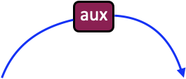
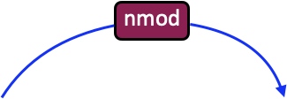

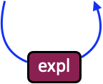
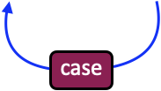
Static Graph Construction: Dependency Graph
Add additional sequential edges to
reserve sequential information in raw text
connect multiple dependency graphs in a paragraph
Dependency parsing
Text input: are there ada jobs outside austin
Notes:
The first static graph construction approach we are going to introduce is dependency graph. Dependency parsing is widely used to capture the dependency relations between different words in a sentence.
(c)For instance, given a sentence “are there ada jobs outside austin”, one can apply dependency parsing tools to convert it to a graph like this.
(c)But what if we have multiple sentences in text? One common way is to add additional sequential edges between nodes so that we can connect multiple dependency graphs in a paragraph. Besides, it also reserves sequential information in raw text which can be helpful in some applications.

Slide 34
Static Graph Construction: Constituency Graph
S
VP
S
VP
NP
PP
are
there
ada
jobs
outside
austin
Constituency parsing
Again, add additional sequential edges
Text input: are there ada jobs outside austin
Notes:
The next approach we will introduce is constituency graph. The constituency graph is able to capture phrase-based syntactic relations in a sentence.
(c)For instance, given a sentence, one can apply constituency parsing tools to convert it to a graph.
(c)Due to the same reasons, one can add additional sequential edges between nodes.

Slide 35
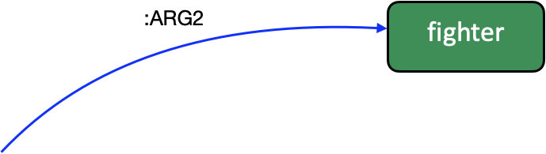
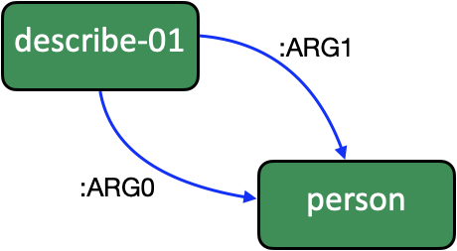


Static Graph Construction: AMR Graph
AMR parsing
Text input: Paul’s description of himself: a fighter
Notes:
The AMR graphs are widely used to represent the high-level semantic relations between abstract concepts of text. Different sentences that are semantically similar may share the same AMR graph.
(c)Given a sentence “Paul’s description of himself: a fighter”, one can apply AMR parsing tools to convert it to a graph.

Slide 36
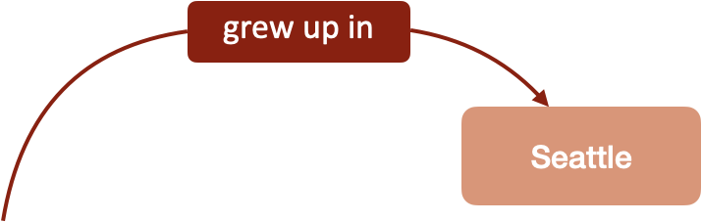
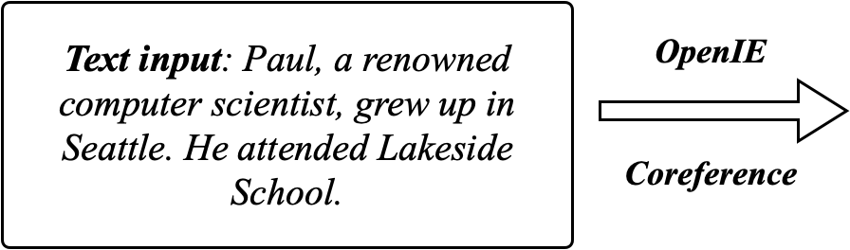
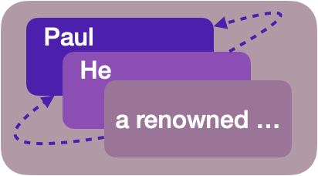
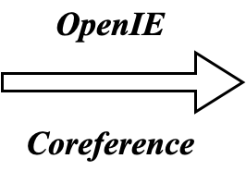
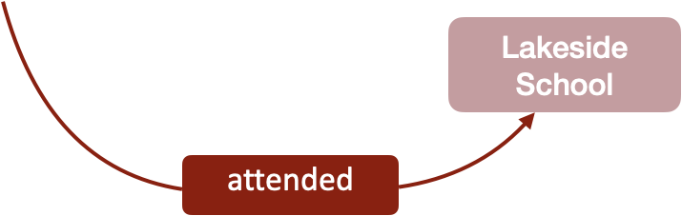
Static Graph Construction: IE Graph
Notes:
The IE graph aims to extract the structural information from text to represent the high-level information about entities and their relations.
(c)Given the input text, one can apply IE tools to convert it to a graph which contains entities such as “Seattle“ as nodes, and relations such as “attended” as edges. Coreference resolution is usually conducted to group entities referring to the same concept to a single node. Like here, Paul, He and a renowned computer scientist refer to the same person.

Slide 37
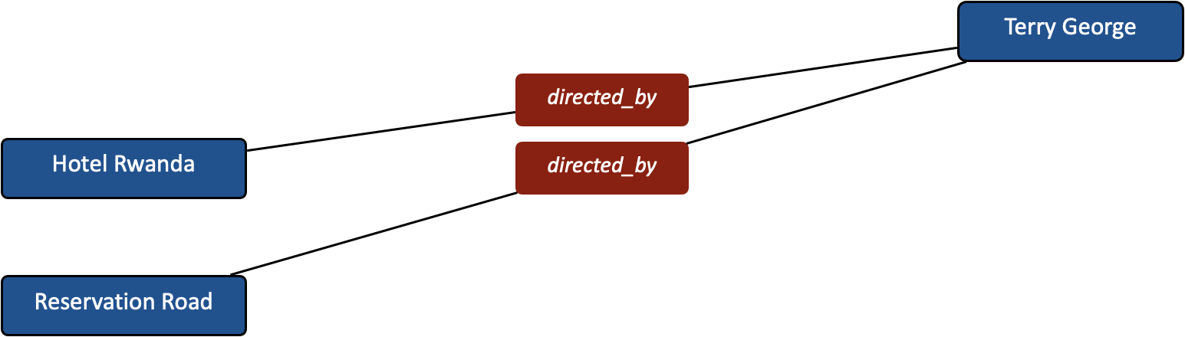
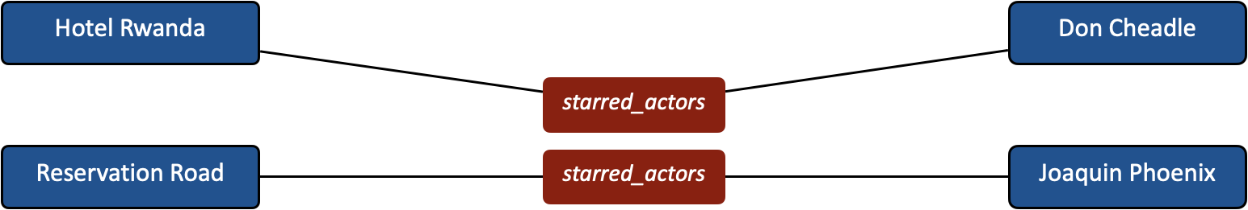


Static Graph Construction: Knowledge Graph
Notes:
The knowledge graph stores world knowledge about entities and their relations.
(c)Given a question “who acted in the movies directed by the director of Some Mother’s Son?”, one can first identity the topic entity of the question which is “Some Mother’s Son”, and then extract a subgraph from a Knowledge Graph which surrounds the topic entity and hopefully contains the answer entities of this question.

Slide 38



Static Graph Construction: Topic Graph
Notes:
Topic is a subject that text is about. One can find the connections among multiple paragraphs or documents by connecting them to a shared set of topics.

Slide 39






Static Graph Construction: Similarity Graph
Notes:
(c)Another way to find the connections among texts is to compute their pair-wise similarity scores.
(c)And one common way to compute similarity scores is to first embed text into some vector representations such as TF-IDF vectors, and then compute pair-wise similarity in the embedding space.

Slide 40



Static Graph Construction: Co-occurrence Graph
Notes:
(c)In order to capture the word co-occurrence information, one can regard the co-occurrence matrix as an adjacency matrix.
(c) And then construct a graph containing each unique word as a node.

Slide 41






Static Graph Construction: SQL Graph
Notes:
Some logic form such as SQL query can also be naturally represented as a
(c)graph which well captures the relations among various objects.

Slide 42

Static Graph Construction: Application-driven Graph
Ming Ding et al. “Cognitive Graph for Multi-Hop Reading Comprehension at Scale”. ACL 2019.
Notes:
There are also various application-driven graphs which augment text with rich information and are tightly coupled with the specific NLP task.

Slide 43
Static Graph Construction: Summary
Widely used in various NLP applications such as NLG, MRC, semantic parsing, etc.
Notes:
As we already see, static graph construction operates by augmenting text with various domain knowledge during preprocessing including syntax, semantics, topic, co-occurrence, world knowledge and so on.
For each type of domain knowledge, there are various types of graphs we can construct which usually depend on the specific application. As we will see in the application part of this tutorial, these static graph construction approaches are widely used in various NLP applications such as NLG, reading comprehension and semantic parsing.

Slide 44
Dynamic Graph Construction
Problem setting:
  Input: raw text (e.g., sentence, paragraph, document, corpus)
  Output: graph
Graph structure (adjacency matrix) learning on the fly, joint with graph representation learning
Notes:
Next, we will introduce dynamic graph construction which shares the same goal with static graph construction. Unlike static graph construction which is performed during preprocessing, dynamic graph construction operates by jointly learning the graph structure and graph representation on the fly. The ultimate goal is to learn the optimized graph structures and representations with respect to certain downstream prediction task.

Slide 45
Dynamic Graph Construction: Overview
Notes:
We summarize the typical dynamic graph construction pipeline as follows.
(c)Given a set of data points which can stand for various NLP elements such as words, sentences and documents, we first apply graph similarity metric learning which aims to capture the pair-wise node similarity and returns a fully-connected weighted graph. Then, we can optionally apply graph sparsification to obtain a sparse graph.
If the input data is instead of data points, but an intrinsic graph containing edges, we can also optionally combine the intrinsic graph and learned implicit graph to form an augmented graph. The output graph will be consumed by a subsequent GNN-based module to learn graph representations and predict outputs.

Slide 46
Dynamic Graph Construction Outline
Notes:
Next, we will introduce each of the four dynamic graph construction techniques which we summarize from the existing practice of its applications in the NLP field. These include graph similarity metric learning techniques, graph sparsification techniques, combining intrinsic graph structures and implicit graph constructions, and learning paradigms.

Slide 47
Graph Similarity Metric Learning Techniques
Graph structure learning as similarity metric learning (in the node embedding space)
Enabling inductive learning
Various metric functions
Notes:
The idea of graph similarity metric learning is to compute the pair-wise node similarity in the node embedding space, and obtain an adjacency matrix based on that.
It can enable inductive learning because once the similarity metric learning is finished, one can apply it to unseen nodes to learn a graph. This is important for many NLP applications, because we want to learn a new graph for each new text example.
Various metric functions have been proposed by previous works. We group them into two categories: node embedding based similarity metric learning and structure-aware similarity metric learning.

Slide 48
Node Embedding Based Similarity Metric Learning
Learning a weighted adjacency matrix by computing the pair-wise node similarity in the embedding space
Common metrics functions
  Attention-based similarity metric functions
  Cosine-based similarity metric functions
Notes:
For node embedding based similarity metric learning,
(c)we are given a set of data points and their vector representations, and apply various metric functions to learn pair-wise node similarity. The output is a weighted adjacency matrix which is corresponding to a fully-connected weighted graph.
(c)Common metric functions include attention-based and cosine-based functions.

Slide 49
Attention-based Similarity Metric Functions
Variant 1)
Node feature vector
Non-negative learnable weight vector
Variant 2)
Learnable weight matrix
Chen at al. “GraphFlow: Exploiting Conversation Flow with Graph Neural Networks for Conversational Machine Comprehension”. IJCAI 2020.
Chen et al. “Reinforcement Learning Based Graph-to-Sequence Model for Natural Question Generation”. ICLR 2020.
Notes:
Let’s talk about attention-based …
In variant 1), v_i is node embedding, and u is a non-negative weight vector learning to highlight different dimensions of the node embeddings.
In variant 2), W is learnable weight matrix which maps the node embedding to a latent space, ReLU is used to enforce the sparsity of the similarity matrix.
In both variants, dot product is used to compute similarity.
S_{i,j} = (\mathbf{v}_i \odot \mathbf{u})^T \mathbf{v}_j
u is a non-negative weight vector learning to highlight different dimensions of the node embeddings
S_{i,j} = \mathrm{ReLU}(\mathbf{W} \mathbf{v}_i)^T \mathrm{ReLU}(\mathbf{W} \mathbf{v}_j)
ReLU used to enforce the sparsity of the similarity matrix.

Slide 50
Cosine-based Similarity Metric Functions
Learnable weight vector
Multi-head similarity scores
Chen et al. “Iterative Deep Graph Learning for Graph Neural Networks: Better and Robust Node Embeddings”. NeurIPS 2021.
Notes:
Let’s see an example of cosine-based metric function.
(c)Here, w_p is a weight vector associated to the p-th perspective, and has the same dimension as the node embeddings. Intuitively, S_{i,j}^p computes the pair-wise cosine similarity for the p-th perspective where each perspective considers one part of the semantics captured in the embeddings.
(c)One can average multi-head similarity scores to increase the learning power of the metric, which is similar to the idea of multi-head attention in Transformer.
S_{i,j}^p &= \mathrm{cos}(\mathbf{w}_p \odot \mathbf{v}_i, \mathbf{w}_p \odot \mathbf{v}_j)
S_{i,j} &= \frac{1}{m}\sum_{p=1}^{m}{S_{ij}^p}

Slide 51
Structure-aware Similarity Metric Learning
Learning a weighted adjacency matrix by computing the pair-wise node similarity in the embedding space
Considering existing edge information of the intrinsic graph in addition to the node information
Notes:
Now, let’s talk about structure-aware similarity metric learning. Unlike the node embedding based metric learning,
(c)this metric learning approach in addition considers the existing edge information of the intrinsic graph when it’s available.
S_{i, j}^l = \mathrm{softmax}(\mathbf{u}^T \mathrm{tanh}(\mathbf{W}[\mathbf{h}^l_i, \mathbf{h}^l_j, \mathbf{v}_i, \mathbf{v}_j, \mathbf{e}_{i,j}]))
https://arxiv.org/abs/1811.08600
S_{i, j} = \frac{\mathrm{ReLU}(\mathbf{W}^Q \mathbf{v}_i )^T (\mathrm{ReLU}( \mathbf{W}^K \mathbf{v}_i)+ \mathrm{ReLU}(\mathbf{W}^R \mathbf{e}_{i, j}))}{\sqrt{d}}

Slide 52
Attention-based Similarity Metric Functions
Variant 1)
Edge embeddings
Variant 2)
Liu et al. “Contextualized Non-local Neural Networks for Sequence Learning”. AAAI 2019.
Liu et al. “Retrieval-Augmented Generation for Code Summarization via Hybrid GNN”. ICLR 2021.
Notes:
Let’s see two example metric functions.
(c)In these two variants, attention-based function is applied and notably, edge embeddings of the intrinsic graph play an important role in learning the implicit graph structure.
S_{i, j}^l = \mathrm{softmax}(\mathbf{u}^T \mathrm{tanh}(\mathbf{W}[\mathbf{h}^l_i, \mathbf{h}^l_j, \mathbf{v}_i, \mathbf{v}_j, \mathbf{e}_{i,j}]))
https://arxiv.org/abs/1811.08600
S_{i, j} = \frac{\mathrm{ReLU}(\mathbf{W}^Q \mathbf{v}_i )^T (\mathrm{ReLU}( \mathbf{W}^K \mathbf{v}_i)+ \mathrm{ReLU}(\mathbf{W}^R \mathbf{e}_{i, j}))}{\sqrt{d}}

Slide 53
Graph Sparsification Techniques
Similarity metric functions learn a fully-connected graph
Fully-connected graph is computationally expensive and might introduce noise
Enforcing sparsity to the learned graph structure
Various techniques
Notes:
So far, similarity metric functions learn a fully-connected graph. However, fully-connected graph is computationally expensive and might introduce noise.avoid oversmooth
We might want to enforce sparsity to the learned graph structure to obtain a sparse graph by leveraging various techniques such as we list as follows.

Slide 54
Common Graph Sparsification Options
Option 1) KNN-style Sparsification
Option 2) epsilon-neighborhood Sparsification
Option 3) graph Regularization
Notes:
(c)For KNN-style sparsification, for each node, only the $K$ nearest neighbors (including itself) and the associated similarity scores are kept, and the remaining similarity scores are masked off.
(c)For epsilon-neighborhood sparsification, those elements in $S$ which are smaller than a non-negative threshold $\varepsilon$ are all masked off
(c)Besides explicitly enforcing the sparsity of the learned graph by applying certain form of threshold, sparsity can also be enforced implicitly in a learning-based manner. For example, we can apply certain form of graph regularization to the learned adjacency matrix.
\mathbf{A}_{i,:} = \mathrm{topk}(\mathbf{S}_{i,:})
\cite{chen2020reinforcement,chen2020graphflow}
A_{i,j} =
\left\{
\begin{array}{ll}
S_{i,j} & \quad S_{i,j} > \varepsilon \\
0 & \quad \text{otherwise}
\end{array}
\right.
chen2020iterative
\frac{1}{n^2} ||A||_F^2
chen2020iterative

Slide 55
Combining Intrinsic and Implicit Graph Structures
Intrinsic graph typically still carries rich and useful information
Learned implicit graph is potentially a “shift” (e.g., substructures) from the intrinsic graph structure
Normalized graph Laplacian
f(A) can be arbitrary operation, e.g., graph Laplacian, row-normalization
Li et al. “Adaptive Graph Convolutional Neural Networks”. AAAI 2018.
Chen et al. “Iterative Deep Graph Learning for Graph Neural Networks: Better and Robust Node Embeddings”. NeurIPS 2021.
Notes:
the intrinsic graph typically still carries rich and useful information regarding the optimal graph structure for the downstream task.
(c)Some recent works proposed to combine the learned implicit graph structure with the intrinsic graph structure based on the assumption that the learned implicit graph is potentially a ``shift‘’ (e.g., substructures) from the intrinsic graph structure which is supplementary to the intrinsic graph structure.
(c)One common way to do this is to compute a linear combination of the normalized graph Laplacian of the intrinsic graph structure and the normalized adjacency matrix of the implicit graph structure,
\widetilde{A} = \lambda L^{(0)} + (1 - \lambda) \mathrm{f}(A)
li2018adaptive,chen2020iterative

Slide 56
Learning Paradigms: Joint Learning
Node features & (optional) initial graph structure
Downstream task prediction
Learned graph structure
Graph Learner
GNN
Chen at al. “GraphFlow: Exploiting Conversation Flow with Graph Neural Networks for Conversational Machine Comprehension”. IJCAI 2020.
Chen et al. “Reinforcement Learning Based Graph-to-Sequence Model for Natural Question Generation”. ICLR 2020.
Liu et al. “Contextualized Non-local Neural Networks for Sequence Learning”. AAAI 2019.
Liu et al. “Retrieval-Augmented Generation for Code Summarization via Hybrid GNN”. ICLR 2021.
Notes:
Now, let’s talk about some important learning paradigms for dynamic graph constructions which have been explored so far. Most existing dynamic graph construction approaches for GNNs consist of two key learning components: graph structure learning and graph representation learning.
(c)The most straightforward strategy is to jointly optimize the whole learning system in an end-to-end manner toward the downstream downstream prediction task.

Slide 57
Learning Paradigms: Adaptive Learning
Node features & (optional) initial graph structure
Downstream task prediction
Learned graph structure 1
Node embeddings 1
Learned graph structure N
Graph Learner1
GNN
Layer1
Graph LearnerN
GNN
LayerN
Repeat for fixed num. of stacked GNN layers
Li et al. “Adaptive Graph Convolutional Neural Networks”. AAAI 2018.
Notes:
(c)Another common strategy is to adaptively learn the input graph structure to each stacked GNN layer to reflect the changes of the intermediate graph representations. This is kind of similar to how transformer models learn different weighted fully-connected graphs in each layer.

Slide 58
Learning Paradigms: Iterative Learning
Node features & (optional) initial graph structure
Downstream task prediction
Learned graph structure
Graph Learner
GNN
Node embeddings
Repeat until condition satisfied
Chen et al. “Iterative Deep Graph Learning for Graph Neural Networks: Better and Robust Node Embeddings”. NeurIPS 2021.
Notes:
Unlike the above two paradigms,
(c)recent work proposed an iterative graph learning framework by learning a better graph structure based on better graph representations, and in the meantime, learning better graph representations based on a better graph structure in an iterative manner. As a result, this iterative learning paradigm repeatedly refines the graph structure and the graph representations toward the optimal downstream performance.

Slide 59
Dynamic Graph Construction Summary
Notes:
So far, we have introduced various dynamic graph construction techniques
(c)including grahp similarity meteric learning, graph sparsification, combining intrinsic and implicit grahp structures and learning paradigms.

Slide 60
Static vs. Dynamic Graph Construction
New topic in DLG4NLP!
Static graph construction | Dynamic graph construction
Pros | Pros
prior knowledge | no domain expertise
 | joint graph structure & representation learning
Cons | Cons
extensive domain expertise | scalability
error-prone (e.g., noisy, incomplete) sub-optimal | explainability
disjoint graph structure & representation learning error accumulation
Notes:
Why might ask “how is static graph construction compared with dynamic graph construction, which is better?”
Let’s first talk about static graph construction, the biggest advantage is it can easily encode rich prior knowledge in graph which can be very helpful for certain NLP applications. But this can also become a downside when it’s expensive or not doable to obtain such extensive domain expertise. For example, for some low-resource languages, we might not have rich prior knowledge to utilize. Besides, static graph construction is error-prone due to nosiy or incomplete graph and therefore is often sub-optimal. Due to its disjoint graph construction & representation learning nature, it can also lead to error accumulation.
Compared to static graph construction, dynamic graph construction
(c)is quite new and has not been extensively studied in the DLG4NLP area. It’s advantages include requiring no domain expertise, and joint learning of graph structures and representations. Currently, it has some obvious disadvantages such as scalability and explainability which are actually good future directions in this topic.

Slide 61




Static vs. Dynamic Graph Construction (cont)
When to use static graph construction
Domain knowledge which fits the task and can be presented as a graph
When to use dynamic graph construction
Lack of domain knowledge which fits the task or can be presented as a graph
Domain knowledge is incomplete or might contain noise
To learn implicit graph which augments the static graph
Dynamic graph
Liu et al. “Retrieval-Augmented Generation for Code Summarization via Hybrid GNN”. ICLR 2021.
61
Notes:
Now it comes to the question, “when to use which”.
(c)Based on our study and practice, it’s best to use static graph construction when we have domain knowledge at hand which fits the task and can be presented as a graph.
(c)For dynamic graph construction, here might be some reasons why we want to look into that, including 1), 2), 3)

Slide 62
Graph Representation Learning for NLP

Slide 63
GNNs for Graph Representation Learning
Graph Construction
Graph Representation Learning
Prediction
Notes:
Let’s briefly recap on the DLG4NLP pipeline. Given a graph, we will need to decide which GNNs to apply for graph representation learning. We will try to help answer this question in this part.

Slide 64
Homogeneous vs Multi-relational vs Heterogeneous Graphs
Graph types | Homogeneous | Multi-relational | Heterogeneous
# of node types | 1 | 1 | > 1
# of edge types | 1 | > 1 | >= 1
Notes:
Let’s first review some definitions on various types of graphs. These concepts are important since we will mainly depend on graph types to choose which GNNs to apply.

Slide 65
Which GNNs to Use Given a Graph?
Homogeneous GNNs
Multi-relational GNNs
Heterogeneous GNNs
Notes:
Let’s first see the overall roadmap on which GNNs to use given a graph. This works like a decision tree which we summarized to help you make this decision. In short, we will decide whether to apply homogeneous GNNs, multi-relational GNNs or heterogeneous GNNs based on the input graph types.

Slide 66
Homogeneous GNNs for NLP
When to use homogeneous GNNs?
Homogeneous GNNs
  GCN
  GAT
  GraphSAGE
  GGNN
  …
Notes:
When to use homogeneous GNNs?
(c)Given a graph, …
(c)homogeneous GNNs include many of the GNN variants which we have introduced in the introduction part.

Slide 67
Non-homogeneous to Homogeneous Conversion via Levi Graph
fighter
:ARG2
describe-01
:ARG1
person
:ARG0
name
:name
“Paul”
:op1
Levi graph conversion
Levi graph: edges as new nodes
Notes:
Given a non-homogeneous graph which contains various edge types, we can legerage
(c)levi graph conversion to …. Then we can simply apply homogeneous GNNs.
(c) The key dea is to regard each edge in the original graph as new nodes, and connect original nodes and new nodes. As a result, we will get a bipartite graph.

Slide 68
How to Handle Edge Direction Information?
Edge direction is important (think about BiLSTM, BERT)
Common strategies for handling directed graphs
  Message passing only along directed edges (e.g., GAT, GGNN)
  Regarding edge directions as edge types (i.e., adding “reverse” edges)
  Bidirectional GNNs
b)
a)
c)
Notes:
We know edge direction is important (think about the success of BiLSTM and BERT). Given a directed graph, we might not able to directly apply some homogeneous GNNs which will lead to edge direction information loss.
(c)Common strategies for handling directed graphs include a), b), c)
We will introduce each of them next.

Slide 69
Edge Directions as Edge Types
Regarding edge directions as edge types, resulting in a multi-relational graph
Then we can apply multi-relational GNNs
Notes:
dir_{i, j}=\left\{
\begin{aligned}
&default, & \mbox{$e_{i, j}$ is originally existing in the graph} \\
&inverse, & \mbox{$e_{i, j}$ is the inverse edge} \\
&self, & i = j
\end{aligned}
\right.

Slide 70


Bidirectional GNNs for Directed Graphs
Bi-Sep GNNs formulation:
Run multi-hop backward/forward GNN on the graph
Concatenate backward/forward node embeddings at last hop
Xu et al. “Graph2Seq: Graph to Sequence Learning with Attention-based Neural Networks”. 2018.
Notes:
We summarized two varaints of Bidirectional GNNs. The first one is called Bi-Sep GNN.
(c)Bi-sep works similarly to the famous BiLSTM mode, 1), 2)
\mathbf{h}^{k}_{i, \dashv} &= \textit{GNN}(\mathbf{h}^{k-1}_{i, \dashv}, \{\mathbf{h}^{k-1}_{j, \dashv}: \forall v_j \in \mathcal{N}_{\dashv}(v_i) \})
\mathbf{h}^{k}_{i, \vdash} &= \textit{GNN}(\mathbf{h}^{k-1}_{i, \vdash}, \{\mathbf{h}^{k-1}_{j, \vdash}: \forall v_j \in \mathcal{N}_{\vdash}(v_i) \})
\mathbf{h}^{K}_{i} = \mathbf{h}^{K}_{i, \dashv} || \mathbf{h}^{K}_{i, \vdash}

Slide 71
Bidirectional GNNs for Directed Graphs (cont)
Bi-Fuse GNNs formulation:
Run one-hop backward/forward node aggregation
Fuse backward/forward aggregation vectors at each hop
Update node embeddings with fused aggregation vectors at each hop
Chen et al. “Reinforcement Learning Based Graph-to-Sequence Model for Natural Question Generation”. ICLR 2020.
Notes:
The second one we will introduce is called Bi-Fuse GNN.
(c) 1), 2), 3)
\mathbf{h}^{k}_{\mathcal{N}_{\dashv}(v_i)} &= \textit{AGG}(\mathbf{h}^{k-1}_i, \{\mathbf{h}^{k-1}_j: \forall v_j \in \mathcal{N}_{\dashv}(v_i) \})
\mathbf{h}^{k}_{\mathcal{N}_{\vdash}(v_i)} &= \textit{AGG}(\mathbf{h}^{k-1}_i, \{\mathbf{h}^{k-1}_j: \forall v_j \in \mathcal{N}_{\vdash}(v_i) \})
\mathbf{h}^k_{\mathcal{N}(v_i)} = \textit{Fuse}(\mathbf{h}^{k}_{\mathcal{N}_{\dashv}(v_i)}, bi_fuse)
\mathbf{h}^{k}_i = \sigma(\mathbf{h}^{k-1}_i, \mathbf{h}^k_{\mathcal{N}(v_i)})

Slide 72
Multi-relational GNNs for NLP
When to use multi-relational GNNs?
Multi-relational GNNs
  Including relation-specific transformation parameters in GNN
  Including edge embeddings in GNN
  Multi-relational Graph Transformers
Notes:
When to use multi-relational GNNs?
(c)Given a graph, …
(c)multi-relational GNNs have various types of architectures. We sumarized three common variants which either a), b), c)

Slide 73
R-GNN: Overview
GNN
1) relation-specific transformation,
e.g., node feature transformation,
attention weight …
R-GNN
2) aggregation per relation-specific subgraph
Notes:
R-GNN is the most common variant which works like this.(c)
It has two features, 1), 2)
Introduce equation
\mathbf{h}^{k}_i = \sigma(\mathbf{h}^{k-1}_{i}, \sum_{v_j \in \mathcal{N}(v_i)} \textit{AGG}(\mathbf{h}^{k-1}_{j}, \mathbf{\theta}^{k}))
\mathbf{h}^{k}_i = \sigma(\mathbf{h}^{k-1}_{i}, \sum_{r \in \mathcal{E}} \sum_{v_j \in \mathcal{N}_{r}(v_i)} \textit{AGG}(\mathbf{h}^{k-1}_{j}, \mathbf{\theta}^{k}_{r}))
Key idea: apply relation-specific node feature transformation

Slide 74
R-GNN Variant: R-GCN
Relation-specific node feature transformation during neighborhood aggregation
Relation-specific d x d learnable weight matrix
Schlichtkrull et al. “Modeling Relational Data with Graph Convolutional Networks”. 2017.
Notes:
When we apply the R-GNN idea to GCN, we get R-GCN.
(c) Introduce equation
\mathbf{h}^{k}_i = \sigma(\sum_{r \in \mathcal{E}} \sum_{v_j \in \mathcal{N}_{r}(v_i)} {\frac{1}{c_{i, r}} {\mathbf{W}^{k}_{r} \mathbf{h}^{k-1}_{j}} } + \mathbf{W}^{k}_{0}\mathbf{h}^{k-1}_{i}), \quad c_{i, r} = |\mathcal{N}_{r}(v_i)|

Slide 75
R-GNN: Avoiding Over-parameterization
Learning d x d transformation weight matrix for each relation is expensive!
O(Rd^2) parameters every GNN layer where R is the num of relation types
How to avoid over-parameterization?
Option 1) basis decomposition
- linear hypothesis
O(RB + Bd^2) parameters
Basis matrices
Option 2) block-diagonal decomposition
- sparsity hypothesis
O(Rd^2/B) parameters
Submatrices
Notes:
R-GNN is good at doing relation-specic message passing and hence handle multi-relational graph.
There are two common ways. One is to
(c)introduce basis decomposition, which regards the relation matrices as the linear combination of shared basis, which can be seen as a form of weight sharing between different relations.
(c)The second strategy is block-diagonal decomposition which can be seen as a matrix sparsity constraint.
Both of the two regularization methods aim to decrease the number of parameters, further alleviating the overfitting problem. The first strategy in eq. \ref{eq:basis} actually regard the relation matrices as the linear combination of shared basis, which can be seen as a form of weight sharing between different relations. The second strategy can be seen as a matrix sparsity constraint. It holds the hypothesis that the latent features can be represented by sets of variables that are more tightly coupled within groups than across groups.
\mathbf{\theta}_{r}^{k} = \sum_{b=1}^{B}a_{rb}^{k}\mathbf{V}_{b}^{k}, \quad \mathbf{V}_{b}^{(k)} \in \mathbb{R}^{d \times d}
\mathbf{\theta}_{r}^{k} = \bigoplus_{b=1}^{B}\mathbf{Q}_{br}^{k}=\textit{diag}(\mathbf{Q}_{1r}^k, \mathbf{Q}_{2r}^k, ..., \mathbf{Q}_{Br}^k), \quad \mathbf{Q}_{br}^{(k)} \in \mathbb{R}^{d/B \times d/B}

Slide 76
Including Edge Embeddings in GNNs
Variant 1) Include edge embeddings in message passing
Edge embeddings
Variant 2) Update edge embedding in message passing
Update edge embeddings
Chen et al. “Toward Subgraph Guided Knowledge Graph Question Generation with Graph Neural Networks”. 2020.
Vashishth et al. “Composition-based Multi-Relational Graph Convolutional Networks”. ICLR 2020.
Notes:
The second type of multi-relational GNN explicitly includes edge emb in GNNs.
(c) e_ij
(c) Compared to varaint 1), variant 2) updates e_ij
\mathbf{h}^{k}_i = \sigma(\mathbf{h}^{k-1}_{i}, \sum_{v_j \in \mathcal{N}(v_i)} \textit{AGG}(\mathbf{h}^{k-1}_{j}, \mathbf{e}_{i,j}, \mathbf{\theta}^{k}))
\mathbf{h}^{k}_i = \sigma(\mathbf{h}^{k-1}_{i}, \sum_{v_j \in \mathcal{N}(v_i)} \textit{AGG}(\mathbf{h}^{k-1}_{j}, \mathbf{e}_{i,j}^{k-1}, \mathbf{\theta}^{k})), \quad \mathbf{e}_{i,j}^{k}=\textit{f}(\mathbf{e}_{i,j}^{k-1}, \theta^k_{rel})
KGQG paper, competitive results with much fewer num of parameters
Comp-GCN paper: https://arxiv.org/pdf/1911.03082.pdf

Slide 77
Multi-relational Graph Transformers
Transformers as a special class of GNNs which
  jointly learn and encode a fully-connected graph via self-attention
  share many similarities with GAT
  fail to effectively handle arbitrary graph-structured data
    e.g., position embeddings for sequential data, removing position embeddings for set
Multi-relational graph transformers
  employed with structure-aware self-attention
  respect various relation types
Notes:
Read …
The last type of multi-relational GNN is multi-relational graph transformer which combines features from typical GNNs and transformer architectures.
(c)They usually …

Slide 78

R-GAT based Graph Transformers
GAT-like masked attention
Relation-specific learnable weight matrix
Yao et al. “Heterogeneous Graph Transformer for Graph-to-Sequence Learning”. ACL 2020.
Notes:
\mathbf{z}_i^{r,k} &= \sum_{v_j \in \mathcal{N}_{r}(v_i)} \alpha_{i, j}^k \mathbf{W}^k \mathbf{h}_{j}^{k-1}, r \in \mathcal{E}\\
\mathbf{h}^{k}_i &= \text{FFN}^{k}(\mathbf{W}^{O} [\mathbf{z}_i^{R_1, k},...,\mathbf{z}_i^{R_m, k}])

Slide 79

Structure-aware Self-attention based Graph Transformers
Edge embeddings
Xiao et al. “Lattice-Based Transformer Encoder for Neural Machine Translation”. ACL 2019.
Zhu et al. “Modeling Graph Structure in Transformer for Better AMR-to-Text Generation”. EMNLP 2019.
Notes:
Structure-aware
\mathbf{h}_i^{k} &= \sum_{j} \alpha_{i, j}^k (\mathbf{W}_V^{k} \mathbf{h}_{j}^{k-1} + \mathbf{W}_F^{k}\mathbf{e}_{i,j})\\
\alpha_{i, j}^k &= \textit{softmax}(u_{i, j}^k)\\
u_{i, j}^k &= \frac{ (\mathbf{W}_Q^{k} \mathbf{h}^{k-1}_{i})^T (\mathbf{W}_K^{k} \mathbf{h}^{k-1}_{j} + \mathbf{W}_R^{k}\mathbf{e}_{i, j}) }{\sqrt{d}}\\
https://arxiv.org/pdf/1906.01282.pdf
https://arxiv.org/pdf/1909.00136.pdf

Slide 80

Heterogeneous GNNs
When to use Heterogeneous GNNs?
Heterogeneous GNNs
  Meta-path based Heterogeneous GNNs
Meta paths among author nodes
Notes:
When to use Heterogeneous GNNs?
(c)Given a graph,
(c)We will introduce one popular variant of heterogeneous GNNs which is based on the meta-path idea.
Meta-path image from https://www.researchgate.net/publication/329956636_Joint_Embedding_of_Meta-Path_and_Meta-Graph_for_Heterogeneous_Information_Networks

Slide 81
Meta-path based Heterogeneous GNN example: HAN
Step 1) type-specific node feature transformation
Node-type specific learnable weight matrix
Step 2) node-level aggregation along each meta path
Aggregate over neighboring nodes in k-length meta path
Step 3) meta-path level aggregation
Attention weights over meta paths
Wang et al. “Heterogeneous Graph Neural Networks for Extractive Document Summarization”. ACL 2020.
Notes:
Below are the three key steps of meta-path based heterogeneous GNN,
(c)1), 2), 3)
\mathbf{h}_{i} = \mathbf{W}_{\tau({v_i})} \mathbf{v}_{i}
\mathbf{z}_{i, \Phi_k} &= \sigma(\sum_{v_j \in \mathcal{N}_{\Phi_k}(v_i)} \alpha^{\Phi_k}_{i, j} \mathbf{h}_{j})\\
\alpha^{\Phi_k}_{i, j} &= softmax_j(u^{\Phi_{k}}_{i, j}) \\
u^{\Phi_k}_{i, j} &= \sigma(\mathbf{W}[\mathbf{h}_{i},\mathbf{h}_{j}])
\mathbf{z}_{i} = \sum_{k=1}^{p} \beta_{\Phi_k} \mathbf{z}_{i, \Phi_k}
(\beta_{\Phi_1}, ..., \beta_{\Phi_p}) = \text{Meta\_Attn}(\mathbf{Z}_{\Phi_1}, ..., \mathbf{Z}_{\Phi_p})

Slide 82
Graph Encoder-Decoder Models
for NLP

Slide 83

Seq2Seq: Applications and Challenges
Applications
  Machine translation
  Natural language generation
  Logic form translation
  Information extraction
Challenges
  Only applied to problems whose inputs are represented as sequences
  Cannot handle more complex structure such as graphs
  Converting graph inputs into sequences inputs lose information
  Augmenting original sequence inputs with additional structural information enhances word sequence feature

Slide 84
Graph-to-Sequence Model
Graph Convolutional Neural Network
[1] Kun Xu*, Lingfei Wu*, Zhiguo Wang, Yansong Feng, Michael Witbrock, and Vadim Sheinin (Equally Contributed), "Graph2Seq: Graph to Sequence Learning with Attention-based Neural Networks", arXiv 2018.
[2] Yu Chen, Lingfei Wu** and Mohammed J. Zaki (**Corresponding Author), "Reinforcement Learning Based Graph-to-Sequence Model for Natural Question Generation”, ICLR’20.

Slide 85
Bidirectional GNNs for Directed Graphs
Bi-Sep GNNs formulation:
Run multi-hop backward/forward GNN on the graph
Concatenate backward/forward node embeddings at last hop
Xu et al. “Graph2Seq: Graph to Sequence Learning with Attention-based Neural Networks”. 2018.
Notes:
\mathbf{h}^{k}_{i, \dashv} &= \textit{GNN}(\mathbf{h}^{k-1}_{i, \dashv}, \{\mathbf{h}^{k-1}_{j, \dashv}: \forall v_j \in \mathcal{N}_{\dashv}(v_i) \})
\mathbf{h}^{k}_{i, \vdash} &= \textit{GNN}(\mathbf{h}^{k-1}_{i, \vdash}, \{\mathbf{h}^{k-1}_{j, \vdash}: \forall v_j \in \mathcal{N}_{\vdash}(v_i) \})
\mathbf{h}^{K}_{i} = \mathbf{h}^{K}_{i, \dashv} || \mathbf{h}^{K}_{i, \vdash}

Slide 86
Bidirectional GNNs for Directed Graphs (cont)
Bi-Fuse GNNs formulation:
Run one-hop backward/forward node aggregation
Fuse backward/forward aggregation vectors at each hop
Update node embeddings with fused aggregation vectors at each hop
Chen et al. “Reinforcement Learning Based Graph-to-Sequence Model for Natural Question Generation”. ICLR 2020.
Notes:
\mathbf{h}^{k}_{\mathcal{N}_{\dashv}(v_i)} &= \textit{AGG}(\mathbf{h}^{k-1}_i, \{\mathbf{h}^{k-1}_j: \forall v_j \in \mathcal{N}_{\dashv}(v_i) \})
\mathbf{h}^{k}_{\mathcal{N}_{\vdash}(v_i)} &= \textit{AGG}(\mathbf{h}^{k-1}_i, \{\mathbf{h}^{k-1}_j: \forall v_j \in \mathcal{N}_{\vdash}(v_i) \})
\mathbf{h}^k_{\mathcal{N}(v_i)} = \textit{Fuse}(\mathbf{h}^{k}_{\mathcal{N}_{\dashv}(v_i)}, bi_fuse)
\mathbf{h}^{k}_i = \sigma(\mathbf{h}^{k-1}_i, \mathbf{h}^k_{\mathcal{N}(v_i)})

Slide 87

Graph Encoding
Graph embedding
  Pooling based graph embedding (max, min and average pooling)
  Node based graph embedding
    Add one super node which is connected to all other nodes in the graph
    The embedding of this super node is treated as graph embedding

Slide 88

Attention Based Sequence Decoding
context vector
node representation

Slide 89
Attention Based Sequence Decoding
context vector
node representation
attention weights
alignment model

Slide 90

Attention Based Sequence Decoding
context vector
node representation
attention weights
alignment model
Objective Function

Slide 91


Text Reasoning and Shortest Path
Notes:
Experiments: Text Reasoning and Shortest Path

Slide 92

Effect of Bidirectional Node Embedding
Converge
More quickly
Bidirectional Node Embedding
VS Unidirectional Node Embedding

Slide 93


When Shall We Use Graph2Seq?
Case I: the inputs are naturally or best represented in graph
Case II: Hybrid Graph with sequence and its hidden structural information
Augmenting “are there ada jobs outside Austin”
with its dependency parsing tree results
“Ryan’s description of himself: a genius.”

Slide 94

Learning Structured Input-Output Translation
To bridge the semantic gap between the human-readable words and machine-understandable logics.
Semantic parsing is important for question answering, text understanding
Automatically solving of MWP is a growing interest.

Slide 95



Graph and Tree Constructions

Slide 96


Tree Decoding
DFS-based tree decoder
BFS-based tree decoder
Notes:
Depth First Search based tree decoder
Breadth First Search based tree decoder

Slide 97

Graph-to-Tree Model
[1] Shucheng Li*, Lingfei Wu*, et al. "Graph-to-Tree Neural Networks for Learning Structured Input-Output Translation with Applications to Semantic Parsing and Math Word Problem", EMNLP 2020.

Slide 98



Separated Attention Based Tree Decoding
Context vector embeddings
Separated attention weights
Final attention hidden state

Slide 99


Math Word Problem

Slide 100

Visualization of Separated Attentions

Slide 101
Half-hour Break
Want to prepare for our demo session?
1) git clone https://github.com/graph4ai/graph4nlp_demo
2) follow Get Started instructions in README
References:
Graph4NLP demo link: https://github.com/graph4ai/graph4nlp_demo
Graph4NLP library link: https://github.com/graph4ai/graph4nlp
DLG4NLP literature link: https://github.com/graph4ai/graph4nlp_literature
Notes:
Pause for a few seconds and copy commands to chat
Go to the jupyter notebook page and introduce environment setup and run code there
Back to slides and explain various components

Slide 102
DLG4NLP
Applications

Slide 103
Information Extraction

Slide 104
Outline
Semantic Graph Parsing for Event Extraction
Cross-lingual Structure Transfer for Relation Extraction and Event Extraction
Cross-media Structured Common Space for Multimedia Event Extraction
Graph Schema-guided Event Extraction and Prediction
Cross-media Knowledge Graph based Misinformation Detection
Improve Quality
Improve Portability
Extend Scope
New Application
104
Notes:
Change low resource IL to a language which is not in wikipedia
Word-level: from bi-lingual dicts and alignment; structure-level comes from wals; multi-level alignment

Slide 105

Information Extraction: a Sequence-to-Graph Task
OneIE [Lin et al., ACL2020] framework extracts the information graph from a given sentence in four steps: encoding, identification, classification, and decoding

Slide 106

Extending to Graph-to-Graph Task
[Nyuyen et al., NAACL2021]

Slide 107

Moving from Seq-to-Graph to Graph-to-Graph
[Zhang and Ji, NAACL2021]
Abstract Meaning Representation (AMR):
  A kind of rich semantic parsing
  Converts input sentence into a directed and acyclic graph structure with fine-grained node and edge type labels
AMR parsing shares inherent similarities with information network (IE output)
  Similar node and edge semantics
  Similar graph topology
Semantic graphs can better capture non-local context in a sentence
Exploit the similarity between AMR and IE to help on joint information extraction

Slide 108





AMR-IE: An AMR-guided encoding and decoding framework for IE
Pretrained
AMR Parser
Roberta
AMR-Guided Graph
Encoding and Decoding
Input
Sentence
Encoded
Sentence
CRF-based
Span Tagger
IE Output

Slide 109




AMR Guided Graph Encoding: Using an
Edge-Conditioned GAT
Map each candidate entity and event to AMR nodes.
Update entity and event representations using an edge-conditioned GAT to incorporate information from AMR neighbors.

Slide 110


AMR Guided Graph Decoding: Ordered decoding guided by AMR
Beam search based decoding as in OneIE (Lin et al. 2020).
The decoding order of candidate nodes are determined by the hierarchy in AMR in a top-to-down manner.
For example, the correct ordered decoding in the following graph is:

Slide 111

Examples on how AMR graphs help

Slide 112
Outline
Semantic Graph Parsing for Event Extraction
Cross-lingual structure transfer for Relation Extraction and Event Extraction
Cross-media Structured Common Space for Multimedia Event Extraction
Graph Schema-guided Event Extraction and Prediction
Cross-media Knowledge Graph based Misinformation Detection
112
Notes:
Change low resource IL to a language which is not in wikipedia
Word-level: from bi-lingual dicts and alignment; structure-level comes from wals; multi-level alignment

Slide 113

Cross-lingual Structure Transfer

Slide 114


Graph Convolutional Networks (GCN) Encoder
Extend the monolingual design (Zhang et al., 2018) to cross-lingual
  Convert a sentence with N tokens into N*N adjacency matrix A
  Node: token, each edge is a directed dependency edge
Initialization of each node’s representation
At the k^{th} layer, derive the hidden representation of each node from the representations of its neighbors at previous layer
Word embedding
POS tag
Dependency relation
Entity type

Slide 115

Application on Event Argument Extraction
  Task: Classify each pair of event trigger and entity mentions into one of pre-defined event argument roles or NONE
  Max-pooling over the final node representations to obtain representations for sentence, trigger and argument candidate, and concatenate them
  A softmax output layer for argument role labeling

Slide 116


Slide 117

Cross-lingual Edge Transfer Performance
  Chinese Event Argument Extraction
Trained from English
Trained from Chinese
Trained from Arabic

Slide 118
Outline
Semantic Graph Parsing for Event Extraction
Cross-lingual structure transfer for Relation Extraction and Event Extraction
Cross-media Structured Common Space for Multimedia Event Extraction
Graph Schema-guided Event Extraction and Prediction
Cross-media Knowledge Graph based Misinformation Detection
118
Notes:
Change low resource IL to a language which is not in wikipedia
Word-level: from bi-lingual dicts and alignment; structure-level comes from wals; multi-level alignment

Slide 119



Multimedia Event Extraction (M²E²)
[Li et al., ACL2020]
Last week , U.S . Secretary of State Rex Tillerson visited Ankara, the first senior administration official to visit Turkey, to try to seal a deal about the battle for Raqqa and to overcome President Recep Tayyip Erdogan's strong objections to Washington's backing of the Kurdish Democratic Union Party (PYD) militias. Turkish forces have attacked SDF forces in the past around Manbij, west of Raqqa, forcing the United States to deploy dozens of soldiers on the outskirts of the town in a mission to prevent a repeat of clashes, which risk derailing an assault on Raqqa.
land vehicle
land vehicle
Output: Multimedia Events & Argument Roles
Event Type | Movement.Transport
Event | Text Trigger | deploy
 | Image
Arguments | Agent | United States
 | Destination | outskirts
 | Artifact | soldiers
 | Vehicle
 | Vehicle

Slide 120

Weakly Aligned Structured Embedding
-- Training Phase (Common Space Construction)

Slide 121

-- Training and Test Phase (Cross-media shared classifiers)
Weakly Aligned Structured Embedding

Slide 122

Compare to Single Data Modality Extraction
Surrounding sentence helps visual event extraction.
Image helps textual event extraction.

Slide 123


Compare to Cross-media Flat Representation
Model | Event Type | Argument Role
Flat | Justice.ArrestJail | Agent = | man
Ours | Justice.ArrestJail | Entity = | man
Model | Event Type | Argument Role
Flat | Movement.Transport | Artifact = | none
Ours | Movement.Transport | Artifact = | man

Slide 124
Outline
Semantic Graph Parsing for Event Extraction
Cross-lingual structure transfer for Relation Extraction and Event Extraction
Cross-media Structured Common Space for Multimedia Event Extraction
Graph Schema-guided Event Extraction and Prediction
Cross-media Knowledge Graph based Misinformation Detection
124
Notes:
Change low resource IL to a language which is not in wikipedia
Word-level: from bi-lingual dicts and alignment; structure-level comes from wals; multi-level alignment

Slide 125

Move from Entity-Centric to Event-Centric NLU
125

Slide 126

Event Graph Schema Induction
[Li et al., EMNLP2020]
How to capture complex connections among events?
  Temporal relations exist between almost all events, even those that are not semantically related
  Causal relations have been hobbled by low inter-annotator agreement (Hong et al., 2016)
Two events are connected through entities and their relations

Slide 127

Event Graph Schema Induction
History repeats itslef: Instance graphs (a) and (b) refer to very different event instances, but they both illustrate a same scenario
We select salient and coherent paths based on Path Language Model, and merge them into graph schemas

Slide 128

Path Language Model
Path Language Model is trained on two tasks
  Autoregressive Language Model Loss: capturing the frequency and coherence of a single path
  Neighbor Path Classification Loss: capturing co-occurrence of two paths

Slide 129

Schema-Guided Information Extraction
Use the state-of-the-art IE system OneIE (Lin et al, 2020) to decode converts each input document into an IE graph
Each path in the graph schema is encoded as a single global feature for scoring candidate IE graphs
OneIE promotes candidate IE graphs containing paths matching schema graphs
http://blender.cs.illinois.edu/software/oneie
F-scores (%) on ACE2005 data [Lin et al., ACL2020]:
Dataset | Entity | Event Trigger Identification | Event Trigger Classification | Event Argument Identification | Event Argument Classification | Relation
Baseline | 90.3 | 75.8 | 72.7 | 57.8 | 55.5 | 44.7
+PathLM | 90.2 | 76.0 | 73.4 | 59.0 | 56.6 | 60.9
Notes:
We also try to use the discovered schema repository to support downstream tasks, here we use information extraction as an example, we use the paths from
relation, example

Slide 130

Temporal Complex Event Schema Composition
Graph Structure Aware:
  Encode entity coreference and entity relation
  Capture the interdependency of events and entities (sequences can not)
Scenario guided:
  Train one model based on instance graphs of the same scenario
Probabilistic:
  Support downstream tasks, such as event prediction

Slide 131

Generative Event Graph Model
Schemas are the hidden
knowledge to control
instance graph generation
Step 1.
Event Node Generation
Step 2.
Message Passing
Step 3.
Argument Node Generation
Step 4.
Relation Edge Generation
Step 5.
Temporal Edge Generation

Slide 132

Schema-guided Event Prediction
Schema-guided Event Prediction: The task aims to predict ending events of each graph.
  Considering that there can be multiple ending events in one instance graph, we rank event type prediction scores and adopt MRR and HITS@1 as evaluation metrics.
Dataset | Models | MRR | HITS@1
General | Human Schema | 0.173 | 0.205
 | Event Graph Model | 0.457 | 0.591
Dataset | Models | MRR | HITS@1
IED | Human Schema | 0.072 | 0.222
 | Event Graph Model | 0.203 | 0.426
Notes:
Event prediction could be a good evaluation task.

Slide 133
Outline
Semantic Graph Parsing for Event Extraction
Cross-lingual structure transfer for Relation Extraction and Event Extraction
Cross-media Structured Common Space for Multimedia Event Extraction
Graph Schema-guided Event Extraction and Prediction
Cross-media Knowledge Graph based Misinformation Detection
133
Notes:
Change low resource IL to a language which is not in wikipedia
Word-level: from bi-lingual dicts and alignment; structure-level comes from wals; multi-level alignment

Slide 134



Information Pollution
134
Notes:
Change low resource IL to a language which is not in wikipedia
Word-level: from bi-lingual dicts and alignment; structure-level comes from wals; multi-level alignment

Slide 135


Quiz Time! Which one is Fake News?

Slide 136



Quiz Time! Which Caption is Fake?

Slide 137



Quiz Time! Which Caption is Fake?

Slide 138
Knowledge Element-Level Misinformation Detection [Fung et al., ACL2021]
Ex of Grover-Generated Fake News - News Spoofing
Hong Kong declared Independence from China Yesterday
- February 19, 2021
In a historic decision made yesterday, Hong Kong declared its independence from mainland China. The Senate of Hong Kong, the local government's legislative body, passed the inaugural Resolution of Independence after members of all races, sects and ages gathered in the senate chambers…
"As the Chief Executive Council today endorsed the proposal of the Chief Executive Council to confirm the first proposed Resolution of Independence, Hong Kong is determined to complete the path of self-rule," said London-based broadcaster CNN yesterday…
"We look forward to the motion being made by the Legislative Council and to firmly reaffirming our commitment to a prosperous and stable life of our people, while working together with China," Hong Kong's Chief Executive, Carrie Lam, said in a statement, according to AFP.
Motivation: misinformative parts of a fake news article lie along the fine-grained details
Current Issues:
Fake news detection approaches tend to focus on checking facts, semantic inconsistencies, style or bias, lacking a unified framework.
The document-level detection task lacks precision and explainability
factually incorrect
awkward linguistic
style
semantic drift

Slide 139

Compare with Previous Work
Motivation: misinformative parts of a fake news article lie along the fine-grained details
  Existing approaches lack a unified framework in checking facts, semantic inconsistencies, text features and bias ​​
Perez-Rosas et al. (2018)
Pan et al. (2017)
Baly et al. (2018)
Zellers et al. (2019)
Tan et al. (2020)
Comparison with related work on fake news detection

Slide 140


Knowledge Element-Level Misinformation Detection
Combine local and global features
Leverage external knowledge to help pinpoint misinformation
External
Knowledge
Base
bbc.com
Police Brutality in HK at new Extreme Levels
GNN
Aug 11, 2019 Lisa Lu
crowd
Entity Linking
Police brutality has risen to a new, extreme level in HK this past weekend. HK police started shooting
at protestors on the streets, including the unarmed, peaceful protestors. One notable incidence involved a
Head
Nodes
HK
protestors
…
Graph
Classifier
Edge
Classifier
HK police shoot cold bullets at protestors from hidden corners.
police
woman
hidden corner
Real /
Fake
Misinformative
Knowledge
Elements:
woman at the Tsim Sha Tsui bus stop being shot in the eye by a policeman hiding behind corners. No warning was issued beforehand, and the woman was permanently blinded. Local activists are avidly calling for international attention on the HK police brutality.
Tsim Sha Tsui
bus stop
activists
IE / KG Representation
{<police, located in, hidden corner>,
<police, blinded, the woman>}
InfoSurgeon

Slide 141

Knowledge Element-Level Misinformation Detection
We also propose a new task in addition to document-level fake news detection that is more challenging but interesting.
Label each triplet connecting two entities as True/False

Slide 142




Multimedia Knowledge Graph Construction
Merged Knowledge Graph
“shoot”
Conflict.
Attack.
Instrument
“real bullets”
Cross-modal event coreference
“police”
“shoot”
Cross-modal object coreference
Conflict.
Attack.
Victim
Conflict.
Attack.
Attacker
Image Caption
Hong Kong police shoot real bullets at protestors from hidden corners.
“Hidden corner”
Physical.
LocatedNear
“Hong Kong Police”
“protestors”
= event trigger

Slide 143
Graph Propagation
Image
Semantic context node
Caption
Semantic context node
Article
Semantic context node
Coreference
Image Knowledge Graph
Caption Knowledge Graph
Article Knowledge Graph
Coreference
Yi Fung, Christopher Thomas, Revanth Gangi Reddy, Sandeep Polisetty, Heng Ji, Shih-Fu Chang, Kathleen McKeown, Mohit Bansal and Avi Sil
“InfoSurgeon: Cross-Media Fine-grained Information Consistency Checking for Fake News Detection”. In submission to ACL 2021

Slide 144
KG-Conditional Fake News Generation
Annotating specifically which elements in a KG are fake is time-intensive / difficult
We propose a solution to automatically obtain knowledge-element labeled knowledge graphs for free
Given a set of real news articles, we extract KGs from the real articles
Train a text generator model that learns to recreate an article from its KG
To generate fake data, perform manipulation operations on the KG (editing knowledge relations, events, entities, etc.) to produce KG’
Generate a fake article from KG’
Key insight – We now know specifically which elements in KG’ were manipulated!

Slide 145
Manipulated KG-to-Article Synthesis
We perform the following manipulations on KGs:
Entity swapping – Swapping entity that has same type and similar embedding (so they are harder to tell apart)
Addition of new relation or event – Randomly select relation / event argument roles and append a new entity to the relation / event
Subgraph replacement – Select a subgraph of the news article from an entity and replace it with a subgraph from another news article

Slide 146

Generating Text from Structured Representations
We manipulate knowledge graphs to synthesize fake news which contain known types of inconsistencies.
This example is trivially detectable due to a inconsistency with the image

Slide 147

Generating Text from Structured Representations
By imposing cross-media knowledge graph manipulation constraints, we prevent generating text with obvious inconsistencies.
Enables generating more realistic / challenging data for training detector

Slide 148



Caption Manipulation – AMR-to-Caption Synthesis
Use text parser to get AMR graphs (Banarescu et al., 2013) from captions
Use AMR since they capture fine-grained relations expressing who does what to whom
Manipulations:
  Role switching – Swapping entity positions in AMR graph
  Predicate negation – Replace triggers / verbs with antonyms from WordNet
Use off-the-shelf model for AMR to text synthesis (Ribeiro et al, 2020)
Ethical Statement: we are not going to share our generator, but sharing our detector!

Slide 149
Knowledge Element-Level Misinformation Dataset
To address the lack of data for the detection task, we further contribute a KG2txt fake news generation approach, which allows for control over knowledge element manipulation and creating silver standard annotation data.
 | Overall | Real Documents | Fake Documents
Human Detection Accuracy | 61.3% | 80.4% | 42.3%
The Turing Test results above show that our automatically generated fake documents are also very hard for humans to detect.

Slide 150
Knowledge Element-Level Misinformation Detection
Experimental result on traditional document-level detection:
Experimental result on the novel task, knowledge element level misinformation detection:
 | NYTimes Neural News Dataset | VOA Manipulated KG2Txt Dataset
Grover | 56.0% | 86.4%
DIDAN | 77.6% | 88.3%
InfoSurgeon (Our Model) | 94.5% | 92.1%
 | VOA Manipulated KG2Txt Dataset
Random (baseline) | 27%
InfoSurgeon (Our Model) | 37%

Slide 151

A Successful Example
Example of fake news article in which baseline misses, but InfoSurgeon successfully detects
[accuracy]
[accuracy]

Slide 152

Demo 1: Multimedia Event Recommendation
(Li et al., ACL2020 Best Demo Paper Award)
GitHub: https://github.com/GAIA-IE/gaia
DockerHub: https://hub.docker.com/orgs/blendernlp/repositories
Demo: http://159.89.180.81/demo/video_recommendation/index_attack_dark.html

Slide 153

Demo 2: Event Heatmap for Disaster Relief
Re-trainable Systems: http://159.89.180.81:3300/elisa_ie/api
Demos: http://159.89.180.81:3300/elisa_ie
Heat map: http://159.89.180.81:8080/
Notes:
deployed

Slide 154
Software and Resources
KAIROS RESIN Cross-document Cross-lingual Cross-media Information Extraction system (Wen et al., NAACL2021 demo)
  https://github.com/RESIN-KAIROS/RESIN-pipeline-public
Joint Neural Information Extraction system (Lin et al., ACL2020)
  http://blender.cs.illinois.edu/software/oneie/
GAIA Multimedia Event Extraction system and new benchmark with annotated data set (Li et al., ACL2020 demo)
  GitHub: https://github.com/GAIA-AIDA/uiuc_ie_pipeline_fine_grained
  Text IE DockerHub: https://hub.docker.com/orgs/blendernlp/
  Visual IE repositories: https://hub.docker.com/u/dannapierskitoptal
154
Notes:
Change low resource IL to a language which is not in wikipedia
Word-level: from bi-lingual dicts and alignment; structure-level comes from wals; multi-level alignment

Slide 186
Natural Language Generation
Machine Translation

Slide 187





Natural Question Generation
Input
  A text passage
  A target answer
Output
  A natural language question
which maximizes the conditional likelihood
Ref: https://images.app.goo.gl/TJEqwFS8nBNW8n8SA
Notes:
The task of natural question generation aims to generate natural language questions from
(c)a passage and an answer. Ideally, the generated questions are supposed to be relevant to the given passage and answer. The QG task has many useful applications, such as provide training data for QA systems.

Slide 188

RL-based Graph2Seq for QG [Chen et al. ICLR’20]
Chen et al. “Reinforcement Learning Based Graph-to-Sequence Model for Natural Question Generation”. ICLR 2020.
Notes:
Generator
Each word as node

Slide 189
RL-based Graph2Seq for QG [Chen et al. ICLR’20]
Two graph construction strategies:
Syntax-based static passage graph construction
Semantics-aware dynamic passage graph construction

Slide 190
RL-based Graph2Seq for QG [Chen et al. ICLR’20]
Bi-Fuse GGNN as the graph encoder

Slide 191

RL-based Graph2Seq for QG [Chen et al. ICLR’20]
Bidirectional GNN performs better
Graph2Seq performs better than Seq2Seq
Ablation study on the SQuAD split-2 test set.
Static graph construction performs slightly better

Slide 192

Natural Question Generation From KG
Q: What languages are spoken in Norway?
Input
  A KG subgraph (i.e., a collection of subject-predicate-object triples)
  A target answer set
Output
  A natural language question
which maximizes the conditional likelihood

Slide 193
Graph2Seq for QG from KG [Chen et al. arXiv’20]
Chen et al. “Toward Subgraph Guided Knowledge Graph Question Generation with Graph Neural Networks”. 2020.

Slide 194
Graph2Seq for QG from KG [Chen et al. arXiv’20]
Bi-Fuse GGNN w/ edge embeddings
Bi-Fuse GGNN
Notes:
\mathbf{h}^k_{\mathcal{N}_{\dashv(v)}}&=\textit{MEAN}(\{\mathbf{h}^{k-1}_v\} \cup \{f([\mathbf{h}^{k-1}_u; \mathbf{e}_{uv}]), \forall u \in \mathcal{N}_{\dashv(v)}\})\\
\mathbf{h}^k_{\mathcal{N}_{\vdash(v)}}&=\textit{MEAN}(\{\mathbf{h}^{k-1}_v\} \cup \{f([\mathbf{h}^{k-1}_u; \mathbf{e}_{uv}], \forall u \in \mathcal{N}_{\vdash(v)}\})

Slide 195

Graph2Seq for QG from KG [Chen et al. arXiv’20]
Automatic evaluation results on the WQ and PQ test sets.
Levi graph conversion + homogeneous GNN performs comparably with multi-relational GNN

Slide 196

Graph2Seq for QG from KG [Chen et al. arXiv’20]
Bidirectional GNN performs better
Ablation study on directionality on the PQ test set.

Slide 197


Summarization
Input
  A document, dialogue, code or multiple ones
Output
  A succinct sentence or paragraph
Ref: https://www.queppelin.com/how-nlp-is-helping-in-automatic-text-summarization-2, https://www.fiverr.com/yosree22/summarize-any-long-text-or-article-for-you

Slide 198

GNN for Code Summarization [Liu et al. ICLR’21]
Liu et al. “Retrieval-Augmented Generation for Code Summarization via Hybrid GNN”. ICLR 2021.

Slide 199


GNN for Code Summarization [Liu et al. ICLR’21]
Static CPG graph + attention-based dynamic dynamic

Slide 200




GNN for Code Summarization [Liu et al. ICLR’21]
Hybrid GNN running message passing on static & dynamic graphs

Slide 201

GNN for Code Summarization [Liu et al. ICLR’21]
Automatic evaluation results (in %) on the CCSD test set.
Combining static + dynamic graphs performs better

Slide 202

Machine Translation
Input
  Source language text
Output
  Target language text
which maximizes the conditional likelihood
Ref: https://ciklopea.com/blog/translation/science-or-fiction-machine-translation-explained/

Slide 203

Syntactic GCN for MT [Bastings et al. EMNLP’17]
Bastings et al. “Graph Convolutional Encoders for Syntax-aware Neural Machine Translation”. EMNLP 2017.
Notes:
\mathbf{h}_v^\prime = \sigma(\sum_{u \in \mathcal{N}(v)}g_{u,v}(\mathbf{W}_{\textit{dir}(u,v)} \mathbf{h}_u + \mathbf{b}_{\textit{lab}(u,v)}))

Slide 204
Syntactic GCN for MT [Bastings et al. EMNLP’17]
Notes:
\mathbf{h}_v^\prime = \sigma(\sum_{u \in \mathcal{N}(v)}g_{u,v}(\mathbf{W}_{\textit{dir}(u,v)} \mathbf{h}_u + \mathbf{b}_{\textit{lab}(u,v)}))

Slide 205


Syntactic GCN for MT [Bastings et al. EMNLP’17]
Test results for English-German.
Test results for English-Czech.
Syntactic GCN is helpful
Notes:
\mathbf{h}_v^\prime = \sigma(\sum_{u \in \mathcal{N}(v)}g_{u,v}(\mathbf{W}_{\textit{dir}(u,v)} \mathbf{h}_u + \mathbf{b}_{\textit{lab}(u,v)}))

Slide 206

Multi-modal Machine Translation [Yin et al. ACL’20]
App-driven static graph construction
.
Yin et al. “A Novel Graph-based Multi-modal Fusion Encoder for Neural Machine Translation”. ACL 2020.
Notes:
\mathbf{h}_v^\prime = \sigma(\sum_{u \in \mathcal{N}(v)}g_{u,v}(\mathbf{W}_{\textit{dir}(u,v)} \mathbf{h}_u + \mathbf{b}_{\textit{lab}(u,v)}))

Slide 207

Multi-modal Machine Translation [Yin et al. ACL’20]
Graph attention for inter-modal fusion
Notes:
\mathbf{h}_v^\prime = \sigma(\sum_{u \in \mathcal{N}(v)}g_{u,v}(\mathbf{W}_{\textit{dir}(u,v)} \mathbf{h}_u + \mathbf{b}_{\textit{lab}(u,v)}))

Slide 208

Multi-modal Machine Translation [Yin et al. ACL’20]

Slide 209
Hands-on Demonstration

Slide 210
Graph4NLP: A Library for Deep Learning on Graphs for NLP

Slide 211

Overall Architecture of Graph4NLP Library
DGL: https://github.com/dmlc/dgl, DIG: https://github.com/divelab/DIG, Huggingface: https://github.com/huggingface/transformers

Slide 212

Dive Into Graph4NLP Library

Slide 213


Data Flow of Graph4NLP
Prediction
Encoded Structured Data (Graph4NLP.GraphData)
Results
Raw Data
Graph Construction
Evaluation
Loss
Featured Structured Data (Graph4NLP.GraphData)
GNN Embedding Methods
User Model

Slide 214

Computing Flow of Graph4NLP

Slide 215

Performance of Built-in NLP Tasks

Slide 216

Ref: https://mentorphile.com/2018/09/14/demo-or-die/

Slide 217

Demo 1: Building a Text Classification Application
1) git clone https://github.com/graph4ai/graph4nlp_demo
2) follow Get Started instructions in README
Notes:
Pause for a few seconds and wait for typing url
Go to the demo repo page and introduce environment setup
Go to text clf jupyter notebook page, run demo
Back to slides and explain various components

Slide 218

Demo 1: Building a Text Classification Application
Model arch
https://github.com/graph4ai/graph4nlp_demo/tree/main/NAACL2021_demo

Slide 219

Demo 1: Building a Text Classification Application
Graph construction API, various built-in options, can be customized
https://github.com/graph4ai/graph4nlp_demo/tree/main/NAACL2021_demo

Slide 220

Demo 1: Building a Text Classification Application
GNN API, various built-in options, can be customized
https://github.com/graph4ai/graph4nlp_demo/tree/main/NAACL2021_demo

Slide 221

Demo 1: Building a Text Classification Application
Prediction API, various built-in options, can be customized
https://github.com/graph4ai/graph4nlp_demo/tree/main/NAACL2021_demo

Slide 222

Demo 1: Building a Text Classification Application
Dataset API, various built-in options, can be customized
https://github.com/graph4ai/graph4nlp_demo/tree/main/NAACL2021_demo

Slide 223

Demo 2: Building a Semantic Parsing Application
1) git clone https://github.com/graph4ai/graph4nlp_demo
2) follow Get Started instructions in README
Notes:
Go to the SP jupyter notebook page and run demo
Back to slides and explain various components

Slide 224
Demo 2: Building a Semantic Parsing Application
Graph2Seq API
https://github.com/graph4ai/graph4nlp_demo/tree/main/NAACL2021_demo

Slide 225

Demo 2: Building a Semantic Parsing Application
Dataset API, various built-in options, can be customized
https://github.com/graph4ai/graph4nlp_demo/tree/main/NAACL2021_demo

Slide 226
DLG4NLP: Future Directions and Conclusions

Slide 227


Future Directions
[Vashishth et al. EMNLP’19 Tutorial]
The Rise of GNN + NLP
Graph Construction for NLP
  Dynamic graph construction are largely underexplored!
  How to effectively combine advantages of static graph and dynamic graph?
  How to construct heterogeneous dynamic graph?
  How to make dynamic graph construction itself scalable?

Slide 228
Future Directions
Scaling GNNs to Large Graphs
  Most existing multi-relational or heterogeneous GNNs will have scalability issues when applied to large graphs in NLP such as KGs (> 1m)
GNNs + Transformer in NLP
  How to effectively combine the advantages of GNNs and Transformer?
  Is graph transformer the best way to utilize?
Pretraining GNNs for NLP
  Information Retrieval/ Search

Slide 229
Future Directions
Graph-to-graph Learning in NLP
  How to effectively develop Graph-to-Graph models for solving graph transformation problem in NLP (i.e. information extraction)?
Joint Text and KG Reasoning in NLP
  Joint text and KG reasoning is less explored although GNNs for multi-hop reasoning gains popularity
Incorporate Source and Context into Knowledge Graph Construction and Verification

Slide 230
Conclusions
Deep Learning on Graphs for NLP is a fast-growing area today!
Since graph can naturally encode complex information, it could bridge a gap by combining both empirical domain knowledges and the power of deep learning.
For a NLP task,
  how to convert text sequence into the best graph (directed, multi-relation, heterogeneous)
  how to determine proper graph representation learning technique?
Our Graph4NLP library aims to make easy use of GNNs for NLP:
  Survey: https://arxiv.org/abs/2106.06090
  Code: https://github.com/graph4ai/graph4nlp
  Demo: https://github.com/graph4ai/graph4nlp_demo
  Github literature list: https://github.com/graph4ai/graph4nlp_literature

